Slide 1
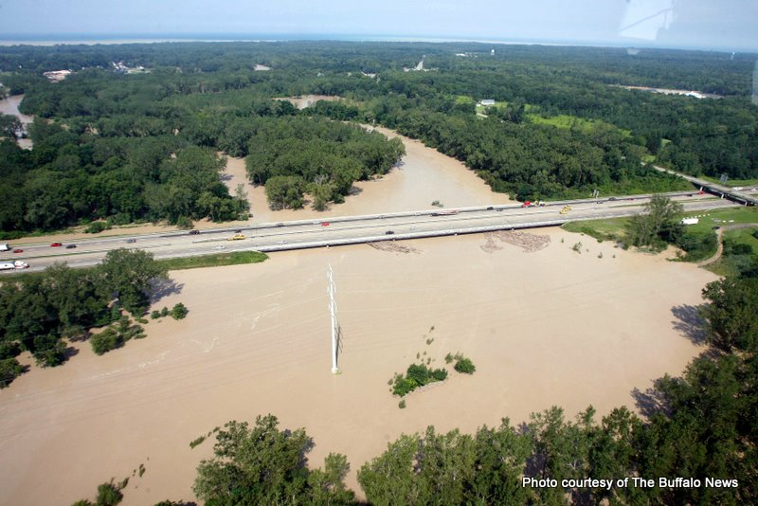
USGS RESPONSE TO FLOODS
FLASH FLOODS of AUGUST 10, 2009
Gowanda and Silver Creek, NY
New York State Thruway
Cattaraugus Creek
Notes:
Cattaraugus Creek at NYS thruway

Slide 2
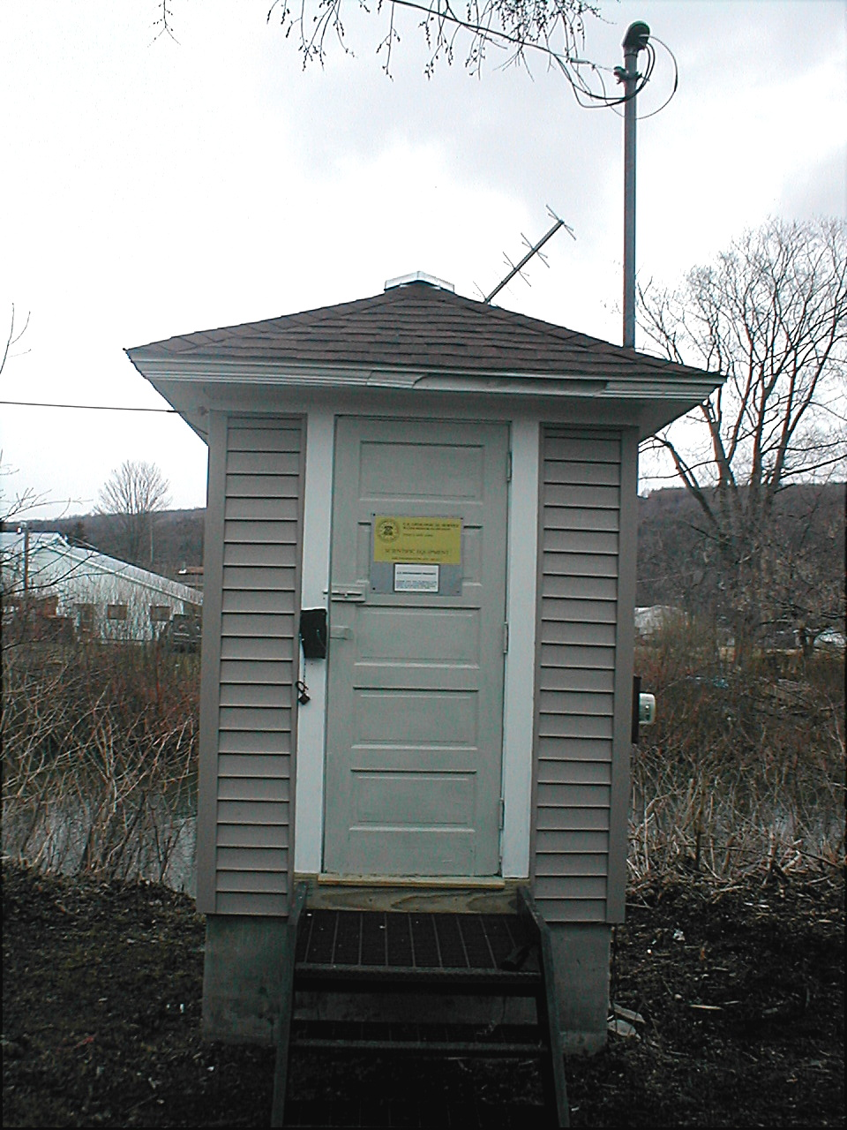
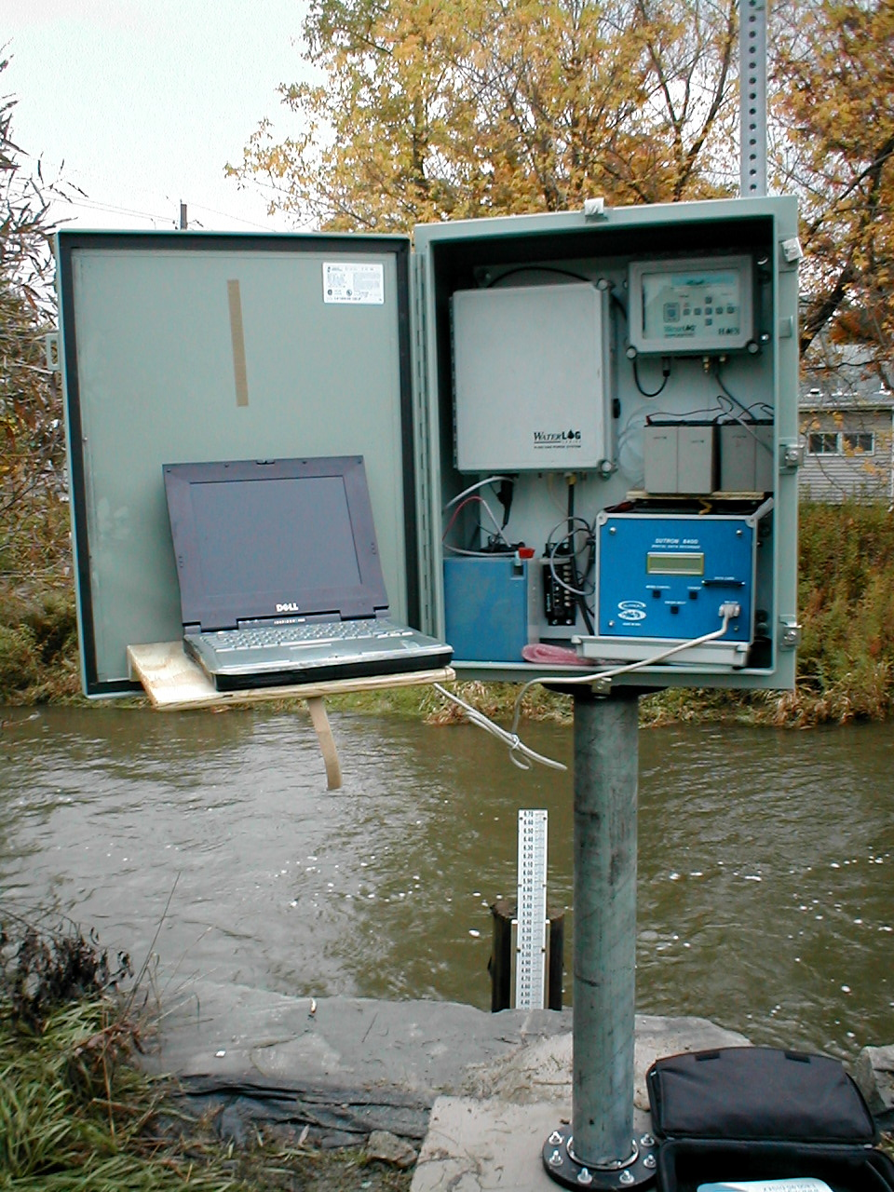
Ensure uninterrupted stage-data collection at USGS gaging stations

Slide 3
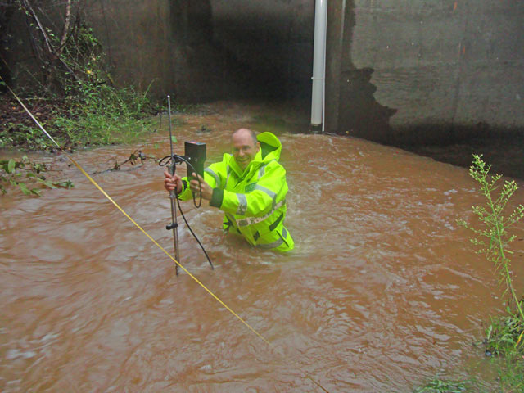
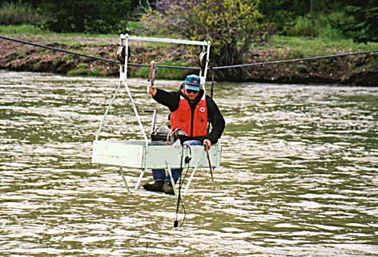
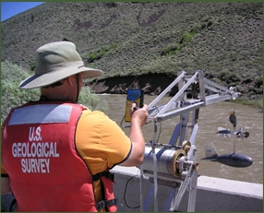
Measure streamflow

Slide 4
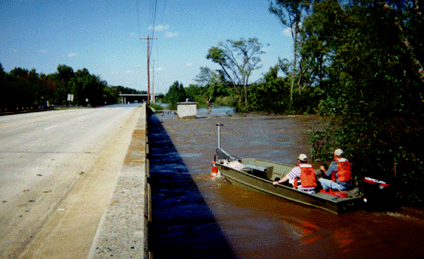
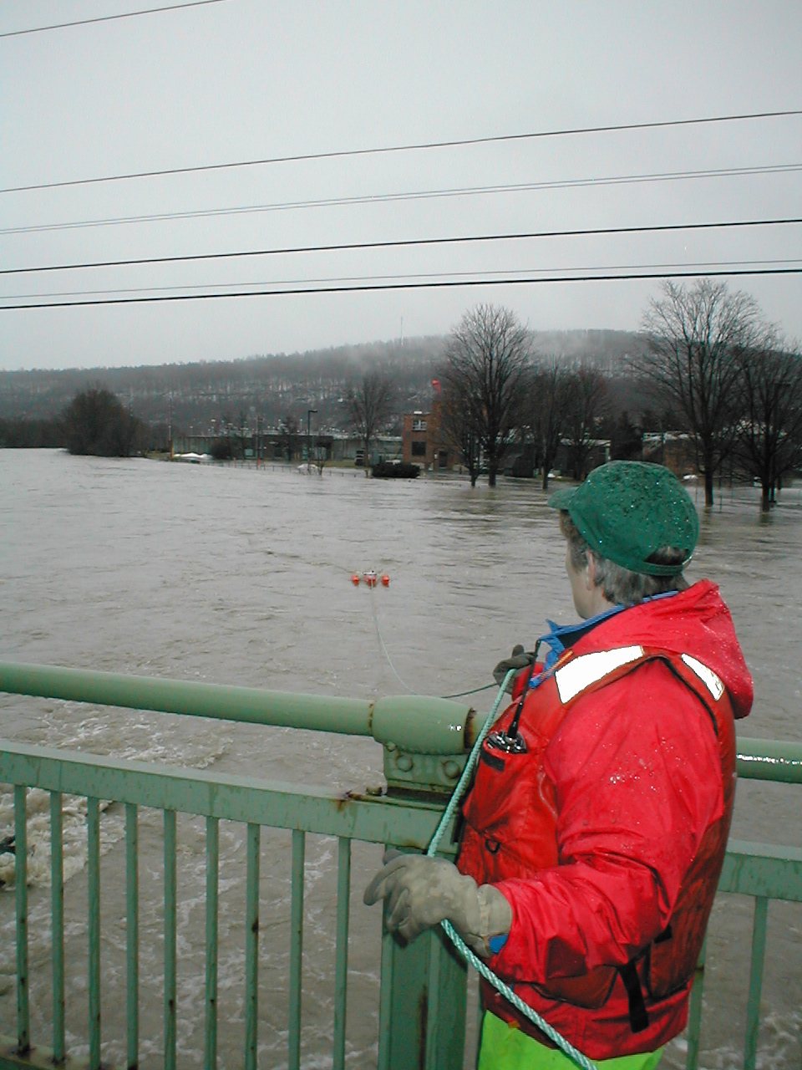
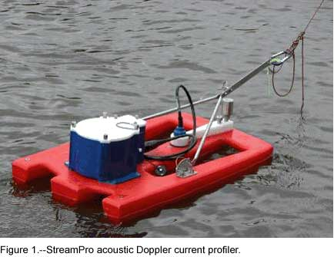

Slide 5
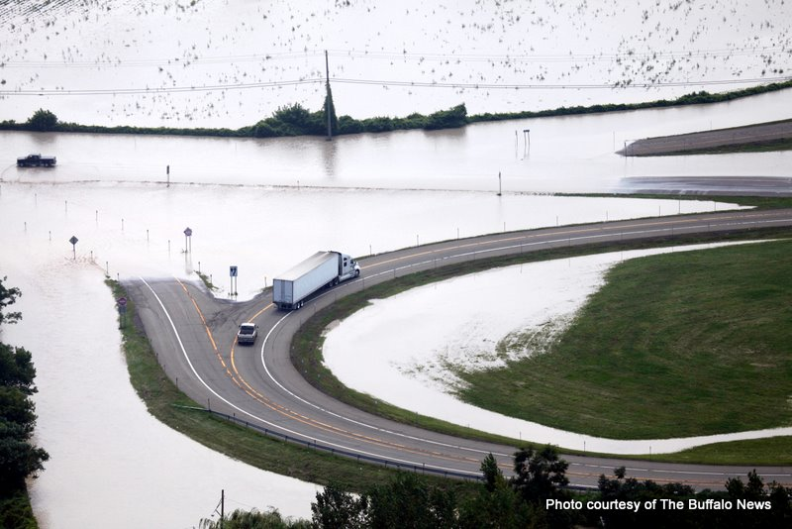
FLASH FLOODS of AUGUST 10, 2009
Gowanda and Silver Creek, NY
NY Routes 5 & 20
Notes:
Intersection of Thruway access road and Routes 5 & 20 at Irving, NY

Slide 6
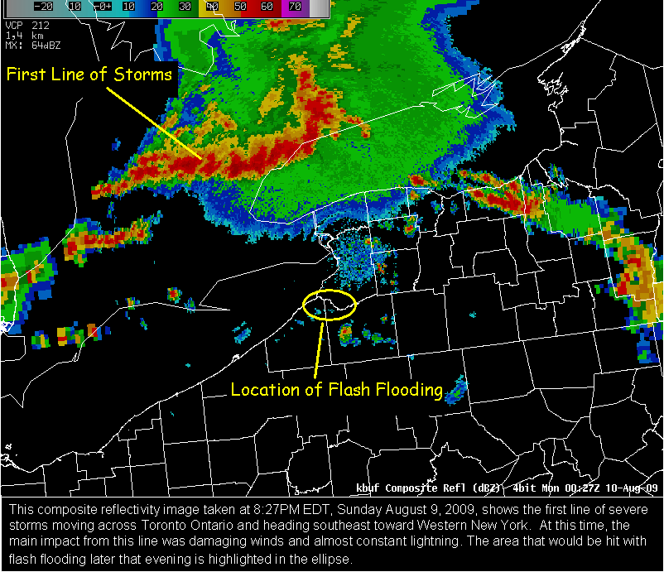
Composite reflectivity image taken at 8:27 PM EDT, August 9 (National Weather Service)

Slide 7
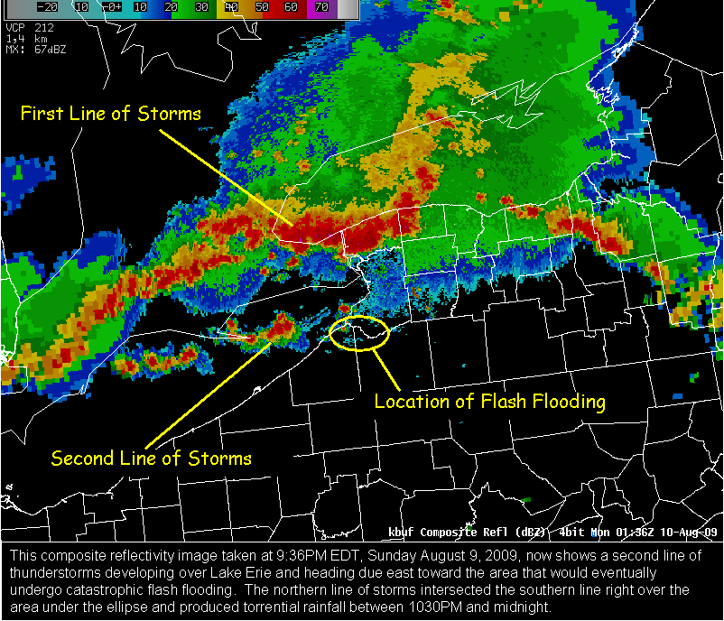
Composite reflectivity image taken at 9:36 PM EDT, August 9 (National Weather Service)

Slide 8
Storm-total radar derived precipitation (NWS)
Max. Recorded Precipitation
5.98 inches in 1.5 hr
Notes:
The two storm systems intersected approximately along the Chautauqua-Cattaraugus-Erie Counties borders.
Producing torrential rainfall – up to almost 6 inches in 1.5 hours – between 1030 PM and midnight.

Slide 9
Storm Recurrence Interval
Maximum Daily Total Precipitation
7.27 inches 200 to 500 yr RI
Maximum Storm Total
5.98 inches in 90 min > 500 yr RI

Slide 10
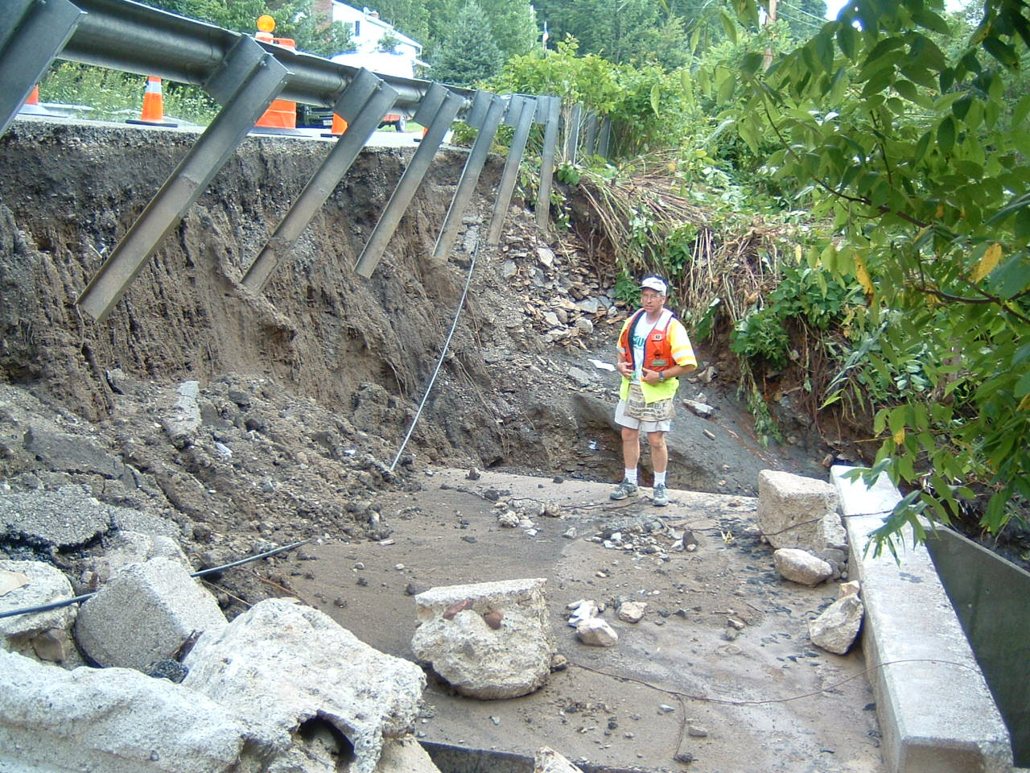

Slide 11
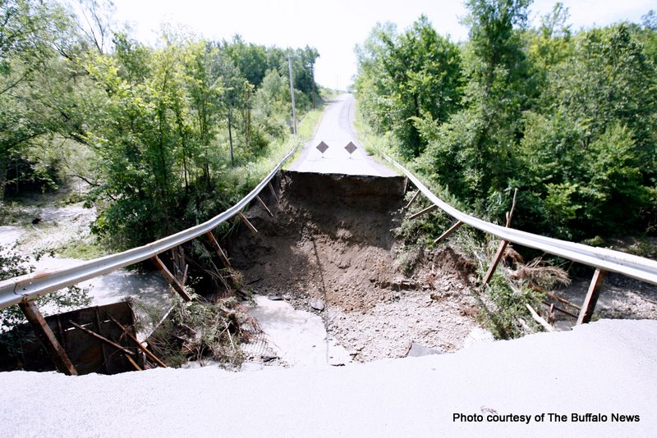

Slide 12
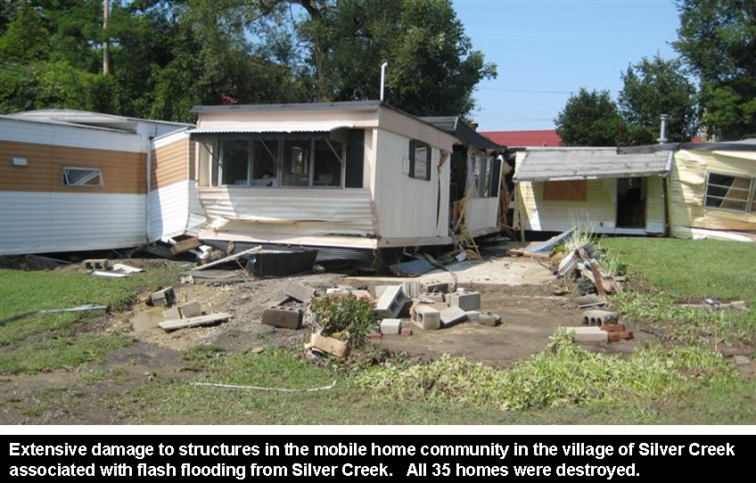
Silver Creek Trailer Park (photo by NWS)

Slide 13
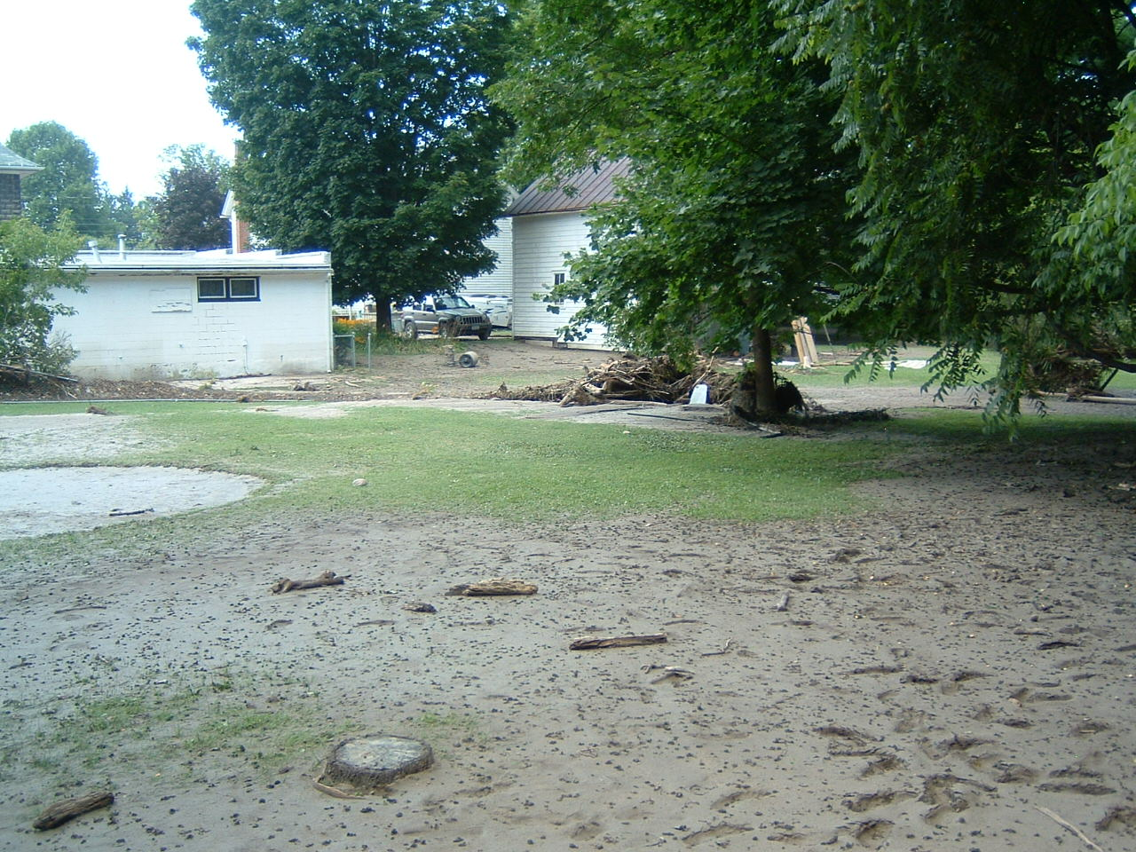

Slide 14
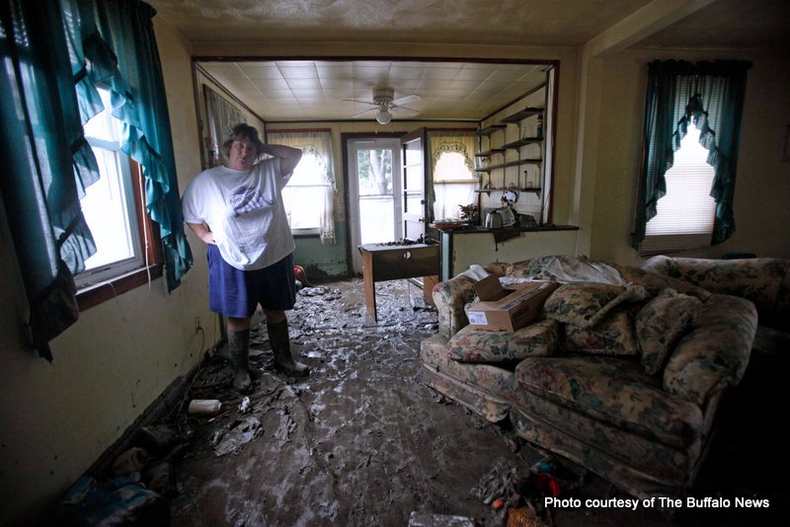

Slide 15
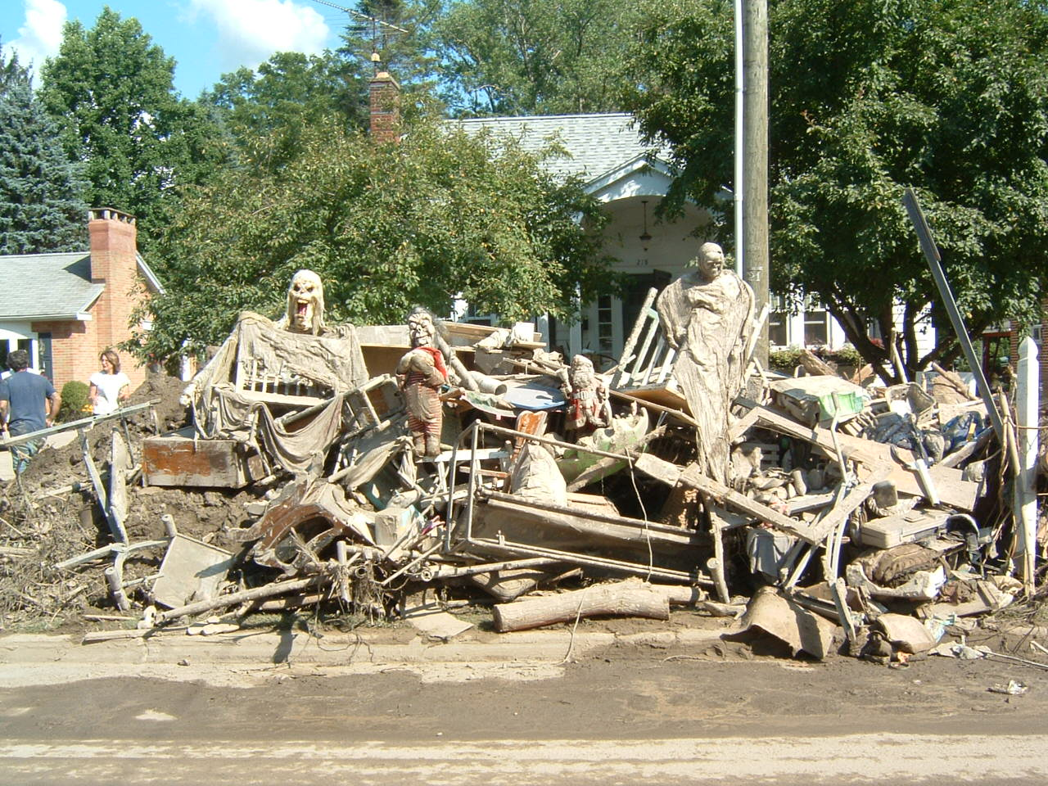

Slide 16
The tri-county area declared a Federal disaster area
More than $45 million in Federal disaster assistance
to more than 1,500 individuals and
an estimated 1,100 public projects
Combined total estimate of damages
was greater than $90 million

Slide 17
Notes:
USGS continuous-record gages and
Peak-flow monitoring sites

Slide 18
Gage Height and Streamflow
Cattaraugus Creek at Gowanda
Notes:
USGS basic data output

Slide 19
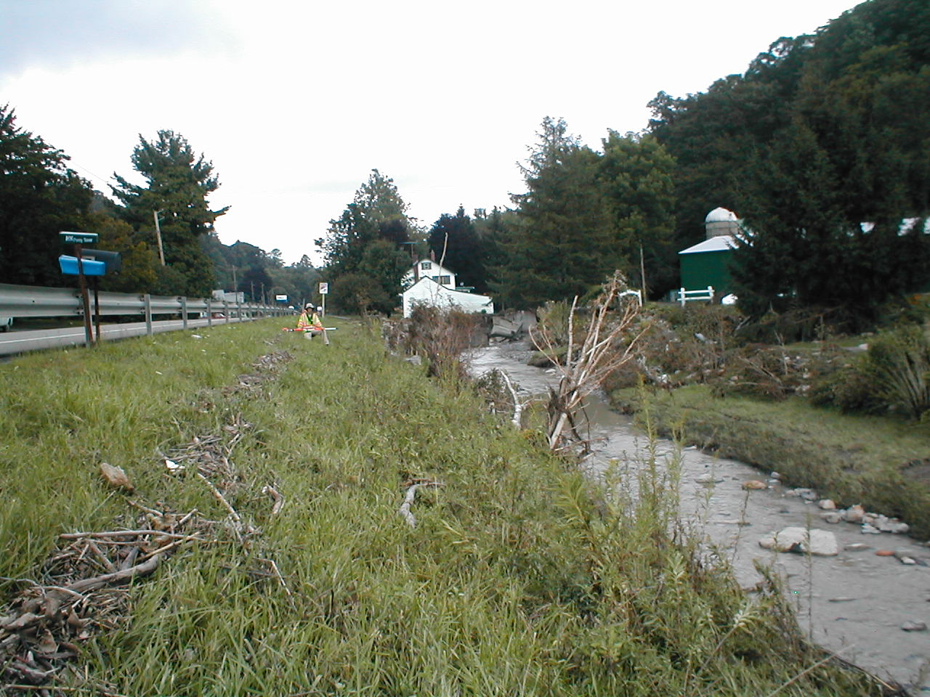
Notes:
Slope-area
Flow-through- culvert
Contracted opening
Critical depth method
Flow-over-road

Slide 20
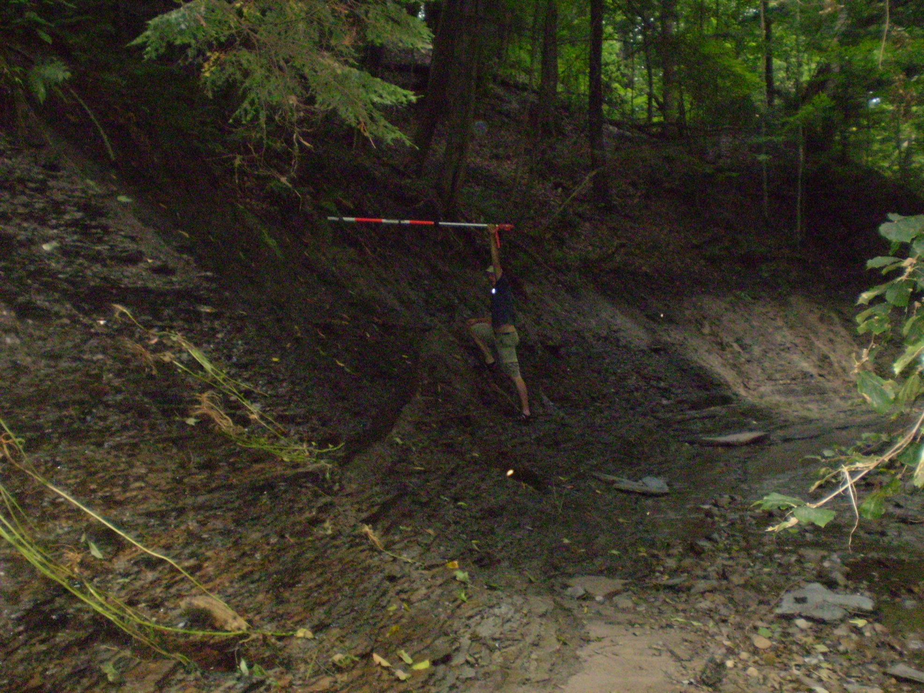

Slide 21
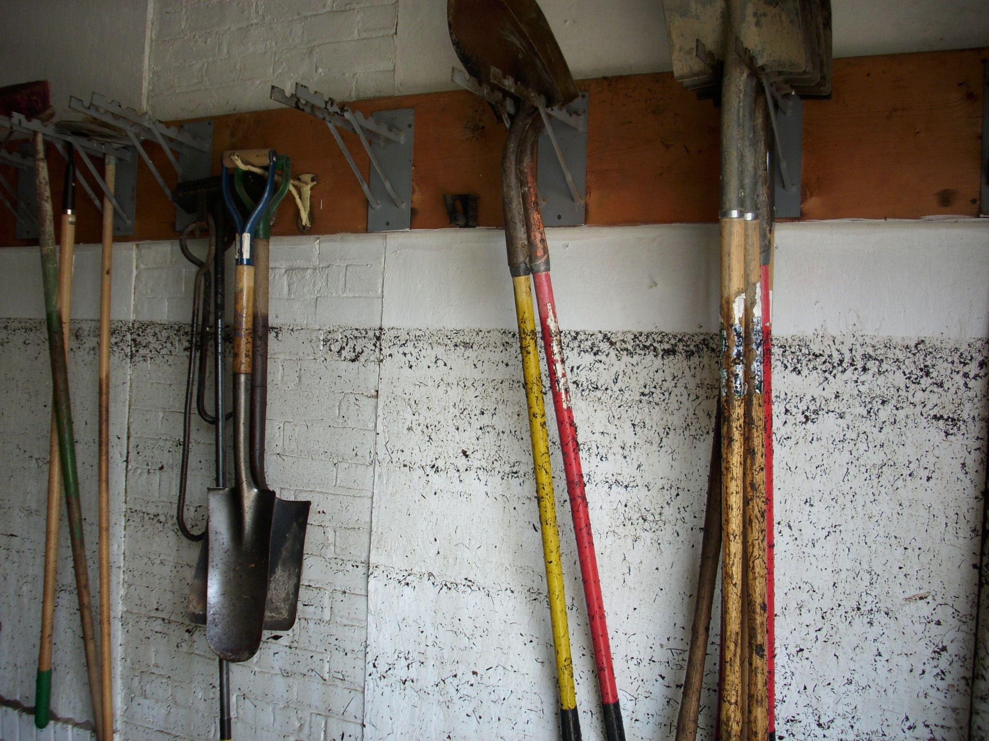

Slide 22
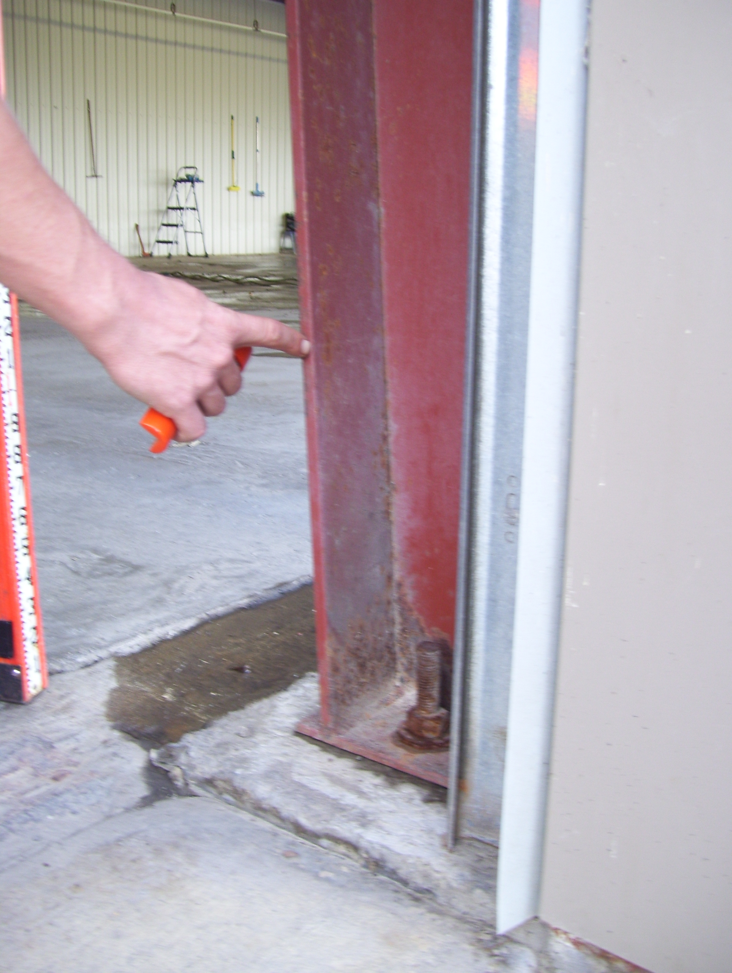

Slide 23
Gowanda
Notes:
243 highwater marks were surveyed

Slide 24
Silver
Creek

Slide 25
Notes:
2009 elevations along Thatcher and Grannis were, at some locations, 2 to 4 ft higher than FEMA elevations

Slide 27
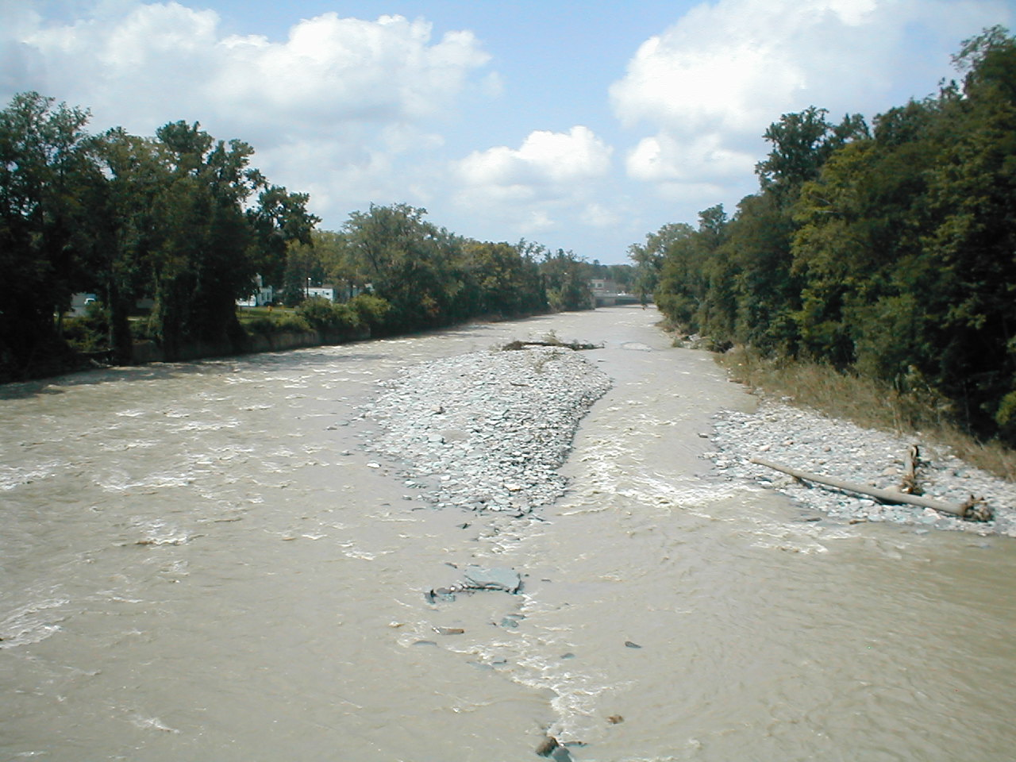
Cattaraugus Creek at Gowanda
Slope-Area Computation: 33,200 cubic feet per second

Slide 28
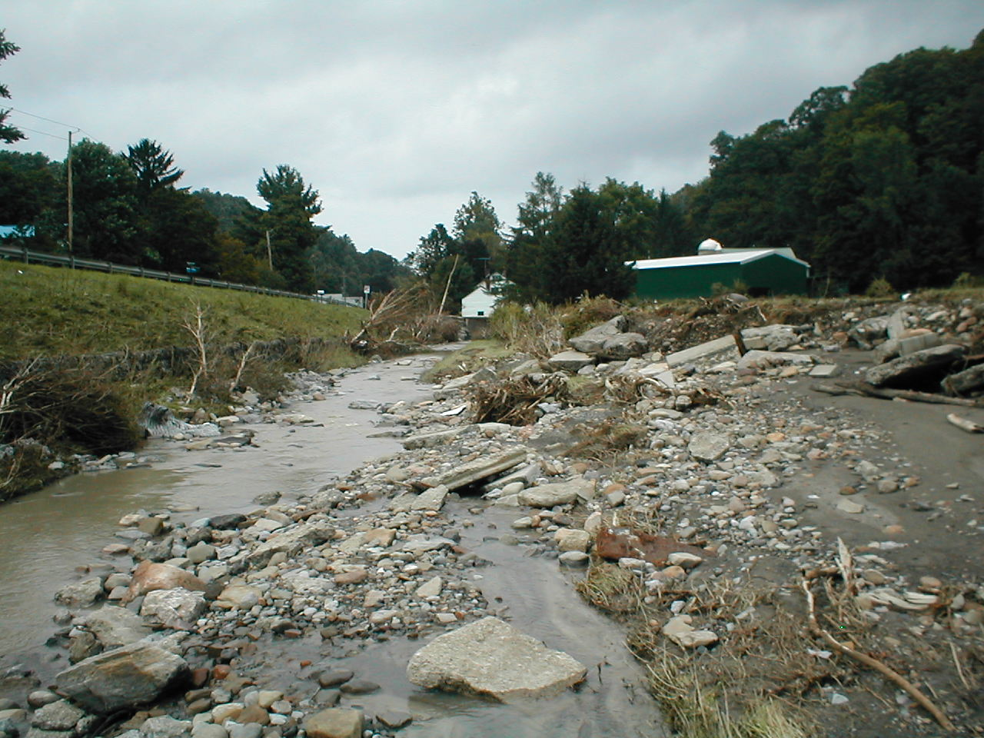
Thatcher Brook at Gowanda
Slope-Area Computation: 7,600 cubic feet per second
Notes:
1986 flood was about 4-5 ft lower; computed Q was 3,100 cfs

Slide 29
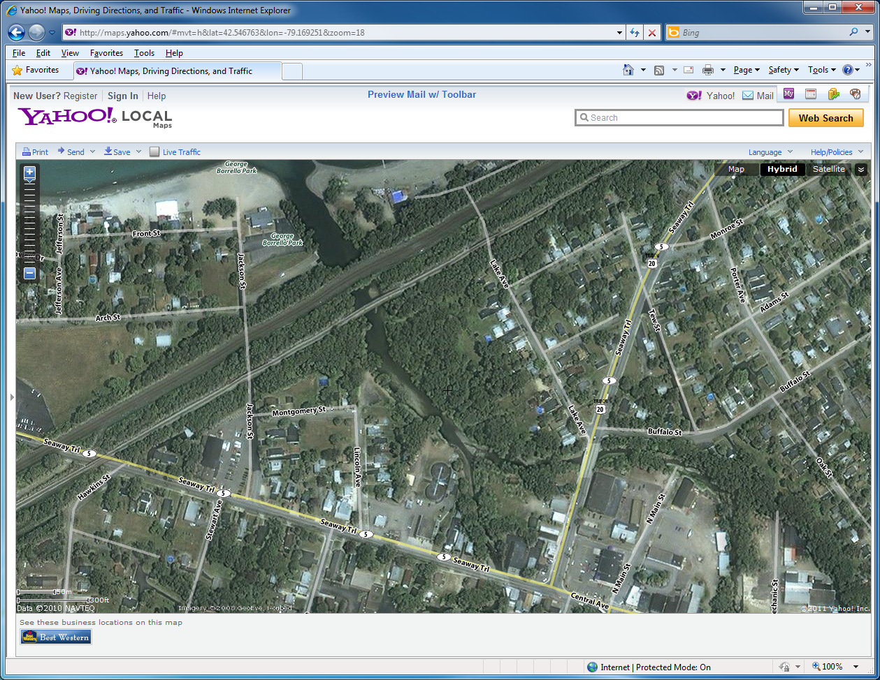
Jackson St. underpass
Silver Creek
Walnut Creek

Slide 30
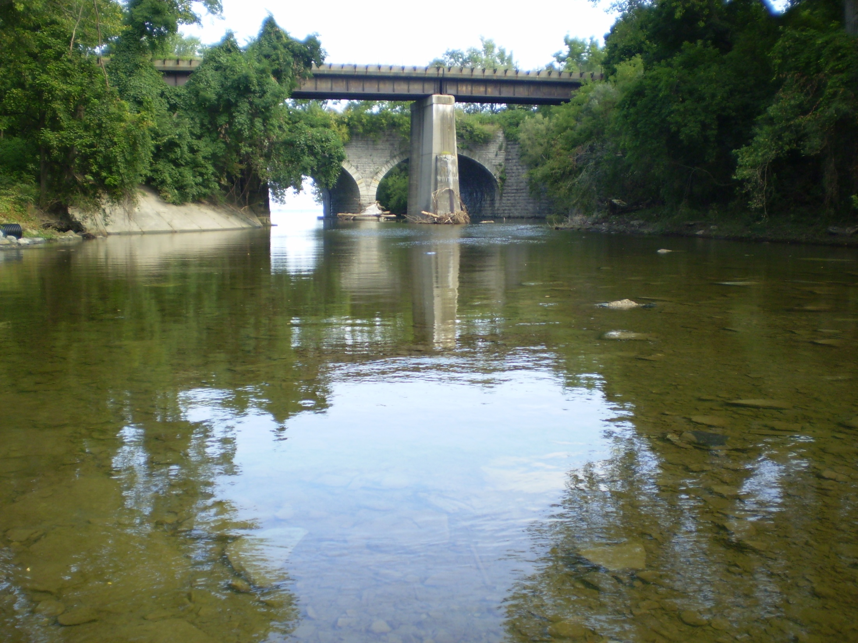
Silver Creek (below confluence with Walnut Creek)
Contracted-Opening Computation:
19,000 cubic feet per second

Slide 31
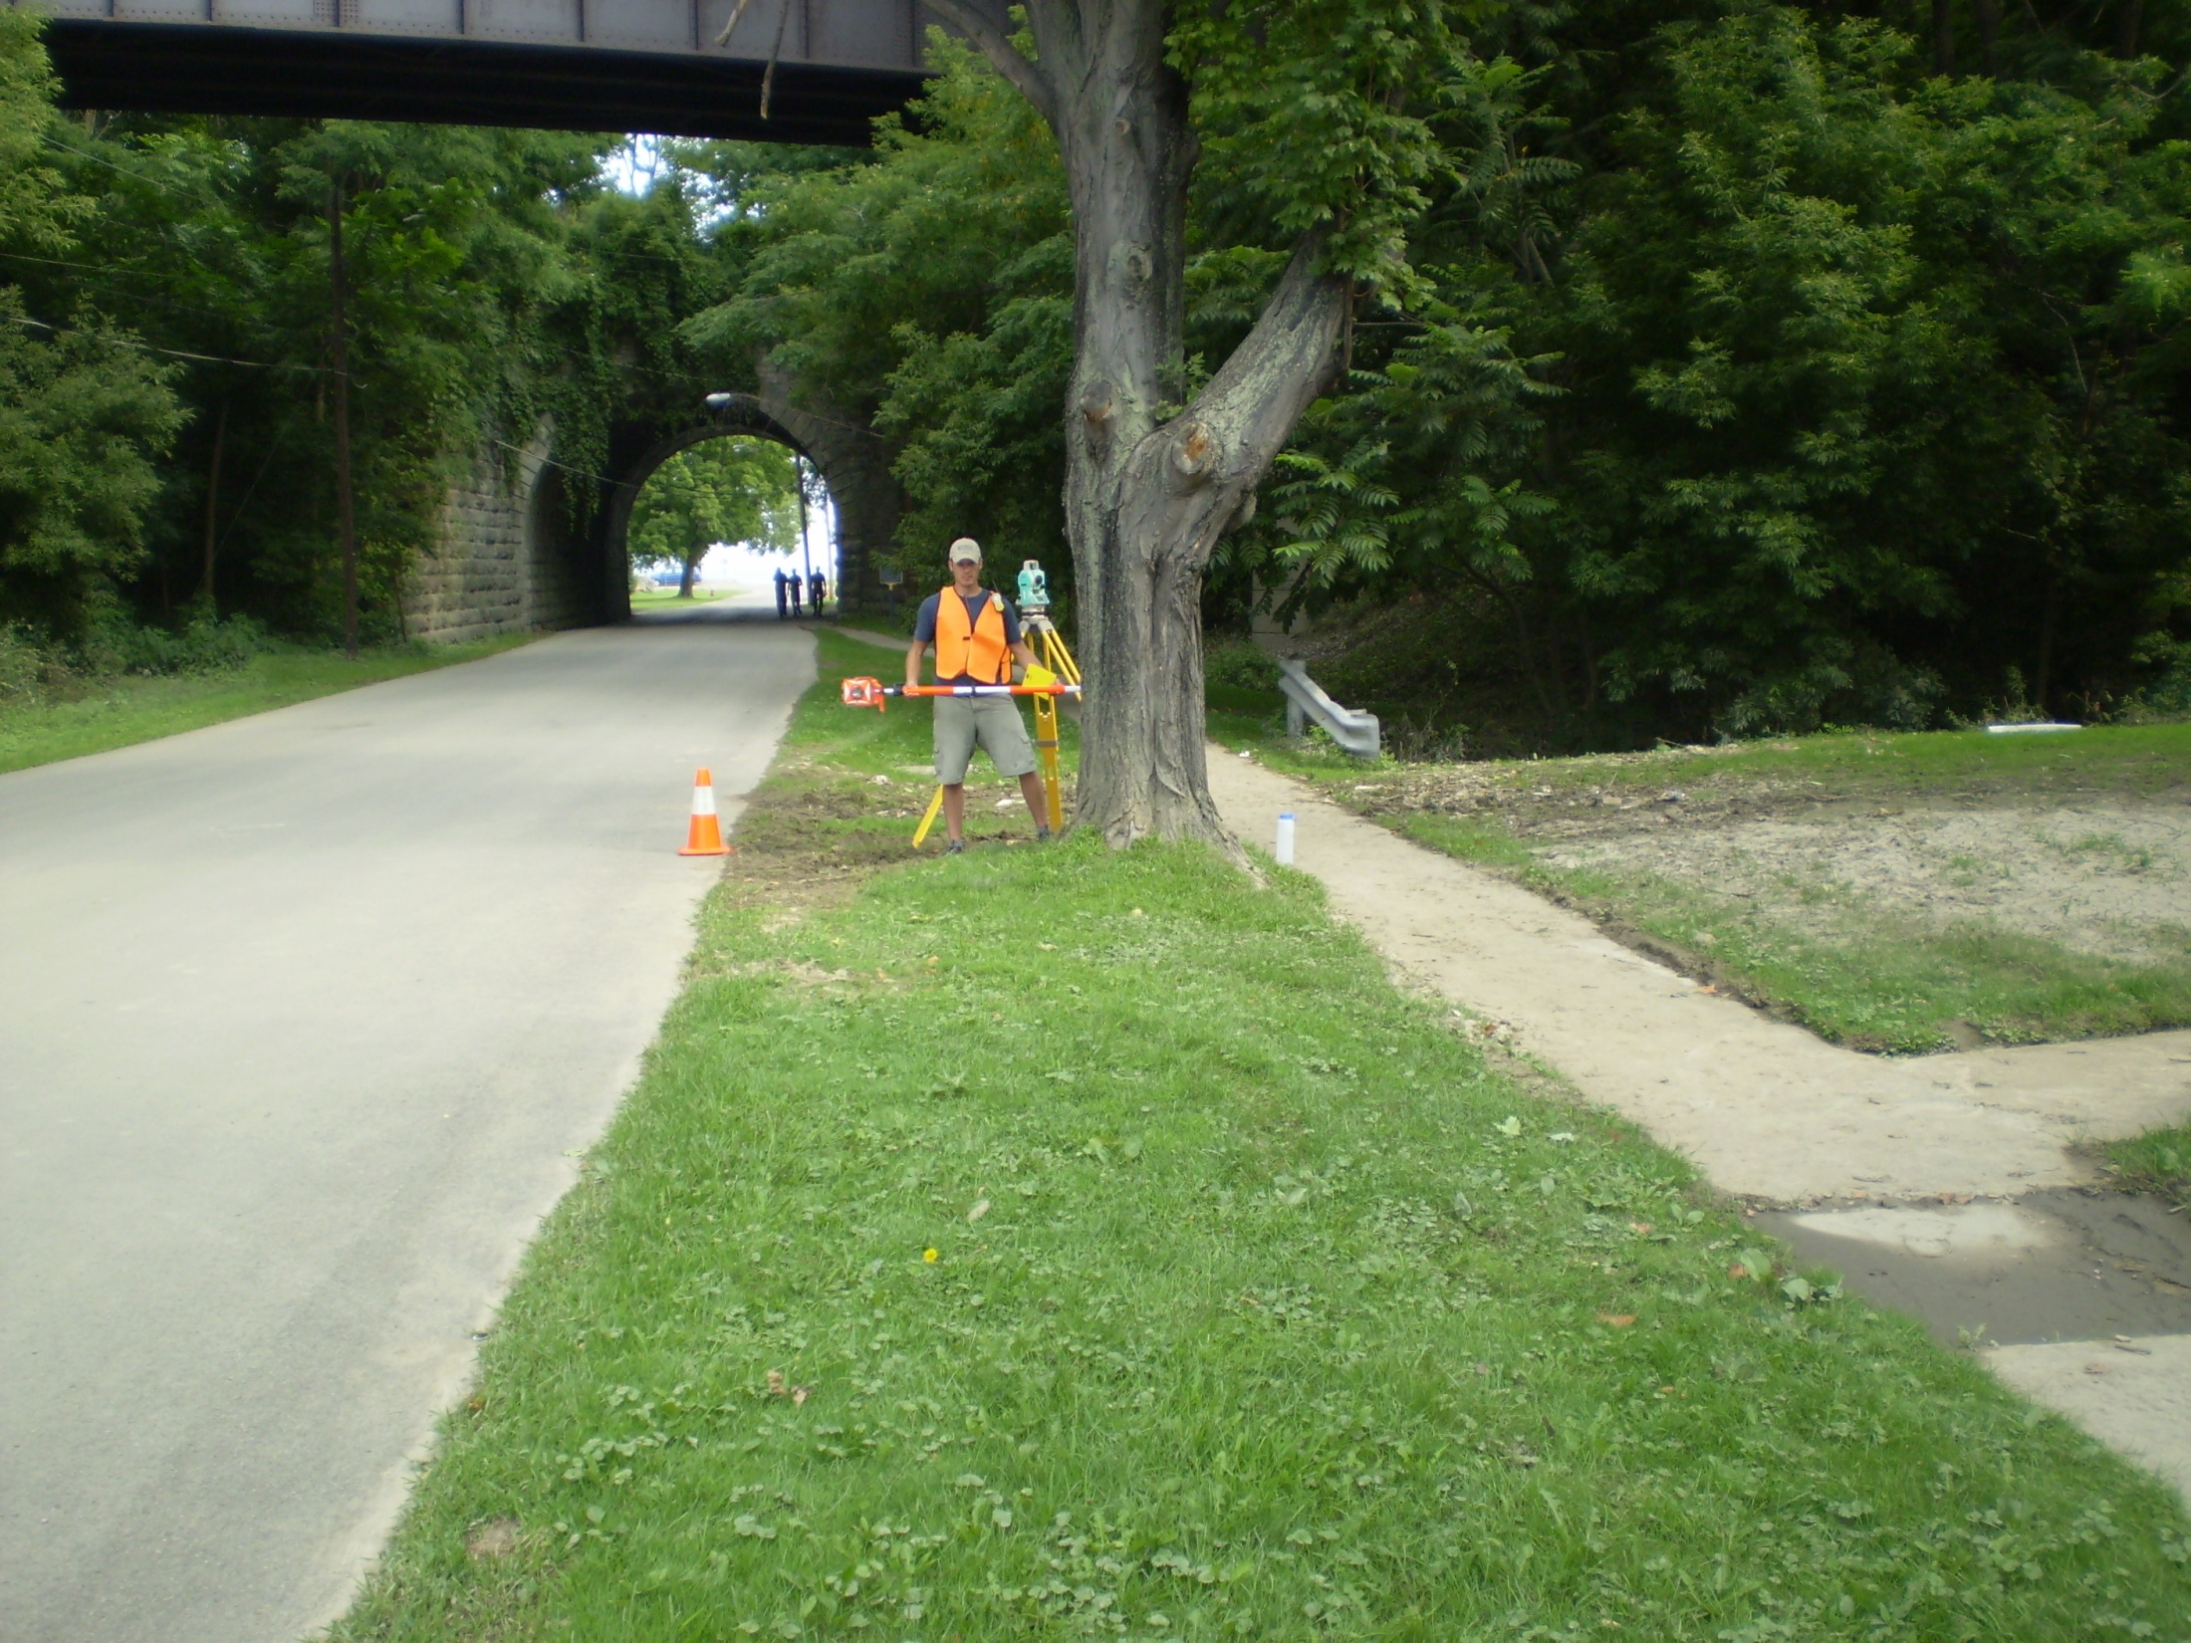
Silver Creek – Flow thru railroad underpass
520 cubic feet per second

Slide 32
STREAM | RECURRENCE INTERVAL
Ischua Creek tributary | 4
Allegheny River | 1.25
Ball Creek | < 1
Chadakoin River | 2
Canadaway Creek | 1.5
Silver Creek | > 500
South Branch Cattaraugus Creek | > 500
Cattaraugus Creek at Gowanda | 45
Grannis Brook | > 500
Thatcher Brook | > 500
Buffalo Creek | 1.5
Cayuga Creek | 2
Cazenovia Creek | 40
Tonawanda Creek at Attica | 2.5
Oatka Creek at Warsaw | 2

Slide 33
Flash Floods of August 10, 2009, in Gowanda and Silver Creek, New York
By Carolyn O. Szabo, USGS, Ithaca
William F. Coon, USGS, Ithaca, (wcoon@usgs.gov) and
Thomas A. Niziol, NWS, Buffalo
Scientific Investigations Report 2010-5259
Available online at USGS Publications Warehouse
Prepared in cooperation with the Federal Emergency Management Agency

Slide 34
USGS RESPONSE TO FLOODS
FLASH FLOODS of AUGUST 10, 2009
Gowanda and Silver Creek, NY
New York State Thruway
Cattaraugus Creek
Notes:
Cattaraugus Creek at NYS thruway

