Slide 1
WFO Binghamton Maddox Synoptic Type Flash Flood Classification Study
By Christopher Gitro
NWS Binghamton, NY

Slide 2
Motivation
Flash flooding remains the number 1 weather killer across the US
29 flash flood related fatalities in BGM’s CWA since Jan 1996
Most Recent: 01 Oct 10
Knowledge of favorable synoptic patterns responsible for significant flash flooding → higher situational awareness →Pattern Recognition
First local attempt to classify large scale flash flood episodes based on large scale synoptic patterns

Slide 3
Methodology
Main Goal: Classify historically significant past flash flood episodes by the Maddox Synoptic classification scheme
Flash flood events from the winter of 1996 through present were examined
42 total Events
An event was classified if any of the following three occurred:
1) 5 or more flash flood reports from a single event
2) $500K crop/property damage
3) Fatality(ies) occurred
For synoptic environments in which the synoptic pattern did not reflect the traditional patterns as described by Maddox et al. (1979), the events were labeled as “Unclassified”
If a flash flood event resulted from a remnant tropical circulation moving across the area, the event was classified as “Tropical”

Slide 4
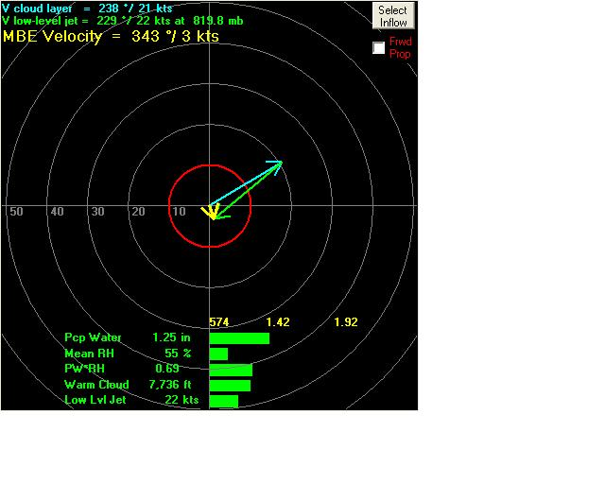
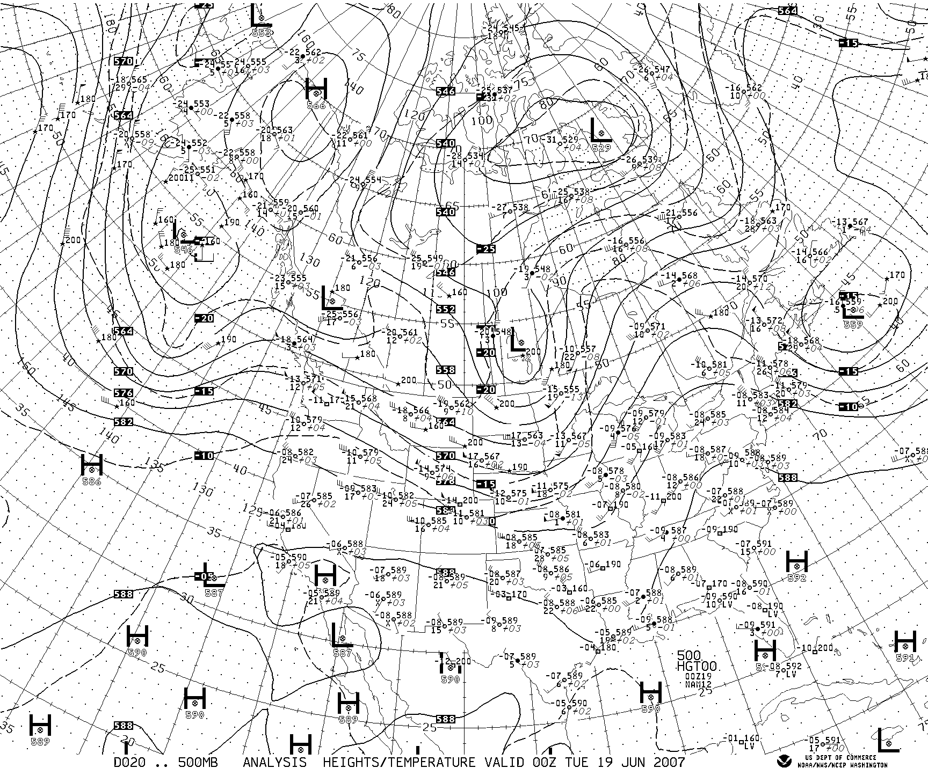
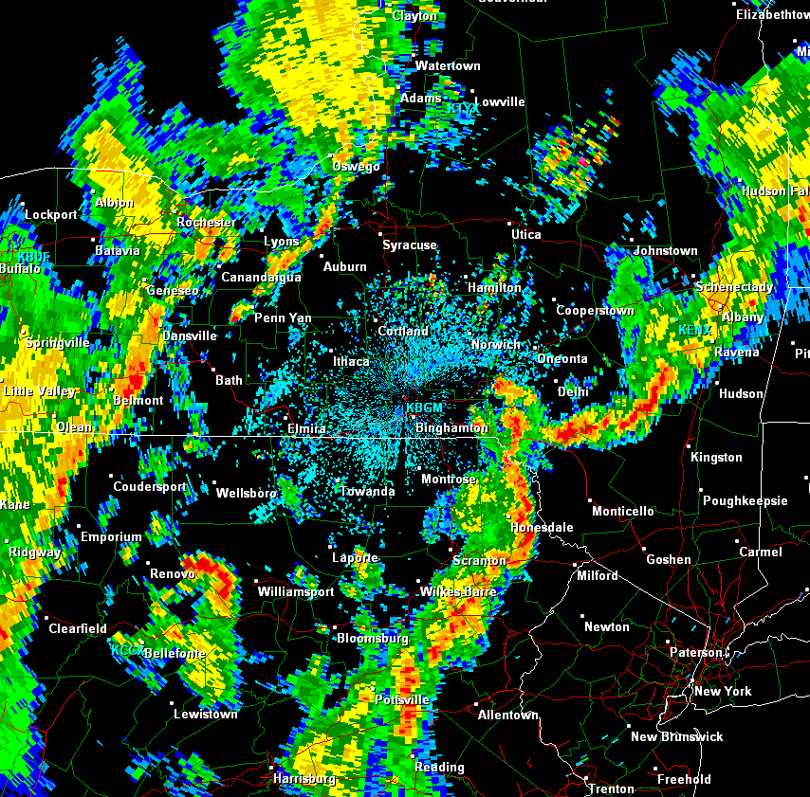
Methodology Cont.
Archived H50 (SPC, HPC) 00Z/12Z Maps
Archived HPC analyzed surface maps
Radar animations analyzed through GR Analyst
NAM BUFKIT Proximity Soundings
Sounding was selected by picking the hour from closest NAM forecast point to time of initial flash flood report
(LLJ winds (BUFKIT defined), Cloud Layer Winds, MBE Speeds, Warm Cloud Depth, etc)

Slide 5
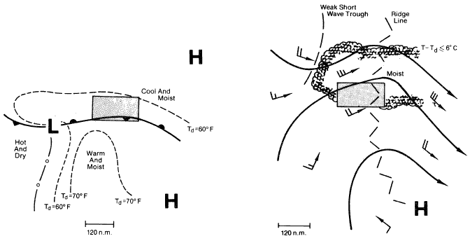
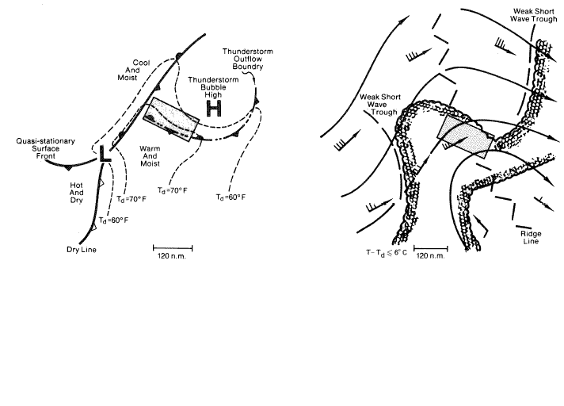
Review
Synoptic
Frontal
All images from Maddox et al. (1979)
Meso High

Slide 6
Results
42 Total Events

Slide 14
Possible New East Coast Hybrid
Flood Pattern?

Slide 15
Current Maddox Classification Types
Synoptic
Frontal
All images courtesy of COMET

Slide 16
Hybrid Surface/Upper-Level Patterns
Large scale flash flood situations
Deep upper troughing
Well developed mid-latitude cyclone (most)
Warm frontal boundary (developing across the
Mid-Atlantic or prepositioned off the East Coast)
Hybrid events display both Frontal and Synoptic type characteristics
Upper pattern resembles Maddox Synoptic (deep upper troughing)
Surface pattern more characteristic of Maddox Frontal (overrunning LLJ/strong isentropic ascent)

Slide 17
26-28 June 06
Record Flood Event

Slide 18
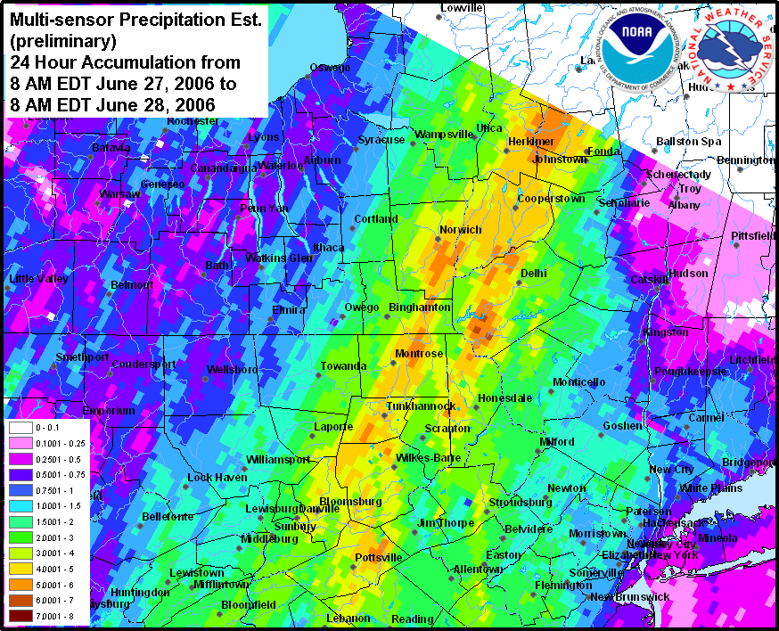
26-28 June 06 Flood Event
06z HPC Sfc Analysis
500 hPa, 00z 28 June
MPE Precip Estimates, 28 June

Slide 19
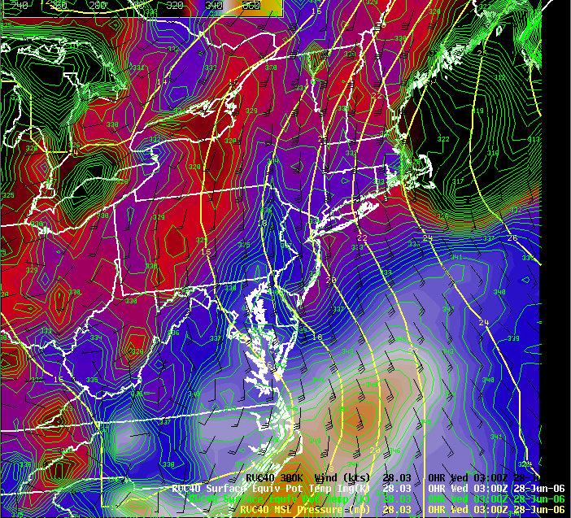
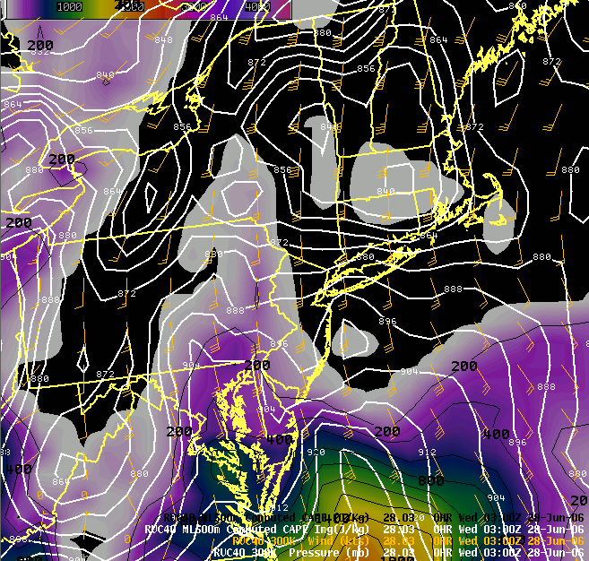
26-28 June 06 Flood Event
Surface Theta-E (contoured/image)
300K Winds (black)
MSLP (yellow)
300K Pressure (White contours)
300K Winds (orange)
Mixed Layer Cape (contoured/image)

Slide 20
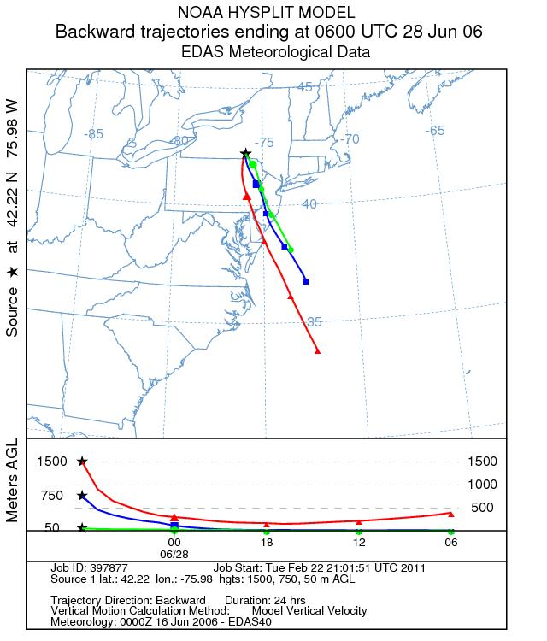
26-28 June 06 Flood Event
Strong isentropic ascent along/north of developing warm front (Frontal)
HYSPLIT parcel trajectories indicated low-level parcels overran front
Upper pattern displayed Synoptic type characteristics
Strong isentropic ascent coupled with a moist and unstable airmass
Heavy rainfall and record flooding across the Mid-Atlantic and Northeast
06Z EDAS HYSPLIT Backward
Parcel Trajectory Analysis

Slide 21
30 September 10
Flood Event

Slide 22
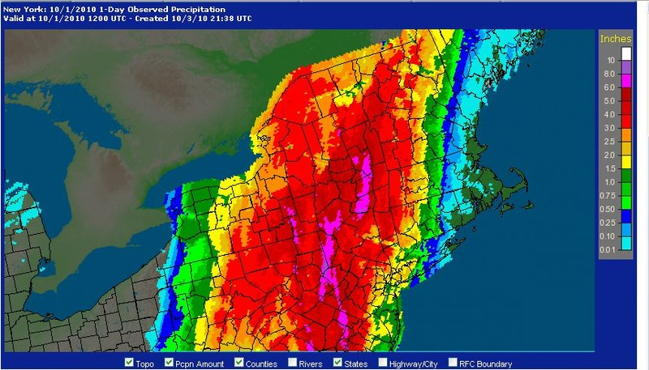
30 Sep 10 Flood Event
15z HPC Sfc Analysis
500 hPa, 12z 30 Sep
MPE Precip Estimates, 01 Oct

Slide 23
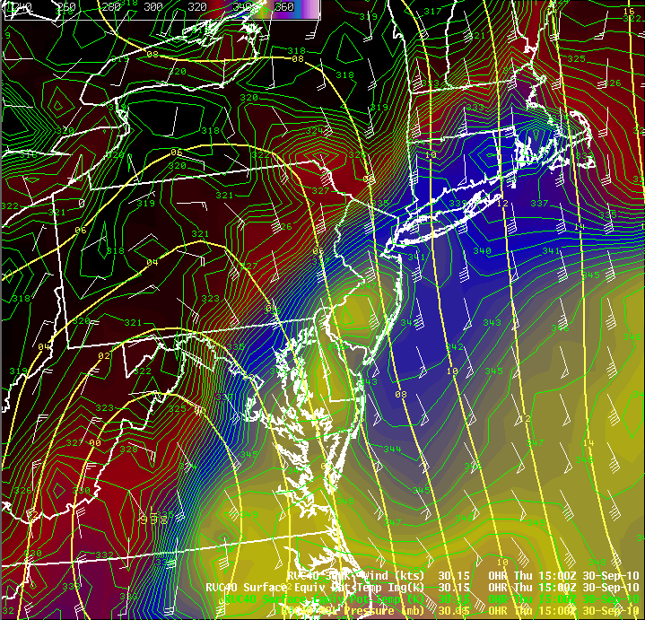
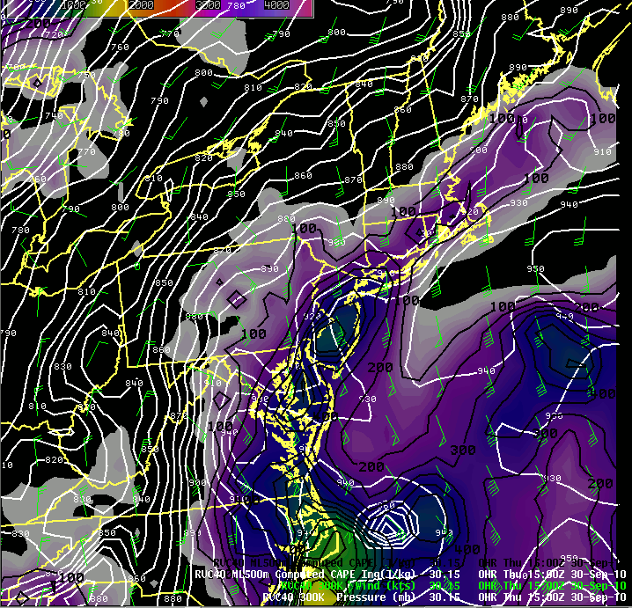
30 Sep 10 Flood Event
Surface Theta-E (contoured/image)
300K Winds (white)
MSLP (yellow)
300K Pressure (White contours)
300K Winds (green)
Mixed Layer Cape (contoured/image)

Slide 24
30 Sep 10 Flood Event
Initial shot of moderate to heavy rainfall overran westward moving frontal boundary
HYSPLIT parcel trajectories indicated low-level parcels of western Atlantic origin overran retrograding front (Maddox Frontal)
Upper pattern characterized by
broad upper trouging to the
west (Maddox Synoptic)
Characteristics of both Frontal and Synoptic setups were displayed
→ Hybrid
15Z GDAS HYSPLIT Backward
Parcel Trajectory Analysis

Slide 25
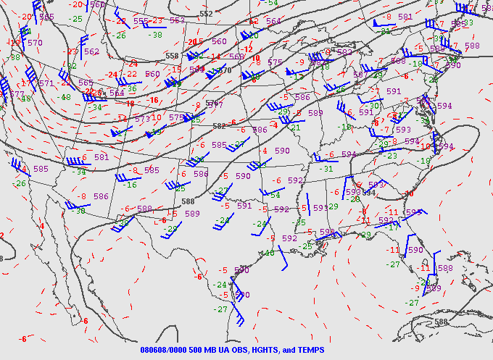
Central Plains Comparison June 2008 Upper Midwest Record Flood Setup
500 hPa, 00z 08 Jun
00z HPC Sfc Analysis
0045 UTC IR Satellite Imagery
Image courtesy of Grumm et
al. (2008)

Slide 26
June 08, 2008 Upper Midwest
From: Grumm et al. (2008)
June 28, 2006 East Coast
From: Grumm and Holmes (2007)
1000 MB Anomaly Comparison
Sept 30, 2010
East Coast
From: Grumm and Kozar (2010)

Slide 27
June 08, 2008 Upper Midwest
June 28, 2006 East Coast
From Grumm et al. (2008)
500 MB Anomaly
Comparison
Sept 30, 2010
East Coast
From: Grumm and Kozar (2010)

Slide 28
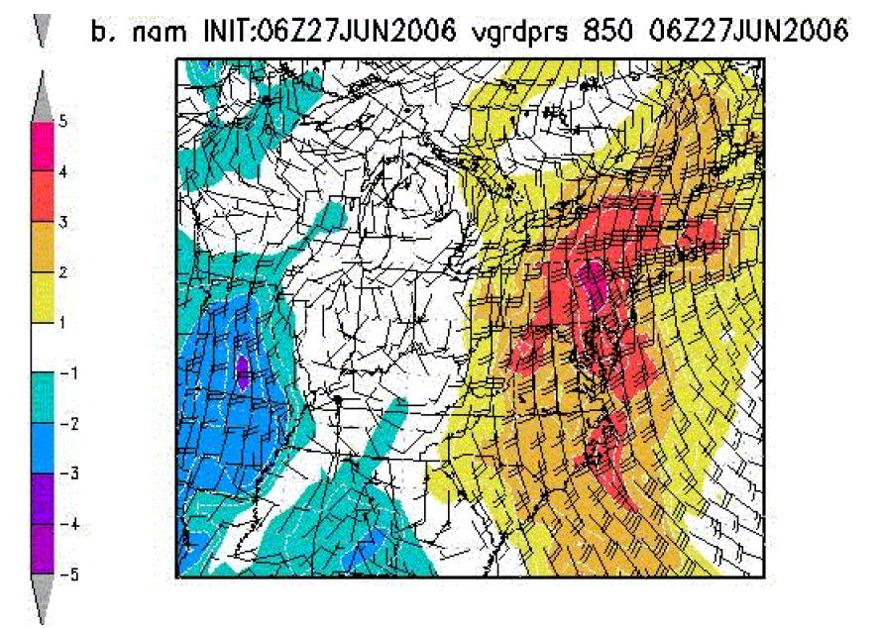
June 08, 2008 Upper Midwest
From: Grumm et al. (2008)
June 28, 2006 East Coast
From: Grumm and Holmes (2007)
850 MB Winds and V-wind Anomaly
Comparison
Sept 30, 2010
East Coast
From: Grumm and Kozar (2010)

Slide 29
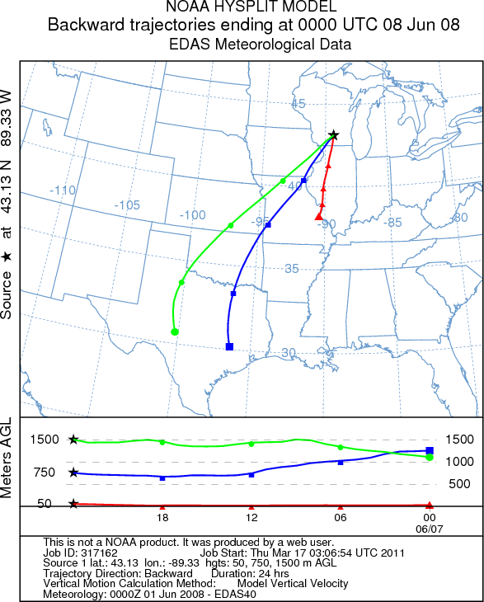
June 08, 2008 Upper Midwest
June 28, 2006 East Coast
Sept 30, 2010 East Coast
East Coast events displayed strong SSE low-level winds → Western Atlantic major source region for low-level moisture
Low-level parcels overrunning developing frontal boundaries along the coast or Mid-Atlantic
Similar forcing to Frontal type FF events common across the central US

Slide 30
Conclusions
The BGM HSA is susceptible to all 3 eastern US Maddox Flash Flood types
Synoptic type flash flood producing environments most common (20 cases)
Frontal/Meso High less common but potentially devastating considering BGM’s highly variable terrain (terrain anchoring)
Both Meso High cases had fatalities
Not all synoptic patterns cleanly fit into the Maddox classification scheme (10 unclassified, 3 tropical) →Hybrid Synoptic/Frontal

Slide 31
Conclusions cont.
Hybrid Synoptic/Frontal FF setups; a common theme along East Coast?
Upper-level patterns display Maddox Synoptic type characteristics →Meridional flow / Longwave trough approaching from west
Sfc patterns often display Maddox Frontal type characteristics → strong isentropic ascent along/north of developing warm front or stalled front along East Coast
Anomaly data suggests East Coast setups are similar to Great Plains Frontal events
East Coast events 1000/500 MB anomaly patterns (axes) highly meridional
Main moisture source: western Atlantic
Plains / upper Midwest frontal events rotated 45° to the right → Positive Tilt
Main moisture source: Gulf of Mexico
N/S anomaly setup for East Coast events allows front responsible for central Plains FF events to rotate to a more N/S orientation near the coast
- Similar low-level forcing mechanism

Slide 32
References
Grumm, R.H., and R. Holmes, 2007a: Patterns of heavy rainfall in the mid-Atlantic. Pre-prints, Conference on Weather Analysis and Forecasting, Park City, UT, Amer. Meteor. Soc., 5A.2.
Grumm, R.H., N.W. Junker, and M. Bodner 2008: Heavy rain and flood event of 8-9 June 2008. [Available online at http://nws.met.psu.edu/severe/2008/08JUN2008.pdf]
Grumm, R.H., and M. Kozar, 2010: The historic synoptic-hybrid rainfall event 30 September 2010. [Available online at http://cms.met.psu.edu/sref/severe/2010/30Sep2010Flood.pdf]
Maddox, R. A., C. F. Chappell and L. R. Hoxit, 1979: Synoptic and meso-α scale aspects of flash flood events. Bull. Amer. Meteor. Soc., 60, 115-123.

