Slide 1
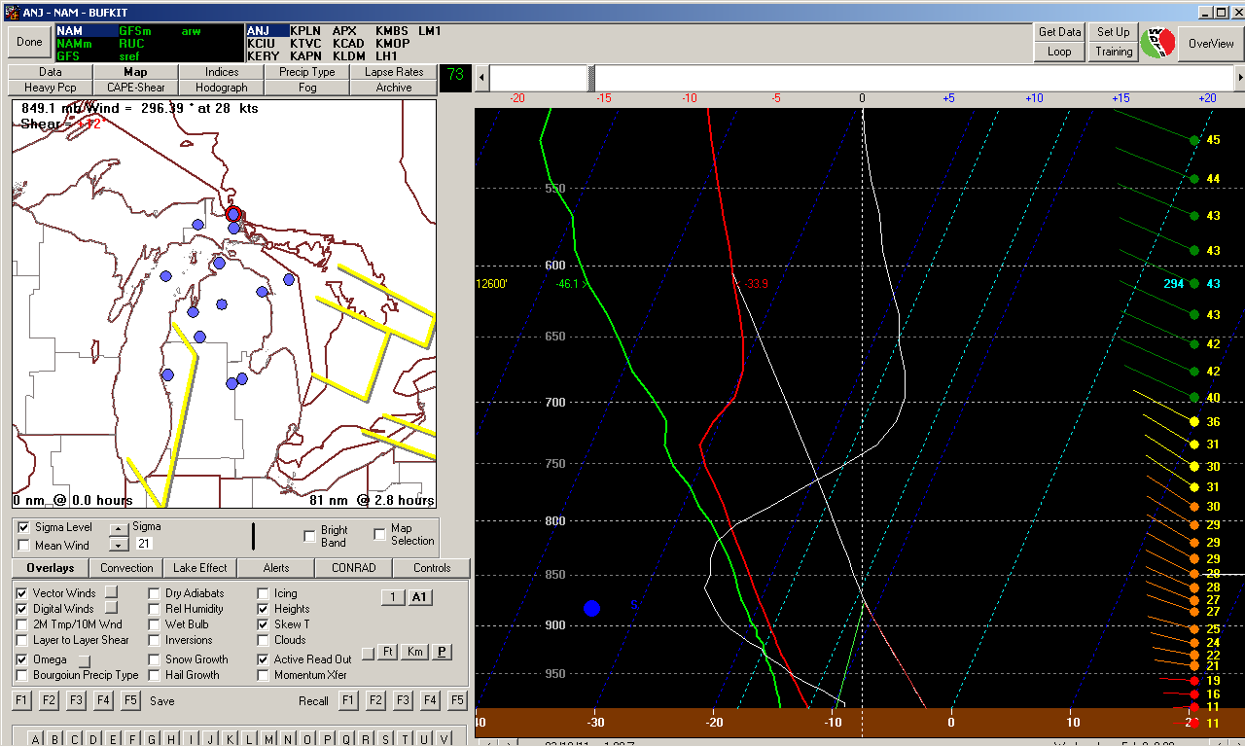
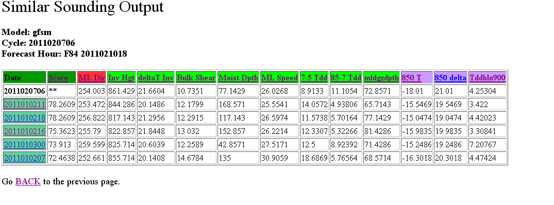
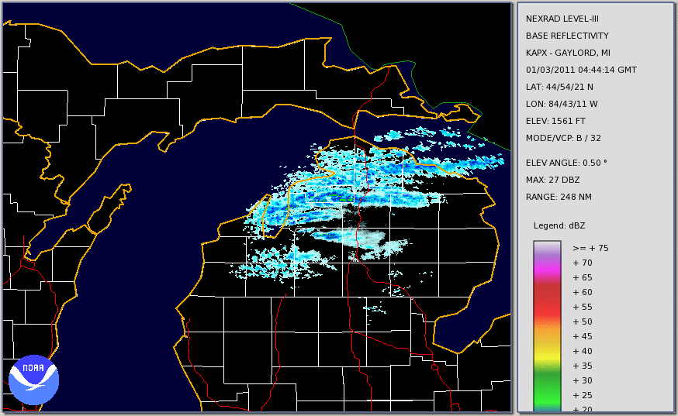
Lake Effect Snow Forecast Tools at NWS Gaylord, MI Part 1: The Similar Sounding Approach
Justin Arnott
Science and Operations Officer
NWS Gaylord, MI

Slide 2
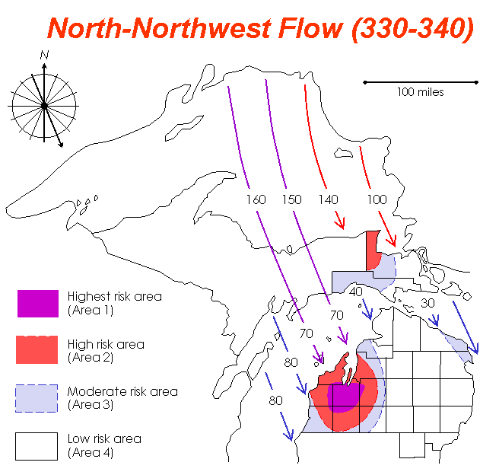
Introduction
“Legacy Approach”
Threat Maps
Flowcharts
12 km NAM
Pattern Recognition
BUFKIT
Demand for improved spatial/temporal evolution in the NDFD
Can we improve upon these tools?
LE Similar Sounding approach (this talk)
High Resolution Local WRF (Part II)

Slide 3
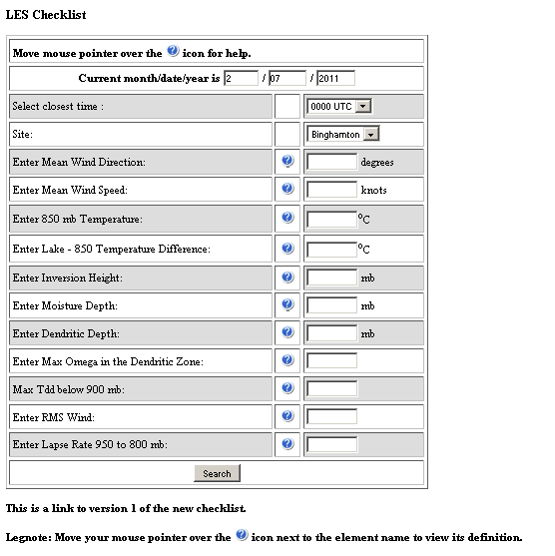
The BGM Approach (Evans and Murphy 2008)
Archive BUFKIT sounding graphics
for lake effect events
One “representative sounding” per event.
Derive LES-important parameters from these soundings
Create database
Compare current forecasts to database to find the most “similar soundings”
Retrieve radar imagery/summary of similar events

Slide 4
The APX Approach
Archive RUC BUFR soundings every hour for the winter season
Derive sounding-based parameters
Similar to those at BGM with some exceptions
ML Wind Direction/Speed
Inversion Height/Delta T
850 T/Delta T
Moist Depth
Mean Tdd (Below 900, 850-700, 700-500)
DGZ Depth
Bulk Shear

Slide 5
The APX Approach - Continued
Create CWA-mean values
Use apx,kpln,anj,lm1,ktvc,kcad,kciu BUFR sites
Create database of RUC-Based Parameters
“Match” current forecast soundings with database to find similar events
Scoring a blend of objectivity/subjectivity
Three ‘tiers’ of scoring

Slide 6
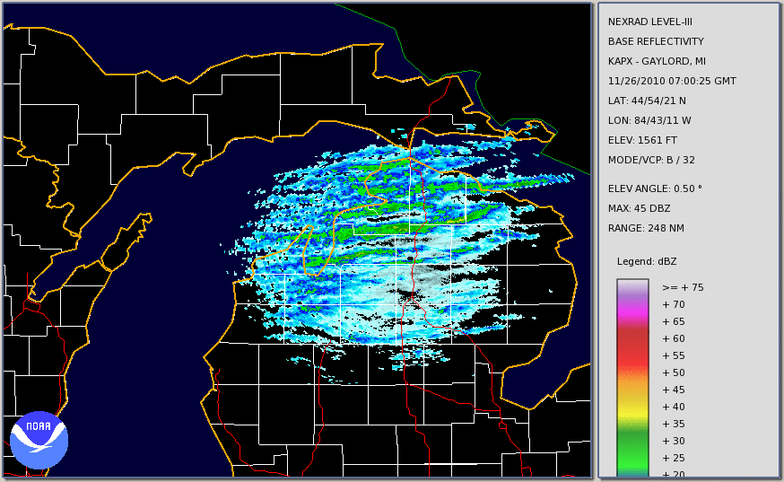
The APX Approach - Continued
Provide 1 hour loop of radar from matching events
Use NCDC Level 3 archive
More information than snapshot?

Slide 7
The APX Approach – To Date
Period of Archive
2010NOV26 - 2011FEB22
57 days with lake effect
1127 ‘sounding hours’
Removed hours with significant synoptic precipitation

Slide 8
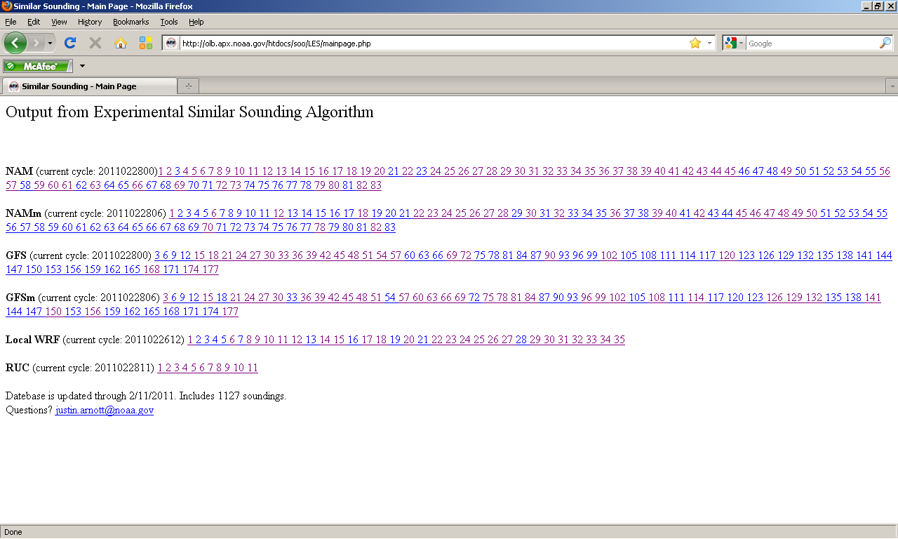

Slide 9
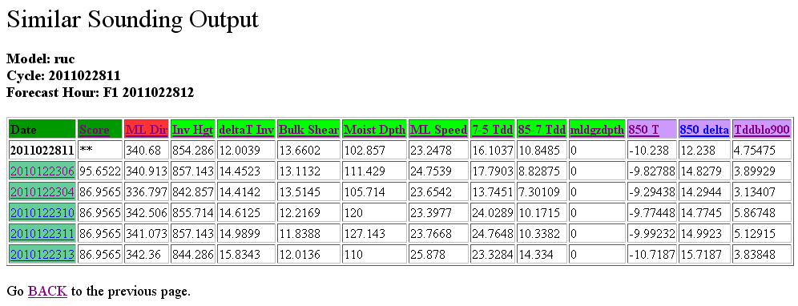
The Result
Run Information
Full Weight
Half Weight
Quarter Weight

Slide 10
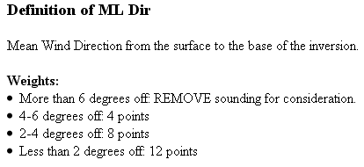

Slide 12
One Hour Base Reflectivity Loop From 12/23/2010 0600-0700

Slide 13
One Hour Base Reflectivity Loop From 12/23/2010 0400-0500

Slide 14
Caveats
RUC 00hr Sounding = Truth?
RUC is non-hydrostatic with relatively few vertical levels – but runs every hour!
Will be replaced with Rapid Refresh once it becomes operational
Many parameters not yet taken into account
Time of Day/Time of Year
Persistence
A plethora of meteorological-parameters

Slide 15
Let’s Turn This Approach Around
Have netCDF Level 3 base reflectivity
Can we look for sounding parameters that correlate to different reflectivity patterns?
E.G. What parameters bring high reflectivities far inland?
What parameters bring heavy snow to Gaylord? Alpena, Traverse City, etc.

Slide 16
Site Specific “LES Roses”
Data:
Hourly average point reflectivity data
For this presentation use KGLR/KTVC
Hourly Mixed Layer Mean Wind direction

Slide 17
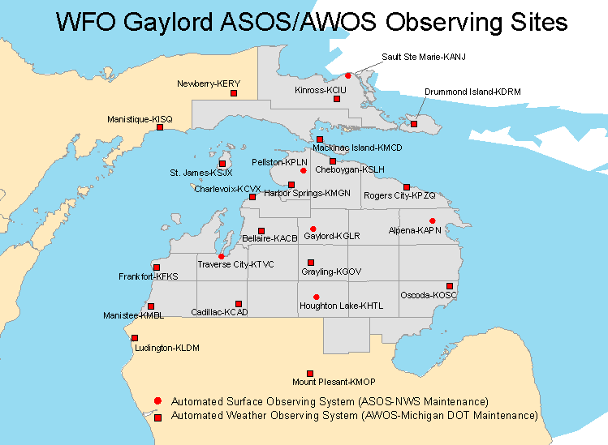
~52 total hours

Slide 18
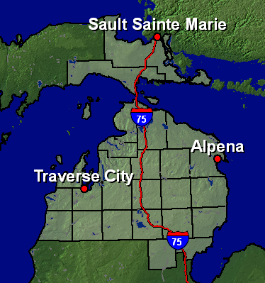
Why the Gap?

Slide 19
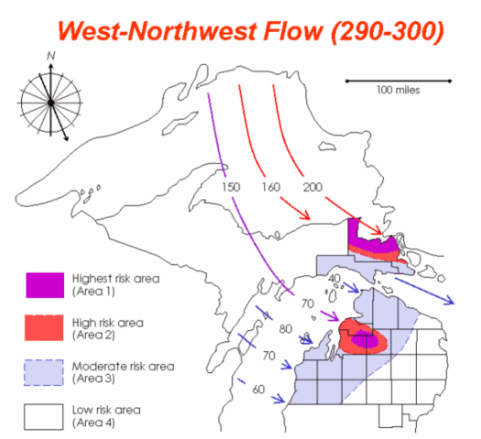
KGLR
280-300 degree maximum
Confirms conceptual models

Slide 20
~61 total hours

Slide 21
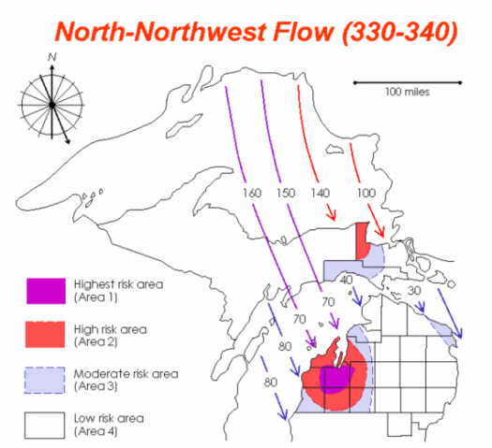
KTVC
320-340 degree maximum

Slide 22
Other Investigations?
Variable scatterplots

Slide 23
Summary
APX Similar Sounding Approach
Similar to BGM, yet different!
Hourly RUC Soundings
Average of numerous CWA BUFR points
Now operational to forecasters
Over 1000 soundings in one cool season
Should improve given more data

Slide 24
Summary – continued
Using Archived LES Radar data
“LES Roses”
Variable/Reflectivity scatterplots
New forecaster training tool
How does LES behave in the APX CWA.
When does TVC get hit? GLR?

Slide 25
Future Plans
New Sounding-based variables
Surface to inversion base mean Tdd, Directional shear, etc.
Move away from average approach
Have a score for EACH sounding site, then make a composite score.
Reassess weights for creating “matches”
Add COOP data in addition to radar
Current approach limited for eastern U.P.
Move from 2D to 3D approach?
E.G. Like a LES-tuned CIPS?

Slide 26
Future Plans - Continued
Develop reflectivity-based LES climatology
Create LES Roses for multiple sites
Deeper investigations of parameter/reflectivity correlations
Use to adjust similar sounding matching techinque
Move away from just point-based
Banded vs. cellular
Inland extent
Expand Training Tool Potential
Intro to LES
Debunk LES Myths

Slide 27
Acknowledgements
NCDC
For radar data and Weather and Climate Toolkit export capability
APX Forecasters
For testing tool

