Slide 1
The Inland Extent of Lake-Effect Snow (LES) Bands Project: What’s Next ?
Joe Villani
NOAA/NWS Albany, NY
Michael L. Jurewicz, Sr.
NOAA/NWS Binghamton, NY
Jason Krekeler
NOAA/NWS State College, PA
19th GLOMW, Cornell Univ., Ithaca, NY
March 21, 2011

Slide 2
Outline
IE Forecast Application
Equation/data inputs
Deeper look at its performance
Potential improvements
Forecasting MLC LES bands
Visualization Techniques
Possible adaptations for IE application and other forecast aids

Slide 3
IE Forecast Application
Designed for output on NWS AWIPS workstations
Equation incorporated the most highly correlated parameters to IE
Mixed-layer wind speed
850/700 mb lake-air differentials
Capping inversion height
Speed/directional shear
MLC (yes/no)

Slide 4
Example of Data Points
Points in and near the LES band
ALY sounding
BUF sounding

Slide 5
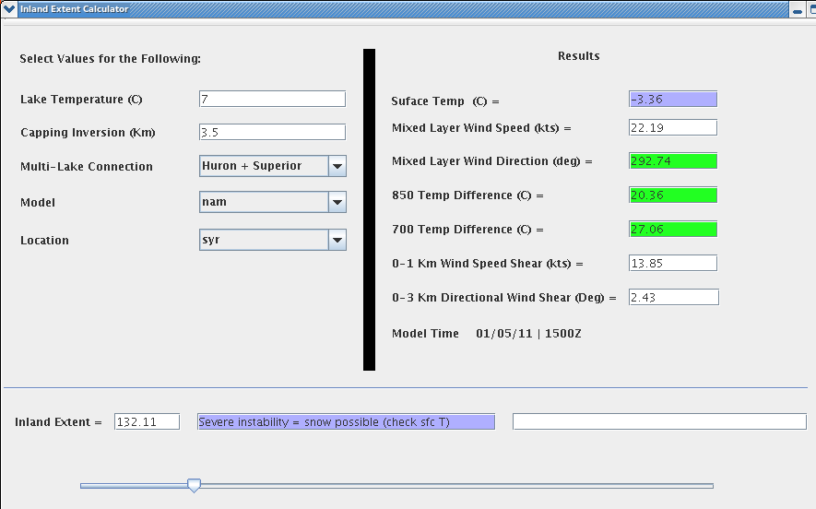
Application Example

Slide 6
Application Results
For LES events that impacted Central NY (WFO BGM), results were fairly similar to those from Eastern NY (WFO ALY)
W flow events (250-280 wind vector)
Mostly single-band cases
Usually good IE estimates (within 10-20 miles)
NW flow events (290-330 wind vector)
Mostly multi-band cases
Tendency for under-estimates, especially for more significant IE/MLC events

Slide 7
A Closer Look
Which terms of the IE equation were most problematic?
It would seem those dealing with moisture availability
A simple Y/N for MLC likely not adequate
Does capping inversion height (proxy for moisture depth) properly simulate true moisture supply?
How do we improve?

Slide 8
“Effective Fetch”
This concept was designed to better represent moisture contributions from upstream lakes
Tries to simulate the additive effects of long fetch distances

Slide 9
Example from 7 Dec 2010 in WFO CTP’s Area
* Cumulative fetch distances across Lakes Superior, Huron, and Erie, in this case (over 300 nmi)
* Satellite imagery normally the best way to determine MLC bands in real-time
Likelihood of radar sampling issues
* Changing the MLC term significantly improved IE estimates in this case (original estimates only about 50% of actual IE)

Slide 10
Example from 6-7 Dec 2010 in WFO BGM’s Area
IE Output: 80 nm

Slide 11
Visible Satellite Image
Effective fetch across Georgian Bay/Lake Ontario was nearly 200 nmi
* Modifying the MLC term again improved the IE output substantially

Slide 12
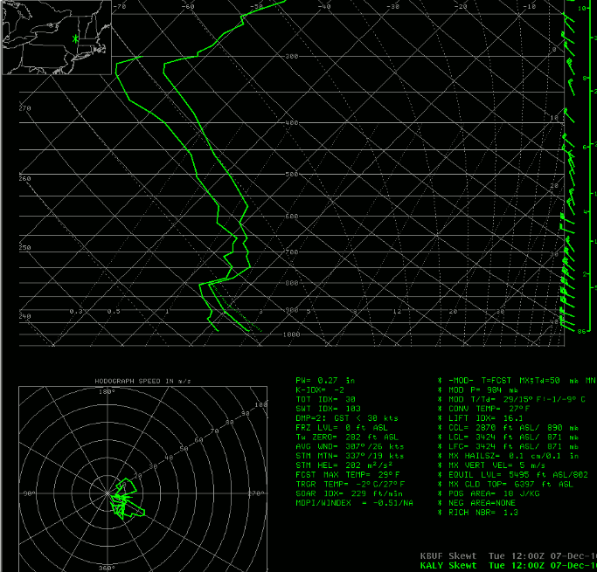
Total Moisture Depth vs. Height of Cap
Significant Moisture above through Mid-levels
Significant Moisture above through Mid-levels
Top of Mixed Layer
Top of Mixed Layer
12 UTC, 7 Dec, near Utica, NY
12 UTC, 7 Dec, Albany, NY

Slide 13
Anticipating MLC
Not necessarily intuitive in forecast mode
What tools can be provided to help operational meteorologists in this regard?

Slide 14
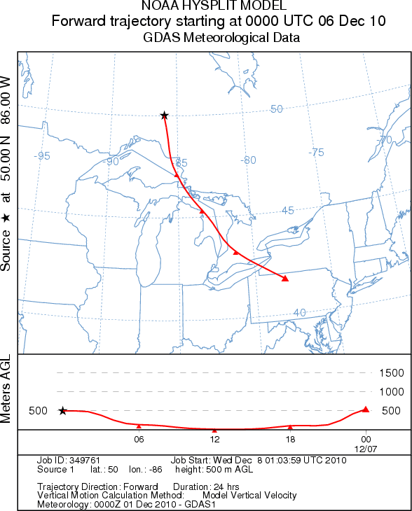
Trajectory Analyses
24 hour trajectory forecast from 00z, 6 Dec to 00z, 7 Dec
Closely resembled actual over-lake fetch for this event (case previously shown)

Slide 15
Using Synoptic Analogs/Composite Plots
* Can help forecasters identify favorable patterns when extensive IE might be expected
* Could conceivably stratify by flow regime and/or add in supporting ingredients

Slide 16
The Future
Better visualization
Add a graphical component to the current AWIPS IE application
Take into account mixed-layer flow orientation
Incorporate this research into BUFKIT

Slide 17
Possible BUFKIT Enhancement?
* Have length of vector boxes and position of terminus points vary according to IE application output

Slide 18
Other Present/Future Work
Perhaps better delineate significant thresholds for certain parameters
Do other parameters need to be looked at?
Mixed-layer LR vs. Lake-air differentials
Cap strengths
Continue to look at single-banded vs. multi-banded cases
Single equation for both would be ideal

Slide 19
Questions?
Joe.Villani@noaa.gov
Michael.Jurewicz@noaa.gov
Jason.Krekeler@noaa.gov
www.weather.gov/aly
www.weather.gov/bgm
www.weather.gov/ctp

