Slide 1
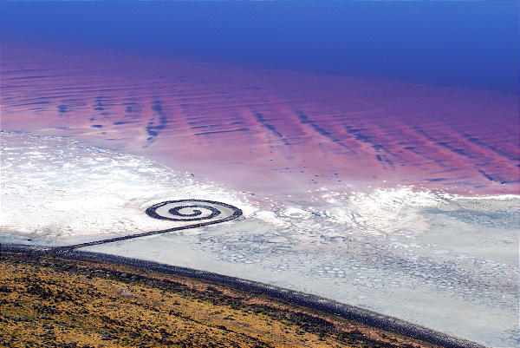
Quantifying lake-effect precipitation in the Great Salt Lake Basin
http://epod.usra.edu
Kristen Yeager
University of Utah
Department of Atmospheric Sciences
Salt Lake City, Utah

Slide 2
Introduction
The Great Salt Lake Basin of the Intermountain West is one of the fastest growing regions of the United States.
Water resources are limited in the arid West.
It is essential to understand and quantify the sources of precipitation in order to plan for future water usage.
Many studies have been conducted on the synoptic and mesoscale processes associated with Great Salt Lake Effect, but none have tried to quantify the amount of precipitation produced.
Notes:
Most of the water resources in the GSL basin come from precipitation and related runoff

Slide 3
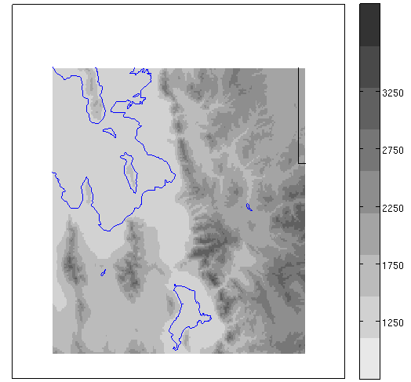
Introduction—Geography
*
KMTX
Great
Salt Lake
Salt
Lake
Valley
Wasatch Mountains
Stansburys
Oquirrhs
Utah
Lake

Slide 4
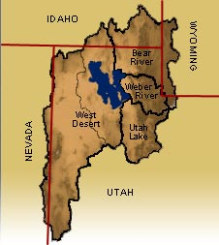
Introduction—Geography
Spans 4 states, encompassing 89,000 km²
Most of Utah
Southwestern Wyoming
Eastern Nevada
Southeastern Idaho
http://www.greatsaltlakeinfo.org

Slide 5
Objectives
To develop a technique to disaggregate daily precipitation data from gauges throughout the Great Salt Lake Basin for an improved estimate of precipitation produced by lake-effect storms
To produce a climatology of lake-effect precipitation that can be used to better understand the hydroclimate of the Great Salt Lake Basin.

Slide 6
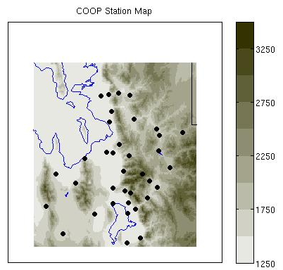
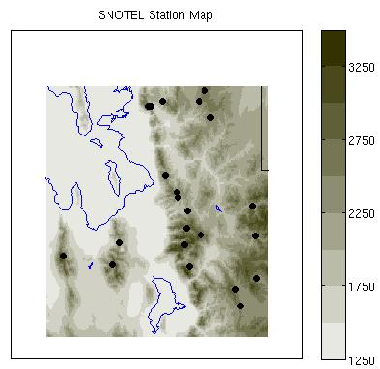
Data
Coop station data came from Utah State University; coop hour of observation information obtained through NWS SLC WFO
SNOTEL data downloaded off NRCS website.
Notes:
Initially there were 69 coop stations and 36 SNOTEL stations

Slide 7
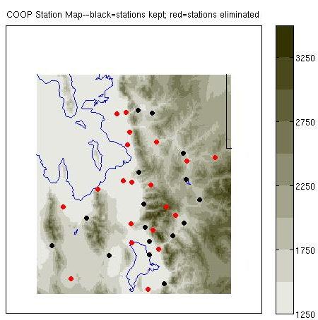
Data—Quality Control
Stations are eliminated if:
Full period of analysis unavailable (9/16/97-5/15/09)
Too many days are missing (>6%)
Too many lake-effect days are missing (>6%)
Ended with 31 coop stations
Number of SNOTEL stations
remained the same

Slide 8
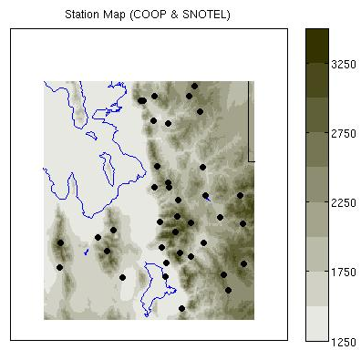
Data—Quality Control
.

Slide 9
Data—Quality Control
Missing data filled in using the normal ratio method:
W_{i} = r_{i}²(n_{i} – 2) / (1 – r_{i}²)
W_{i} = weight of i^{th} surrounding station
r_{i} = correlation coefficient of i^{th} surrounding station
n_{i} = number of observations used to calculate correlation coefficient
To compensate for differing observation times, only stations recording within 3 hours of each other could be used to help fill the missing data of the other.
Notes:
First proposed by J.L.H. Paulhus and M.A. Kohler in 1952
Weights are then calculated as a fraction and used in an estimation algorithm

Slide 10
Methods—Radar Disaggregation
Hourly precipitation observations are needed to quantify
lake-effect precipitation.
Gauge observations more reliable then radar-derived precipitation, but gauges are sparsely located and don’t record on an hourly time step.
Radar coverage is both spatially and temporally continuous.
Radar data is used to disaggregate the 24-hr precipitation observations into hourly observations.
Based on a 2010 article in the International Journal of Climatology by Marc Wüest and Christoph Frei
Notes:
Lake-effect storms formed over the Great Salt Lake can last anywhere from an hour to a couple of days.

Slide 11
Methods—Radar Disaggregation
Radar reflectivity averaged over each hour of 24-hour
observation period.
Z-”S” algorithm of Z=75S² applied to estimate precipitation rate and amount for each hour. This algorithm is recommended for use during cool season snow events west of the continental divide (Vasiloff 2001).
Hourly radar estimates taken as a percent of the daily radar estimate to construct a daily distribution of precipitation.
Radar-derived distribution multiplied by 24-hour gauge observation to determine hourly amounts

Slide 12
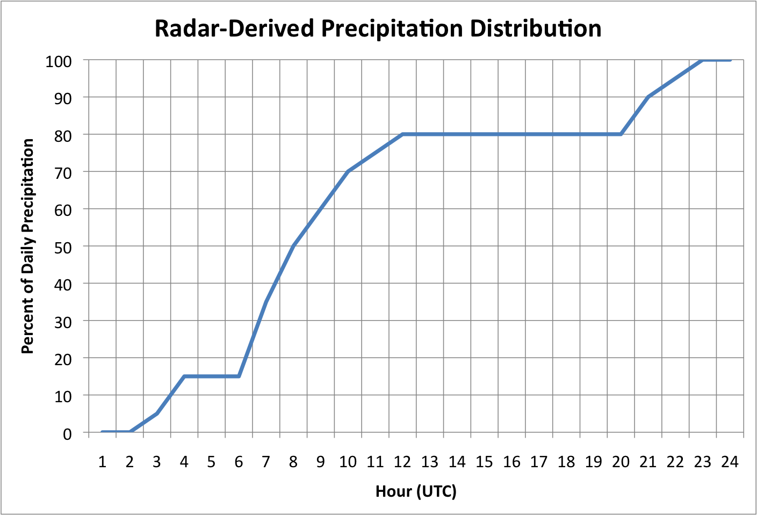
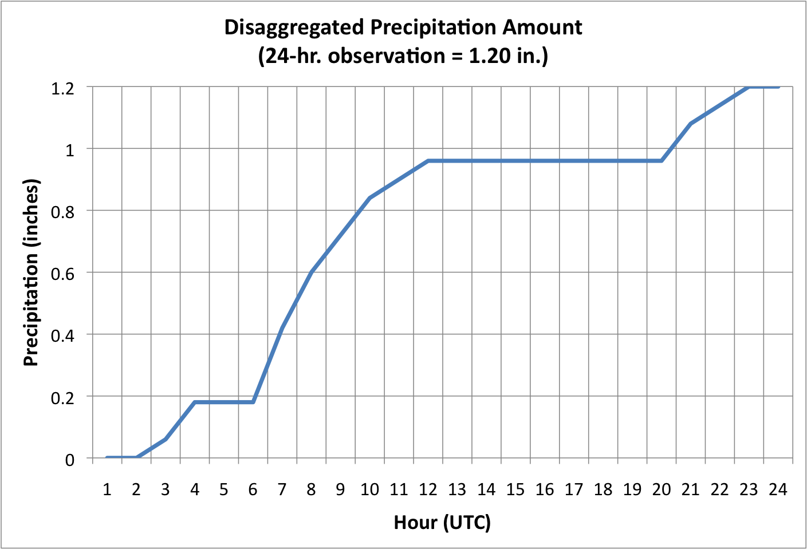
Methods—Radar Disaggregation
Radar-Derived Precipitation Distribution
Disaggregated Precipitation Amount
(24-hr. observation = 1.20 in.)
Percent of Daily Precipitation
Precipitation (inches)
1 2 3 4 5 6 7 8 9 10 11 12 13 14 15 16 17 18 19 20 21 22 23 00
1 2 3 4 5 6 7 8 9 10 11 12 13 14 15 16 17 18 19 20 21 22 23 00
Hour (UTC)
Hour (UTC)
Radar determines distribution of precipitation
24-hour gauge recording remains true 24-hour precipitation amount

Slide 13
Methods—KMTX Radar
Full blockage
Partial blockage
No blockage

Slide 14
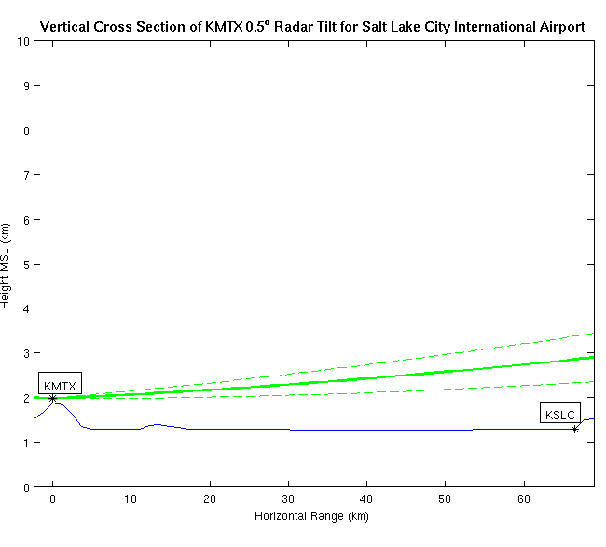
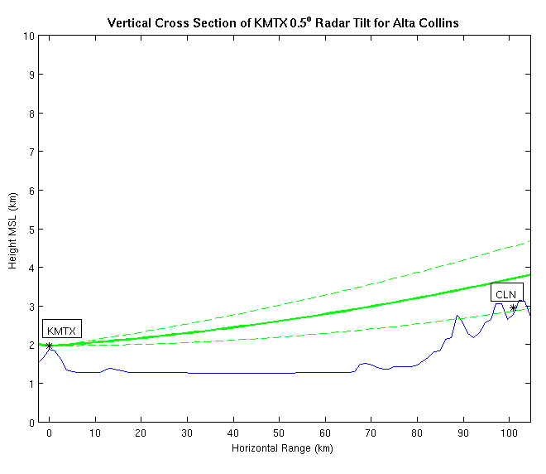
Methods—Verification
Two sites had reliable hourly observations going back to 1997
KSLC—Salt Lake City International Airport
CLN—Alta Collins
Vertical Cross Section of KMTX 0.5° Radar Tilt for KSLC
Vertical Cross Section of KMTX 0.5° Radar Tilt for CLN
Height MSL (km)
Height MSL (km)
0
Horizontal Range (km)
67
0
Horizontal Range (km)
100

Slide 15
Methods—Verification
Radar Bias for Salt Lake City International Airport
During Lake-Effect Events
in.
Radar Bias for Alta Collins
During Lake-Effect Events
in.

Slide 16
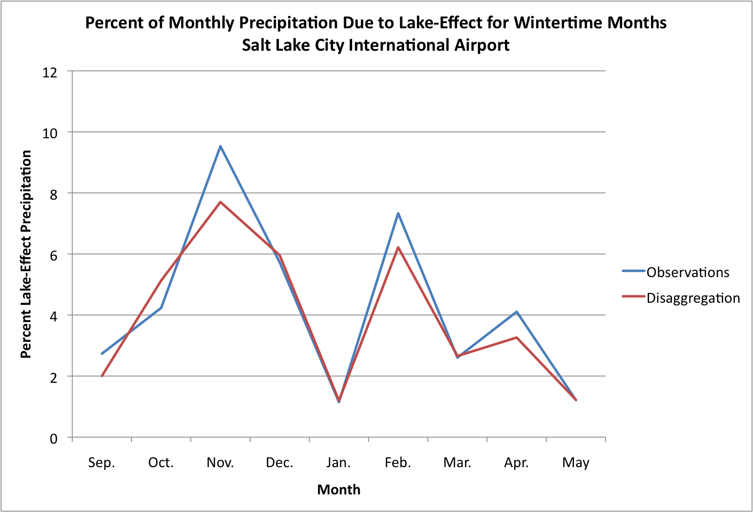
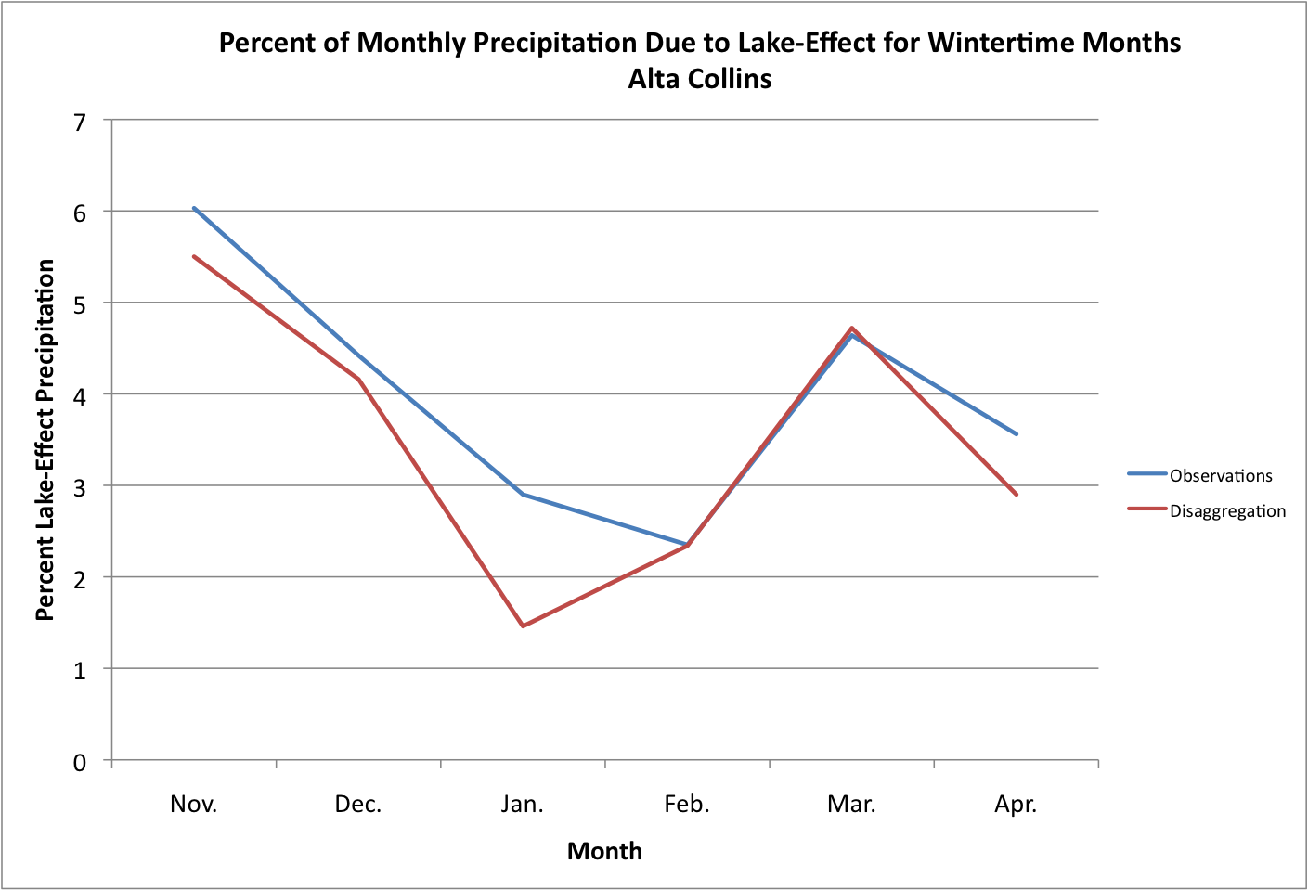
Methods—Verification

Slide 17
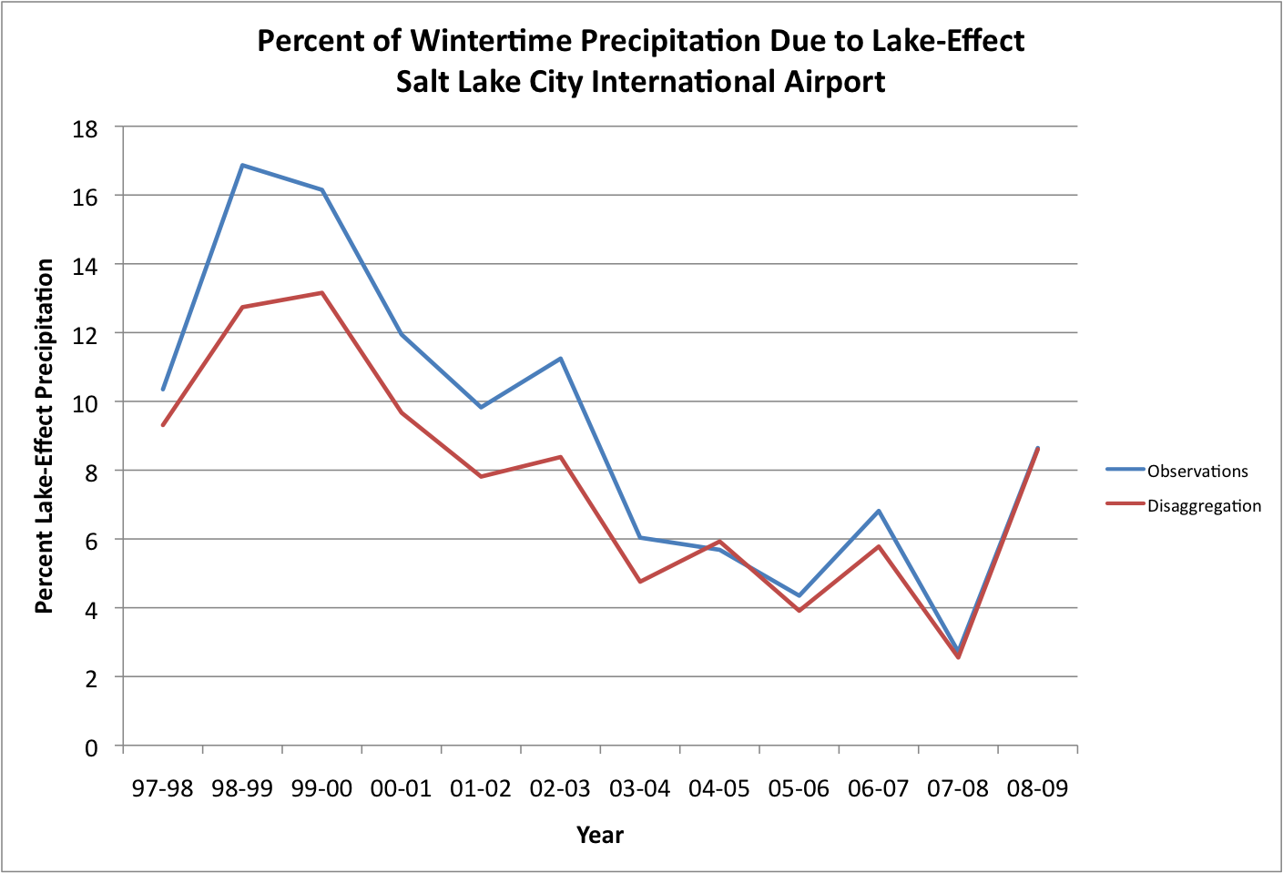
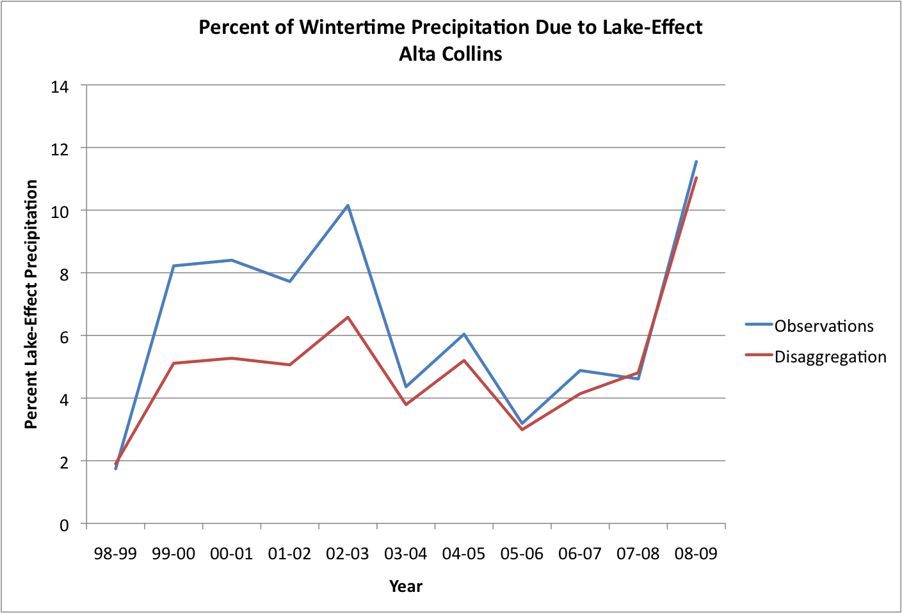
Methods—Verification
97-98
08-09
98-99
08-09

Slide 18
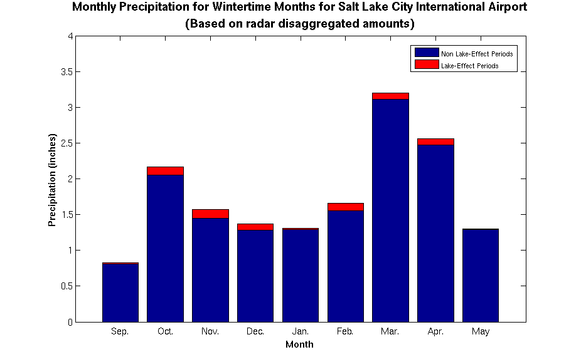
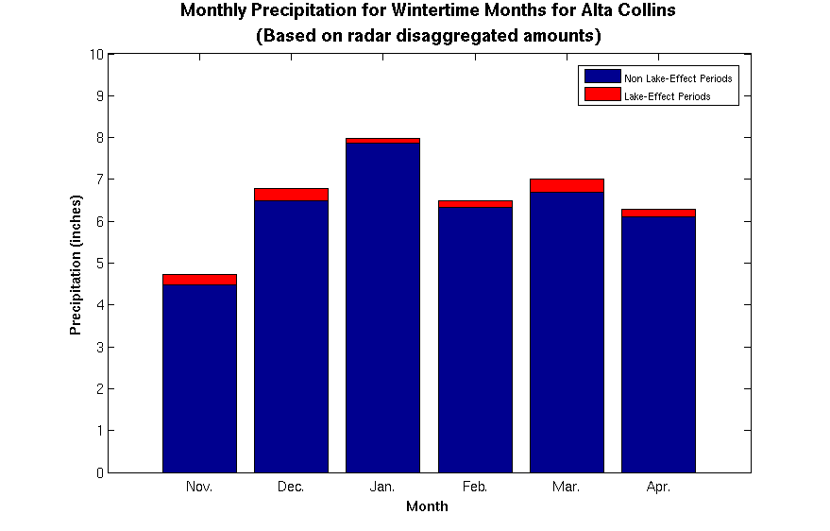
Results
4
2.66%
3.26%
5.13%
Precipitation (inches)
7.70%
6.22%
5.96%
1.19%
1.22%
2.00%
0
10
Sep
Oct
Nov
Dec
Jan
Feb
Mar
Apr
May
1.46%
4.16%
2.34%
4.72%
2.90%
5.50%
Precipitation (inches)
0
Nov
Dec
Jan
Feb
Mar
Apr

Slide 19
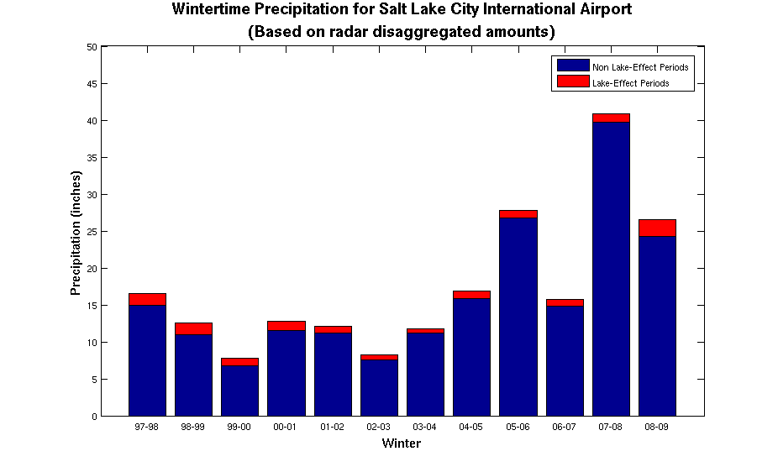
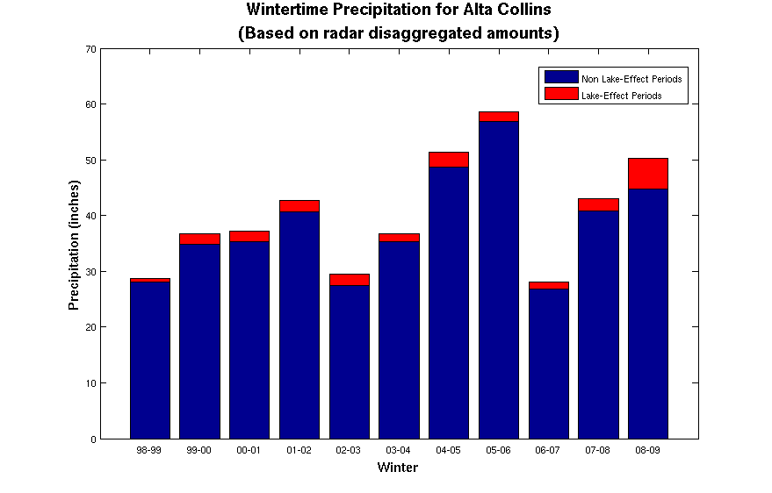
Results
50
2.6%
Precipitation (inches)
3.9%
8.6%
9.3%
5.9%
5.8%
12.7%
9.7%
7.8%
4.8%
13.1%
8.4%
0
70
97-98
Winter
08-09
3.0%
5.2%
11.0%
5.1%
4.8%
5.3%
5.1%
3.8%
Precipitation (inches)
6.6%
1.9%
4.1%
0
98-99
Winter
08-09

Slide 20
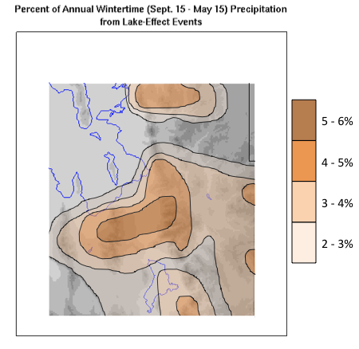
Results

Slide 21
Results
Frequency of Occurrence of
>10 dBZ during Lake-Effect Events
Courtesy of Steenburgh 2000

Slide 22
Conclusions
Radar disaggregation method underestimates during lake-
effect periods and overestimates during non lake-effect periods.
Both disaggregated amounts and hourly observations at the two verification sites indicate a bi-modal distribution of lake-effect contributions across wintertime months.
Lake-effect contribution varies from year to year.
Lake-effect precipitation contributes minimally to the overall wintertime precipitation of the Great Salt Lake Basin.

Slide 23
References
Carpenter, David M., 1993: The Lake Effect of the Great Salt Lake: Overview and Forecast Problems. Wea. Forecasting, 8, 181–193.
Di Luzio, Mauro, Gregory L. Johnson, Christopher Daly, Jon K. Eischeid, Jeffrey G. Arnold, 2008: Constructing Retrospective Gridded Daily Precipitation and Temperature Datasets for the Conterminous United States. J. Appl. Meteor. Climatol., 47, 475–497.doi: 10.1175/2007JAMC1356.
Eischeid, Jon K., Phil A. Pasteris, Henry F. Diaz, Marc S. Plantico, Neal J. Lott, 2000: Creating a Serially Complete, National Daily Time Series of Temperature and Precipitation for the Western United States. J. Appl. Meteor., 39, 1580–1591.doi: 10.1175/1520-0450(2000)039<1580:CASCND>2.0.CO;2
Lall, U. and M. Mann, (1995), "The Great Salt Lake: A Barometer of Low-Frequency Climatic Variability," Water Resources Research, 31(10): 2503-2515.
Steenburgh, W. James, Scott F. Halvorson, Daryl J. Onton, 2000: Climatology of Lake-Effect Snowstorms of the Great Salt Lake. Mon. Wea. Rev., 128, 709–727.doi:10.1175/1520-0493(2000)128<0709:COLESO>2.0.CO;2
Steenburgh, W. James, 2003: One Hundred Inches in One Hundred Hours: Evolution of a Wasatch Mountain Winter Storm Cycle. Wea. Forecasting, 18, 1018–1036.doi:10.1175/1520-0434(2003)018<1018:OHIIOH>2.0.CO;2
Thiros, S. A., and Manning, A. H., 2004, Quality and sources of groundwater used for public supply in Salt Lake Valley, Salt Lake County, Utah, 2001: U.S. Geological Survey Water- Resources Investigation Report 03-4325.
Vasiloff, S. V., 2001: WSR-88D Performance in Northern Utah During the Winter of 1998-1999. Part II: Examples of Error
Sources. National Weather Service Western Region Technical Attachment, No. 01-03.
Wüest, M., Frei, C., Altenhoff, A., Hagen, M., Litschi, M. and Schär, C. (2010), A gridded hourly precipitation dataset for Switzerland using rain-gauge analysis and radar-based disaggregation. International Journal of Climatology, 30: 1764–1775. doi: 10.1002/joc

Slide 24
Questions???

