Slide 1
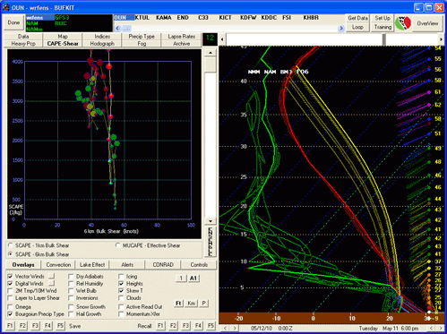
The Warning Decision Training Branch Souper Computer or Building Ensembles in a Bottle
Ed Mahoney, WDTB
22 March 2010 GLOMW

Slide 2
Why Are You Folks Doing This?
NOAA’s Strategic Plan for the next 10 years
Reduced loss of life, property, and disruption from high-impact events ... the formulation and communication of forecast uncertainty, or forecast confidence
… effectively communicate scientific information and its associated uncertainties to policy makers, the media, and the public
… integrating environmental information and uncertainties into routine decision making.

Slide 3
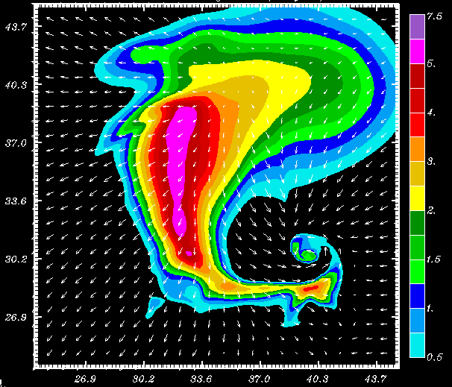
“Transferring Knowledge into Warning Performance”
Human
Factors
Science
Technology
Notes:
Warning and forecast decisions are based on an individual’s:
Knowledge of the science
Ability to use the technology
Human Factors
Handle stress
Maintain situation awareness
Perception of threat
Form expectations
Work in a team

Slide 4
A Little Philosophy
“Tell me, and I will forget.
Show me, and I may remember.
Involve me, and I will understand.”
Do
Apply
Reflect

Slide 5
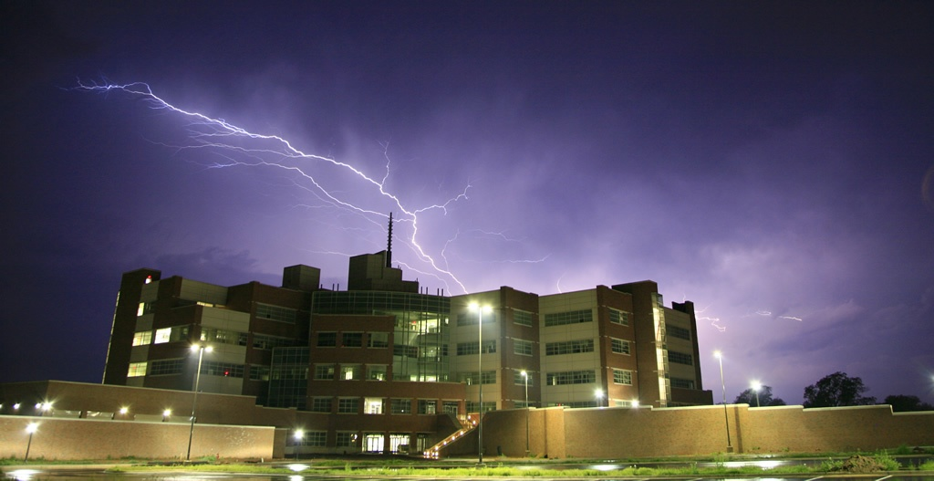
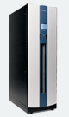
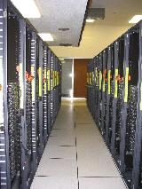
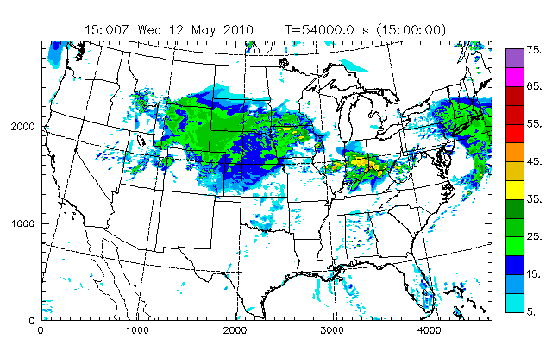
So There I Was …. March 2010 …..

Slide 6
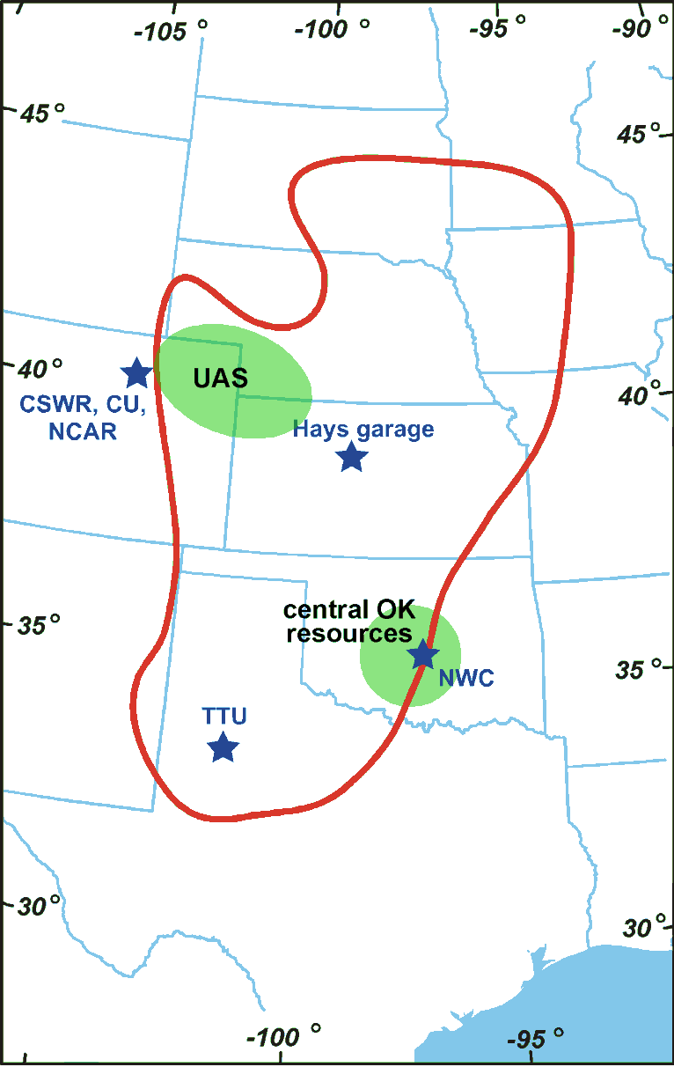
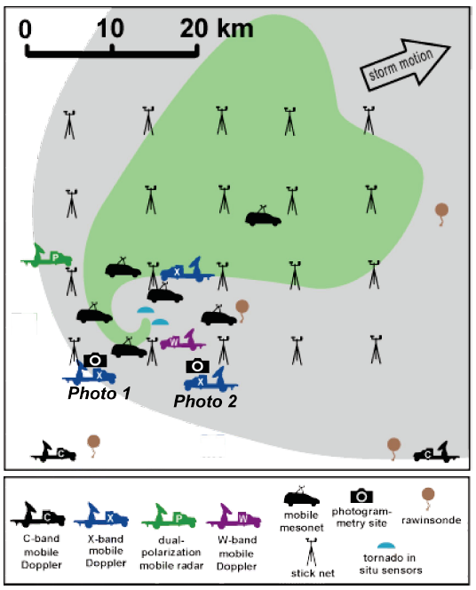
VORTEX2 Storm-scale Photogrammetry Deployment

Slide 7
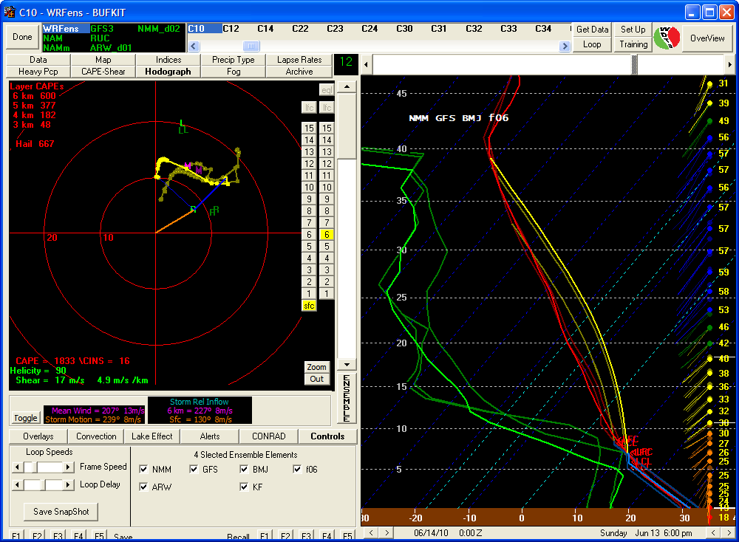
WRF ensemble sounding, 00Z Plainview, TX

Slide 8
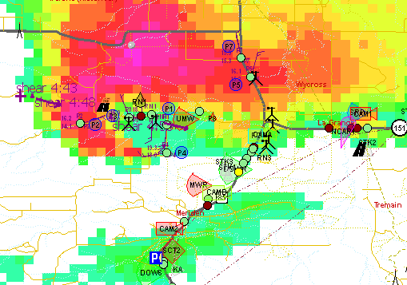
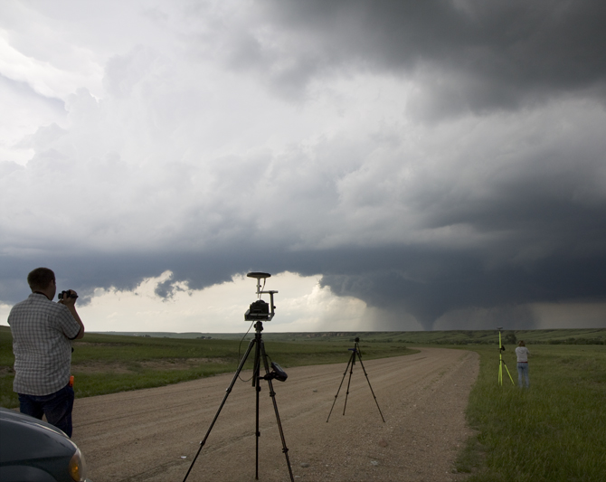
Success … and things close to it

Slide 9
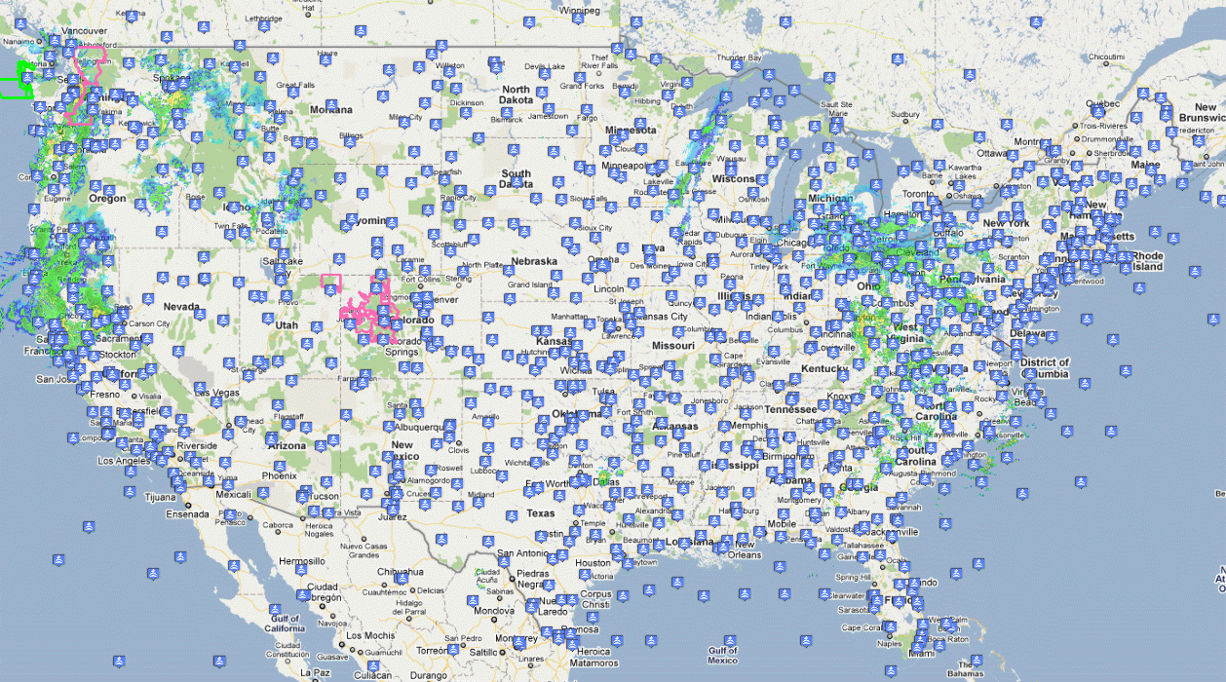
Designing Beyond VORTEX 2
CONUS Domain
16 Ensemble Members
With filtering
Available Twice Per Day
Incremental Updates
up to 32 updates each day
Available by the Lunch Break
Total Costs must be less than $3000

Slide 10
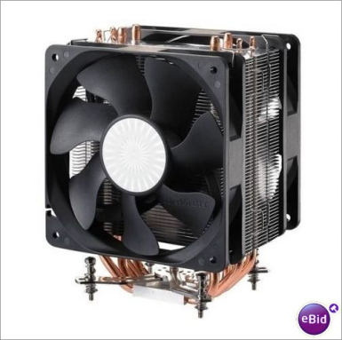
A Souper Computer Node
Lots ‘o Fans
6-Core Processor
4GB RAM
And More Fans

Slide 11
Using 4 Nodes to Build the eWRFs The NAM Cycle
Boundary Conditions
NAM
NMM
ARW
Model Core
Convective Scheme
KF
BMJ
KF
BMJ

Slide 12
Using 4 Nodes to Build the eWRFs The GFS Cycle
Boundary Conditions
GFS
NMM
ARW
Model Core
Convective Scheme
KF
BMJ
KF
BMJ

Slide 13
Where are the 16 Ensemble Members?
Use Forecast Hour F00 and F06 as Starting Boundary Conditions
12Z NAM and GFS Provide 8 Ensemble Members
F00
F03
F06
F42
F45
F48
8am
Tue
8am
Thr
06Z NAM and GFS Provide 8 Ensemble Members
F06
F09
F12
F48
F51
F54

Slide 14
eWRF Production Status
Current WRF Ensemble Status 12Z ensemble cycle
Ensembles initiated at f06
Element | Status | Start | End
nmm_nam212_kf | Complete | 06 Mar 11 08:36 UTC | 06 Mar 11 09:53 UTC
nmm_nam212_bmj | Complete | 06 Mar 11 08:36 UTC | 06 Mar 11 10:17 UTC
nmm_gfs_kf | Complete | 06 Mar 11 10:36 UTC | 06 Mar 11 12:04 UTC
nmm_gfs_bmj | Complete | 06 Mar 11 10:36 UTC | 06 Mar 11 12:11 UTC
arw_nam212_kf | Complete | 06 Mar 11 14:13 UTC | 06 Mar 11 15:39 UTC
arw_nam212_bmj | Complete | 06 Mar 11 14:13 UTC | 06 Mar 11 16:01 UTC
arw_gfs_kf | Complete | 06 Mar 11 10:29 UTC | 06 Mar 11 12:19 UTC
arw_gfs_bmj | Complete | 06 Mar 11 10:29 UTC | 06 Mar 11 11:51 UTC

Slide 15
eWRF Production Status
Current WRF Ensemble Status 12Z ensemble cycle
Ensembles initiated at f00
Element | Status | Start | End
nmm_nam212_kf | Complete | 06 Mar 11 14:35 UTC | 06 Mar 11 15:52 UTC
nmm_nam212_bmj | Complete | 06 Mar 11 14:35 UTC | 06 Mar 11 16:16 UTC
nmm_gfs_kf | Complete | 06 Mar 11 16:15 UTC | 06 Mar 11 17:44 UTC
nmm_gfs_bmj | Complete | 06 Mar 11 16:15 UTC | 06 Mar 11 17:51 UTC
arw_nam212_kf | Complete | 06 Mar 11 17:56 UTC | 06 Mar 11 19:23 UTC
arw_nam212_bmj | Running | 06 Mar 11 17:56 UTC
arw_gfs_kf | Complete | 06 Mar 11 16:30 UTC | 06 Mar 11 18:20 UTC
arw_gfs_bmj | Complete | 06 Mar 11 16:30 UTC | 06 Mar 11 17:56 UTC

Slide 16
Designing for Availability
VORTEX 2 Platform
Intel 2/4 Core
AMD 2/3/6 Core
3.8 GHz
MCP
Relocated
Reliability Testing 3.4 GHz
Reliability Testing 3.6 GHz
AMD
Pure 6 Core

Slide 17
Goals Achieved
November 7, 2010

Slide 18
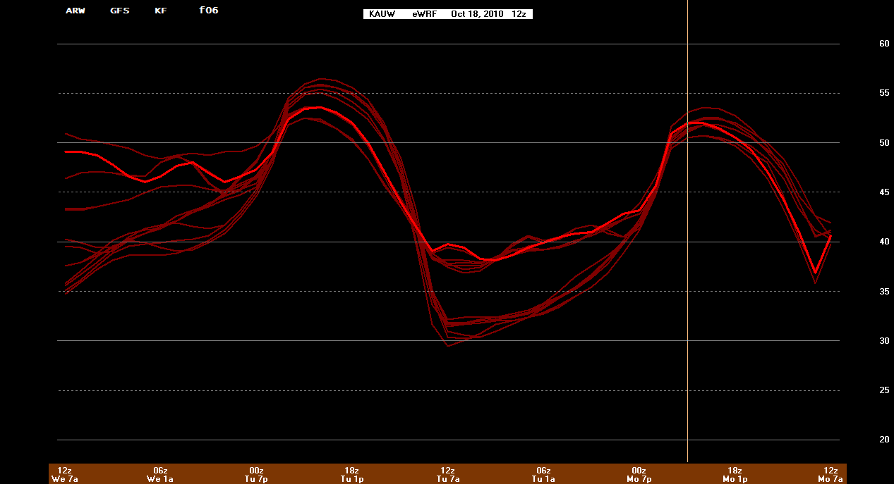
Visualizing Uncertainty
Obs: 54
Obs: 52
Obs: 44
Obs: 36

Slide 19
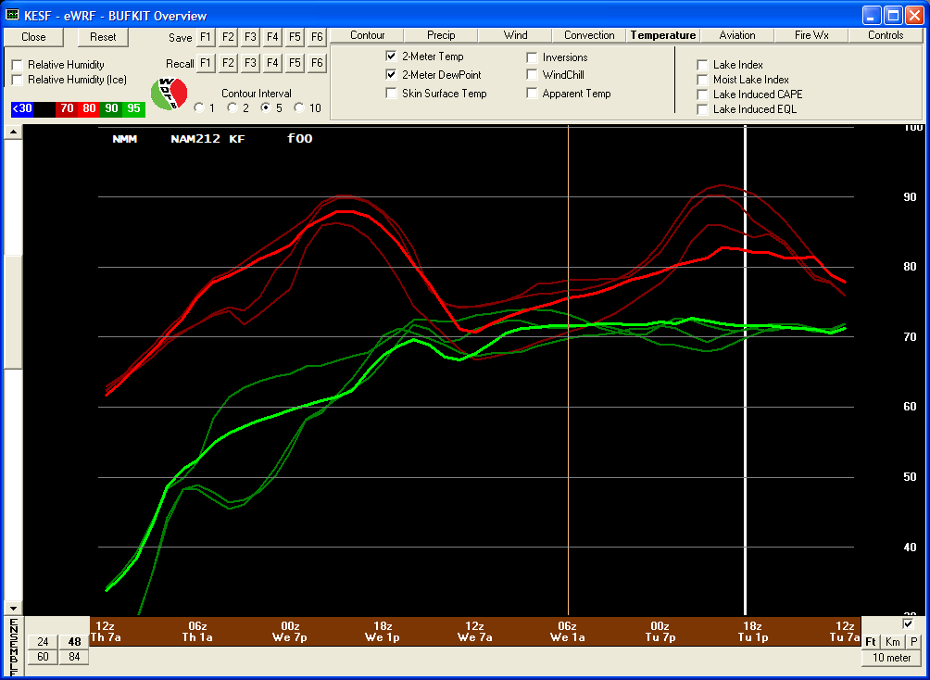
Visualizing Multiple Domains

Slide 20
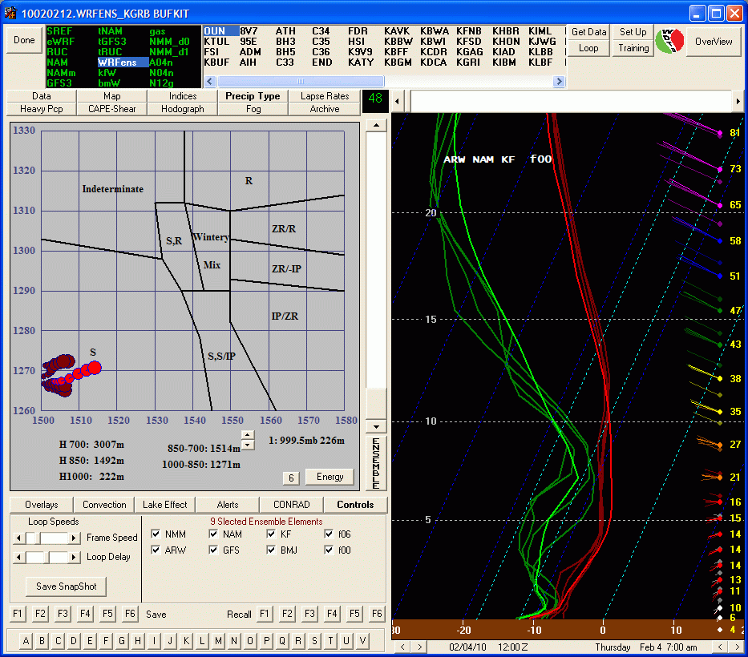
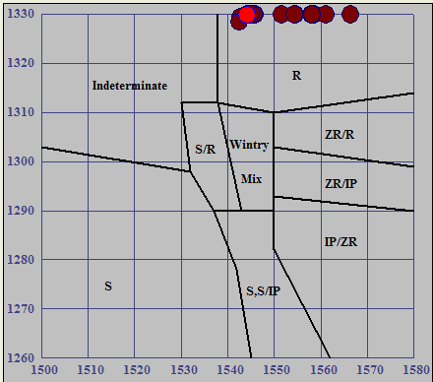
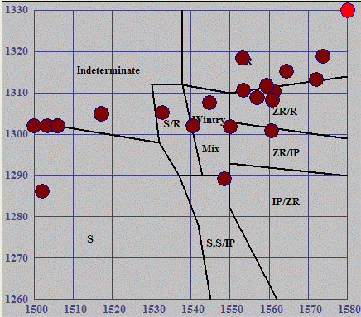
Integrating Uncertainty into Nomograms

Slide 21
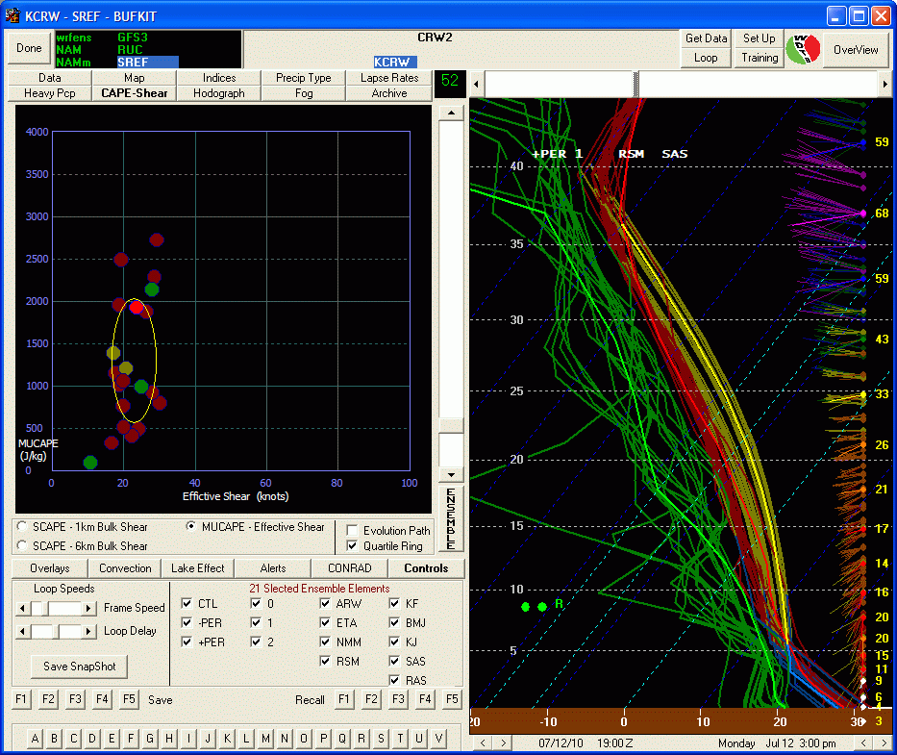
Integrating Uncertainty into Nomograms

Slide 22
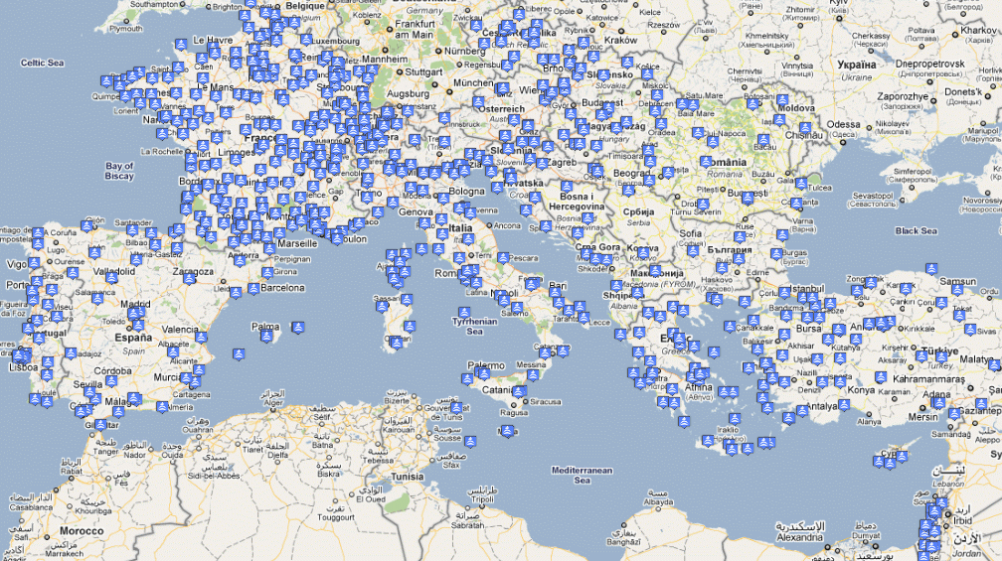
Output
Bufkit Profiles (Winter 2010)
Low bandwidth Requirements (zipped format)
Every model layer… every forecast hour
Full display of each ensemble member
At any location (1000 in CONUS)

Slide 23
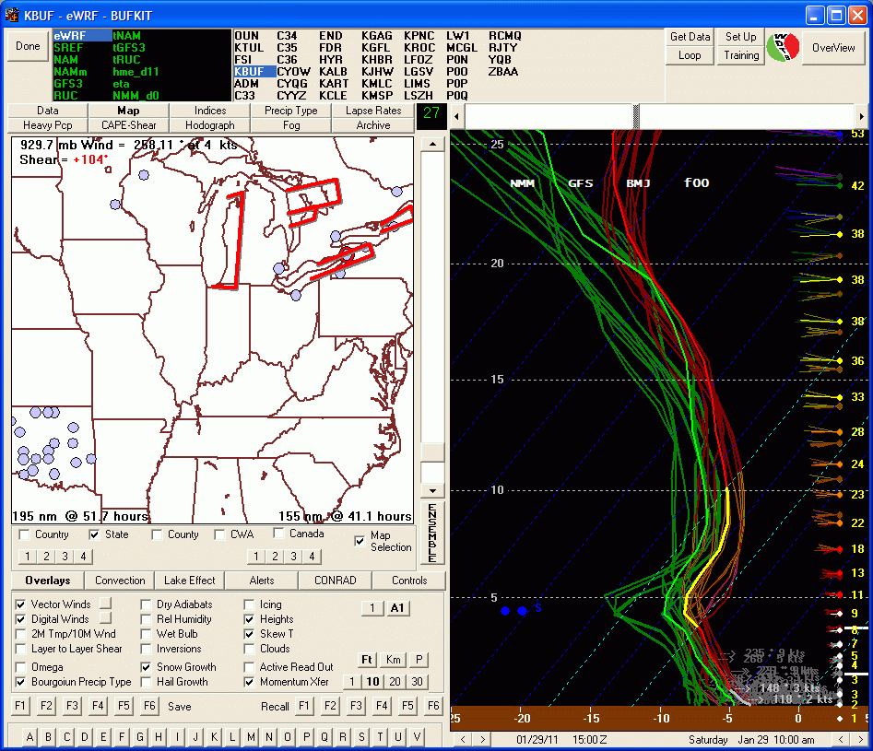
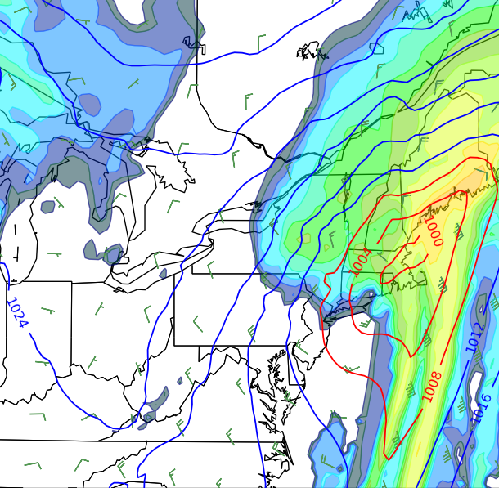
So Now What?
June 2011
eWRFs to
include
ensemble
planview
maps

Slide 24
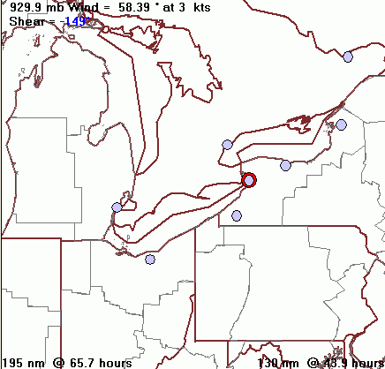
And then What?
Winter
2011-2012
Souper
Computer
Package
Using
RSS feeds
Released

Slide 25
3 Things to Remember
We’ve been tasked to integrate uncertainty into our services
Ensembles as the forecast tool (with training and experience) addresses this requirement
Collaborative - distributive computing allows for the timely generation of ensembles

