Slide 1
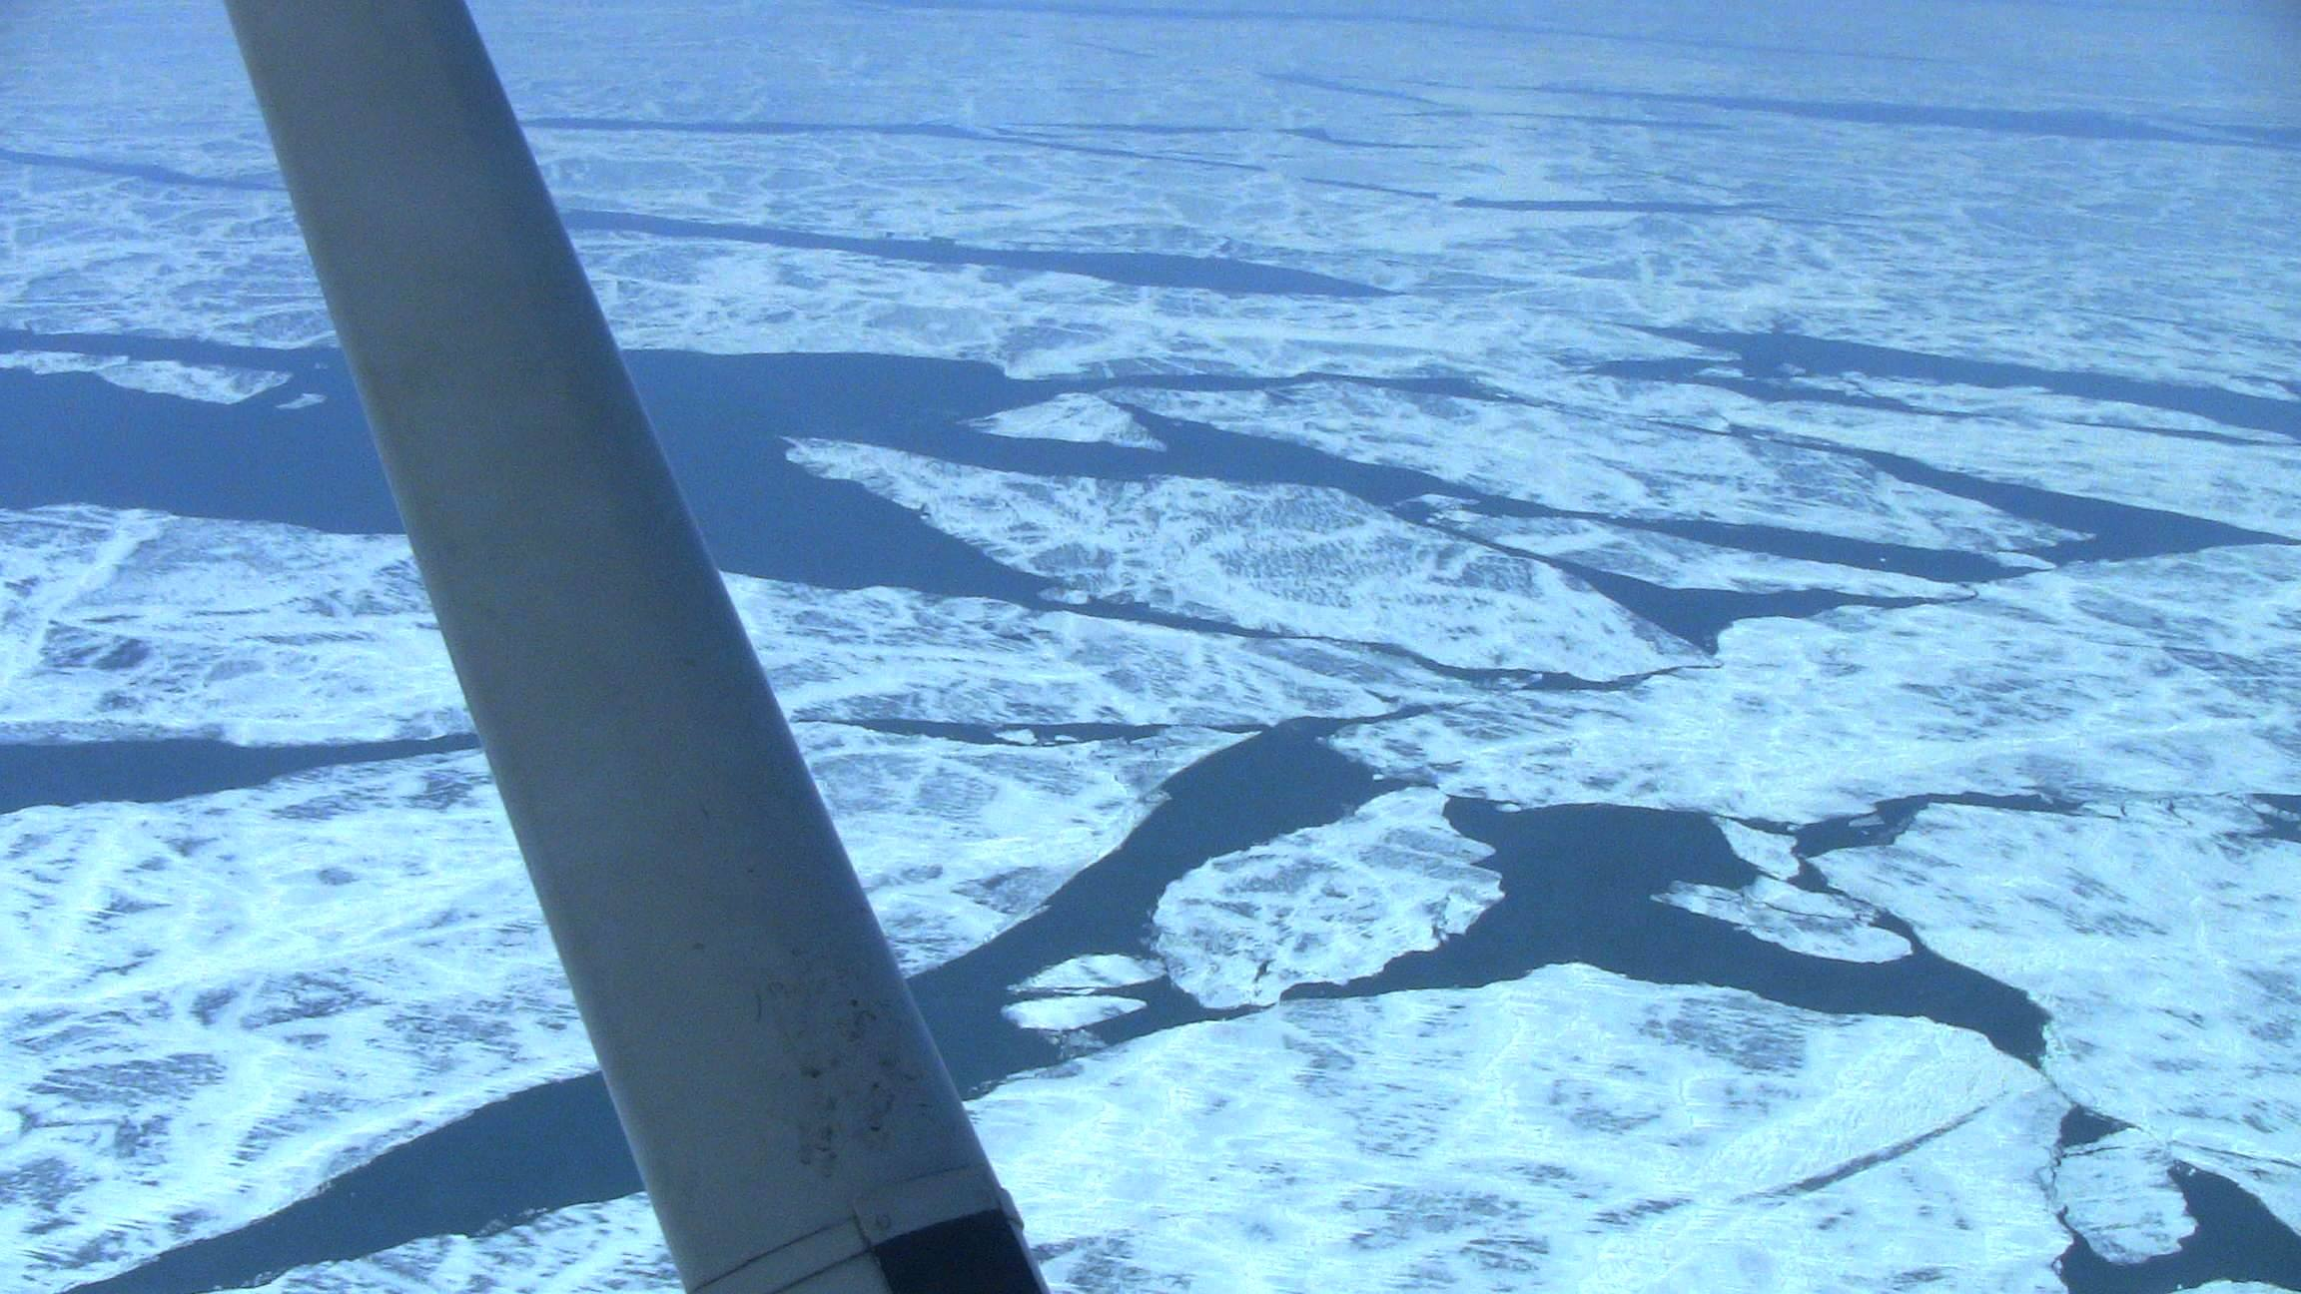
Evaluation of Great Lakes Ice Model (GLIM) Real-time Ice Forecasts for Lake Erie during the 2010-2011 Ice season
Robert LaPlante
NOAA/NWS Cleveland, OH
David Schwab
Jia Wang
NOAA/GLERL Ann Arbor, MI
22 March 2011

Slide 2
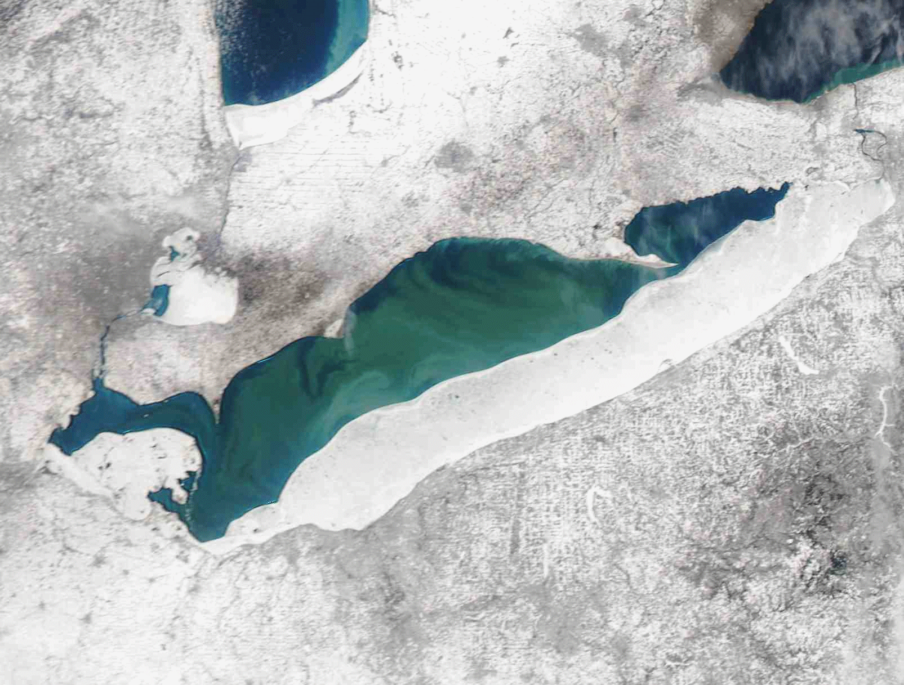
Outline
Description of the improved GLIM for the 2010-2011 ice season
Comparison of the GLIM to the National Ice Center analysis
Future plans for the GLIM
MODIS 4-9 March 2010

Slide 3
Description of the GLIM
GLIM has been under development by GLERL since 2007
GLIM is a combination of the Princeton Ocean Model for hydrodynamics and the Combined Ice Ocean Model tailored for the Great Lakes
GLIM which has two modules, runs twice a day for Lake Erie as part of the Great Lakes Coastal Forecast system (GLCFS) at NOAA/GLERL at 2 km resolution
Hourly Nowcast runs - ingest surface meteorological and daily NIC ice concentration observations
Forecast runs from 00 to 12o hours – driven by the NDFD
The GLIM is run using the latest surface forecast meteorological grids from the NWS National Digital Forecast Database (NDFD) out to 5 days

Slide 4
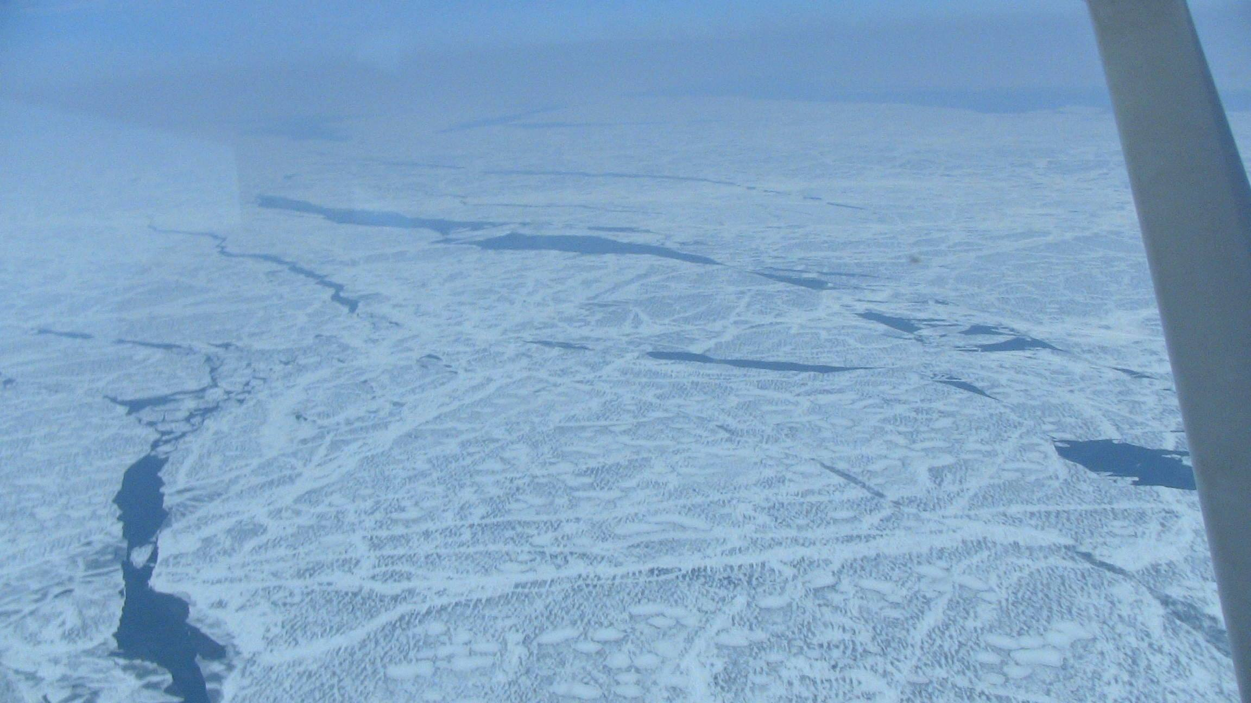
Description of the GLIM
GLIM Nowcasts of ice concentration are “nudged” towards the daily NIC ice concentration field
The initial conditions for the forecast module are based on nowcast runs
Model output for the GLIM is posted to the web
NWS CLE retrieves via ftp the GLIM for AWIPS and GFE

Slide 5
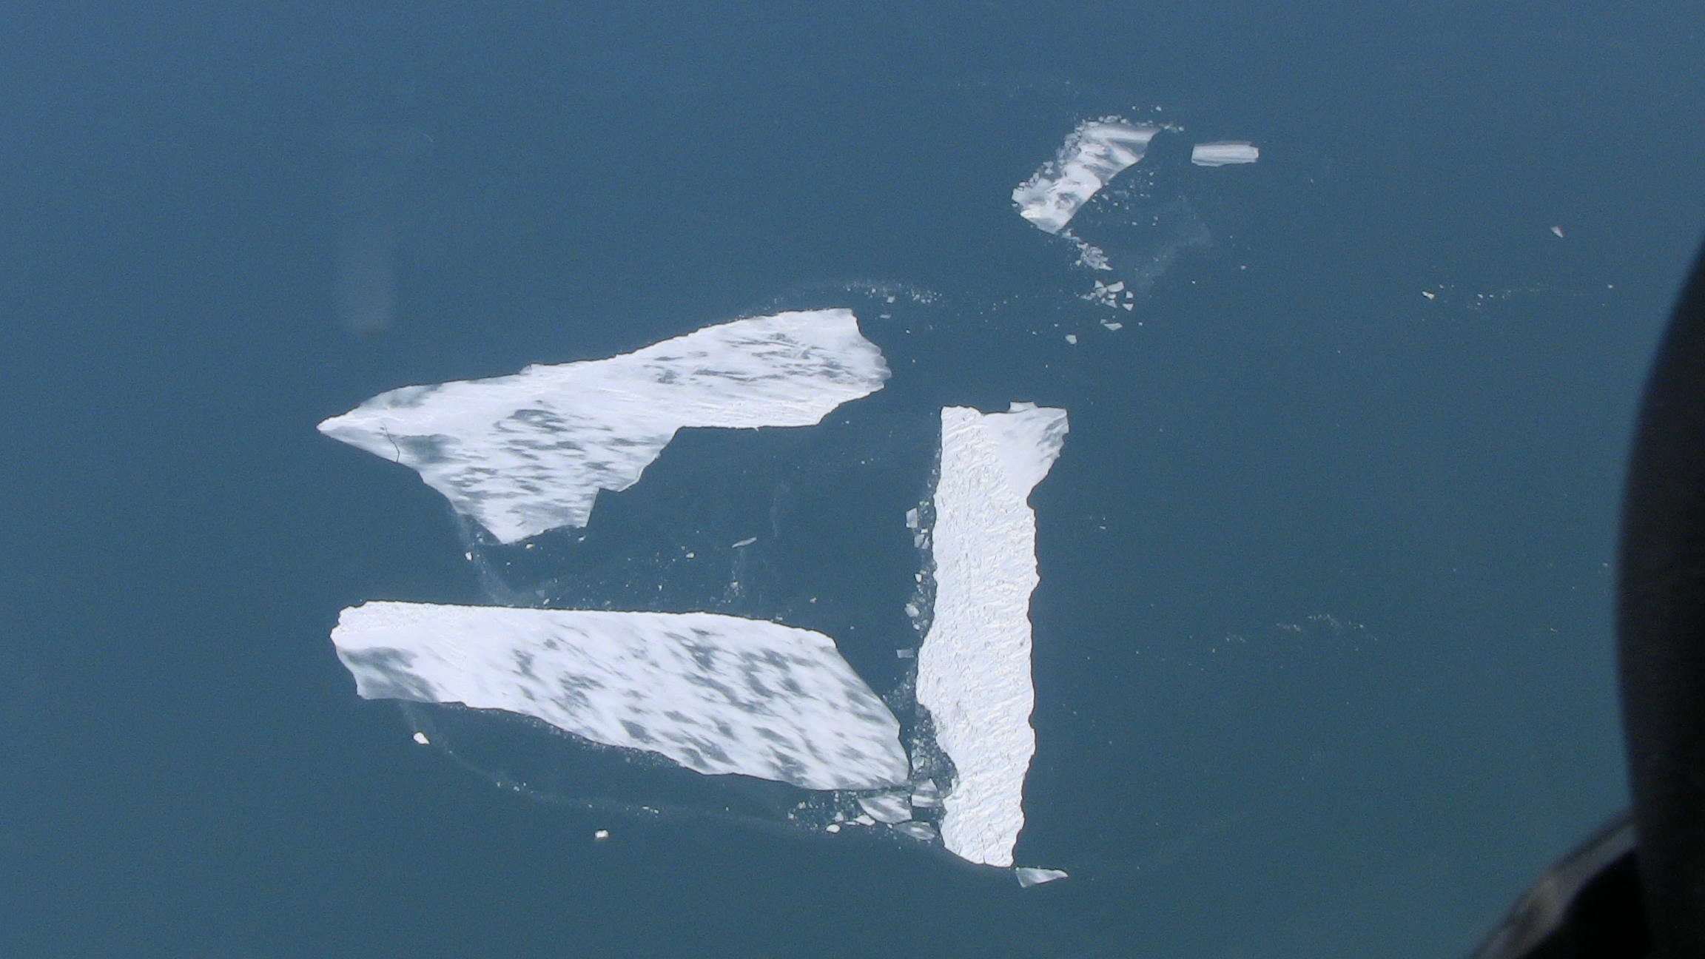
GLIM New Nudge Procedure
GLIM Nowcast nudging procedure added for 2010-2011 takes the GLIM ice concentration and “nudges” it close to the daily NIC ice concentration analysis
In grid cells where both NIC and GLIM are ice-free, no nudging is applied
In grid cells where the NIC has ice, but the GLIM is ice-free, the GLIM ice thickness is set to a small value (1 mm) and the ice concentration is “nudged” toward the NIC
In grid cells where the GLIM has a non-zero ice concentration, the GLIM concentration is nudged toward the NIC concentration, whether it is zero or non-zero

Slide 6
GLIM New Nudge Procedure
The nudging consists of changing the GLIM computed concentration by a fraction of the difference between the GLIM and NIC concentrations
The fraction is adjustable and is set to allow the GLIM to become nearly equal to the NIC field over a period of 12 hours

Slide 7
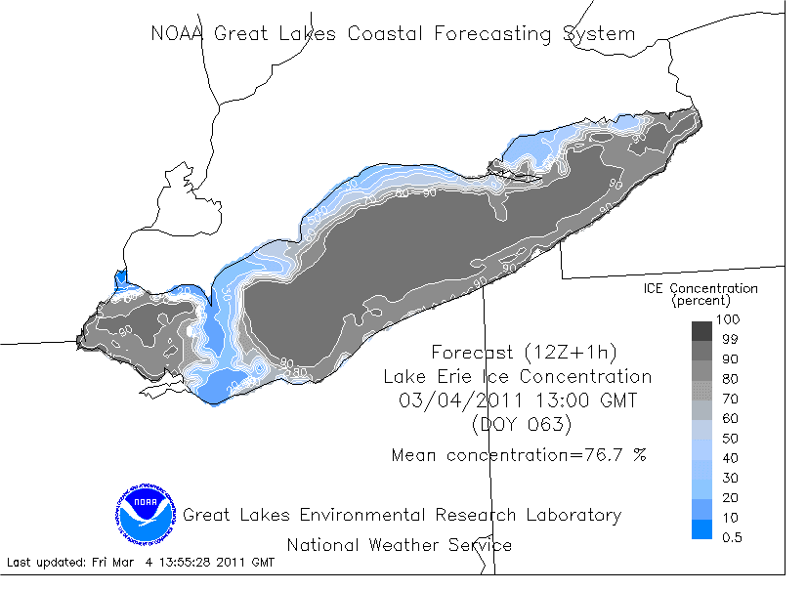
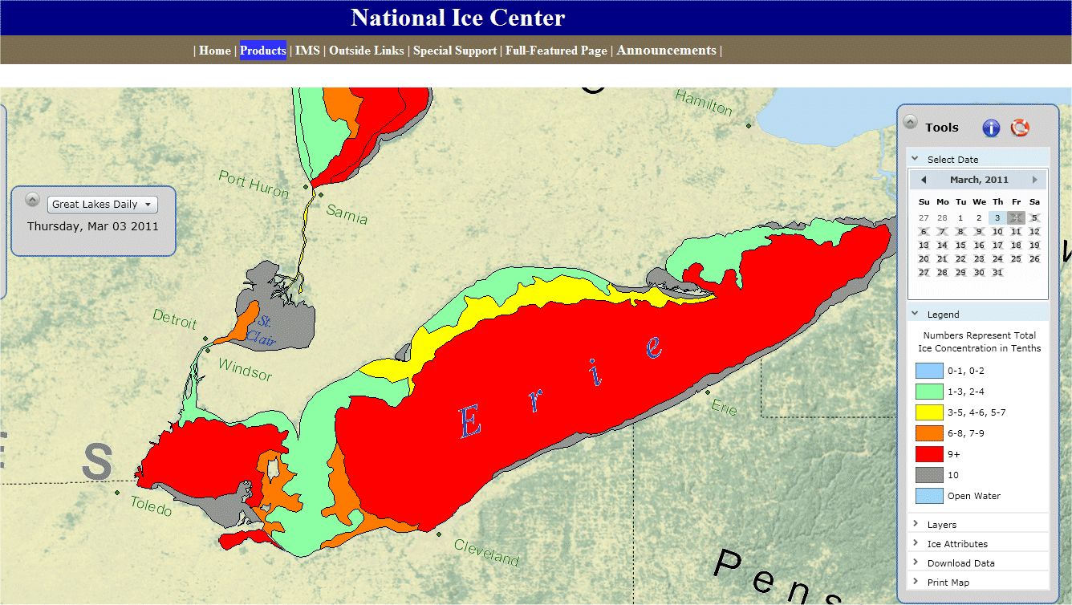
GLIM Ice Concentration is nudged toward the NIC ice concentration field which is updated daily

Slide 8
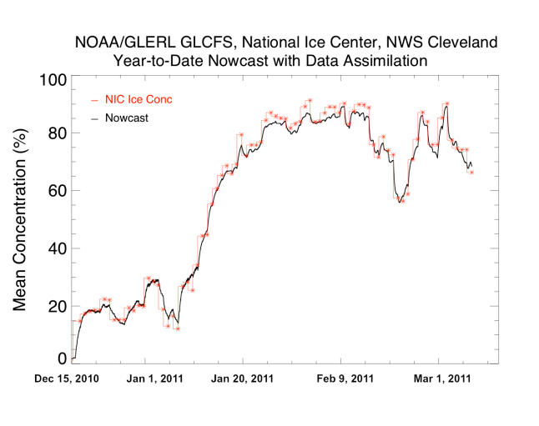
GLIM NOWCAST with NIC NUDGING
Lake Erie Mean Ice Concentraton (%)

Slide 9
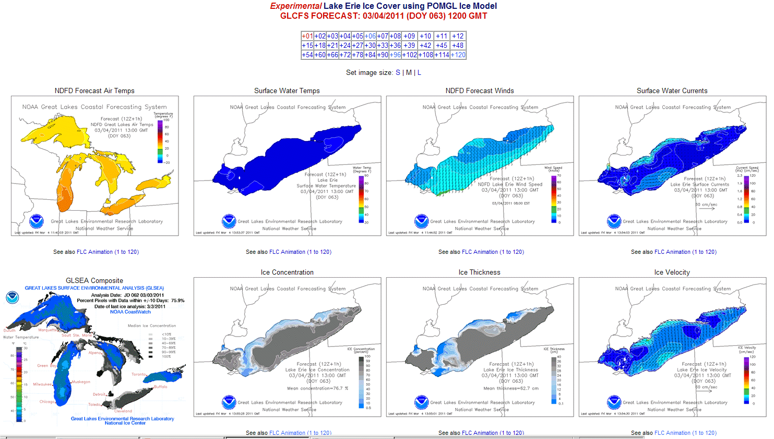
Integration of the GLIM and NDFD results in the Forecast Generation of:
Surface Water Temperature
Ice Concentration
Ice Thickness
Ice Drift
http://www.glerl.noaa.gov/res/glcfs/erie-ice.php?lake=e&type=F&hr=01
For both the nowcast and forecast components of the GLIM

Slide 10
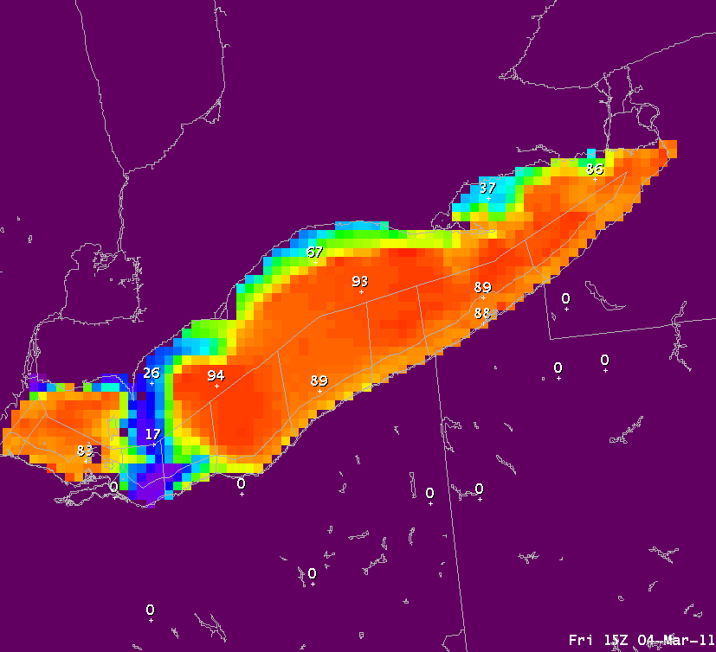
GLIM Ice Concentration in GFE(%) 72 Hr Forecast from 4 Mar 2011

Slide 11
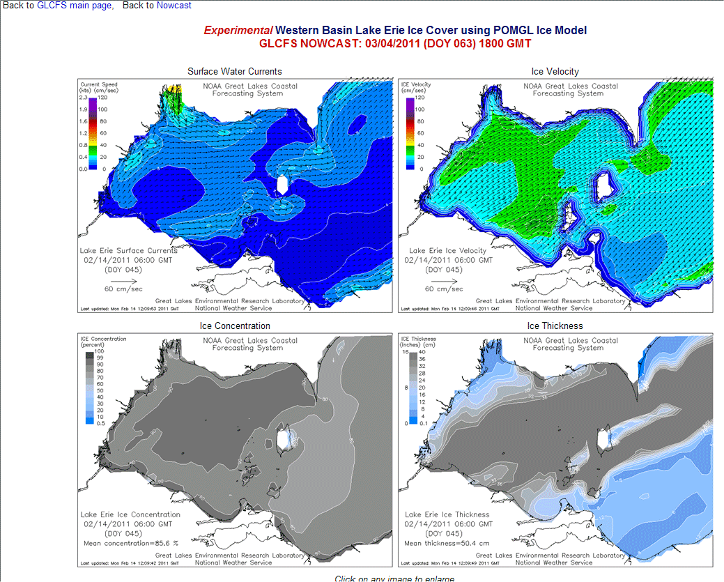
GLIM zoomed for Western Lake Erie
Plenty of winter recreation near the islands of Lake Erie

Slide 12
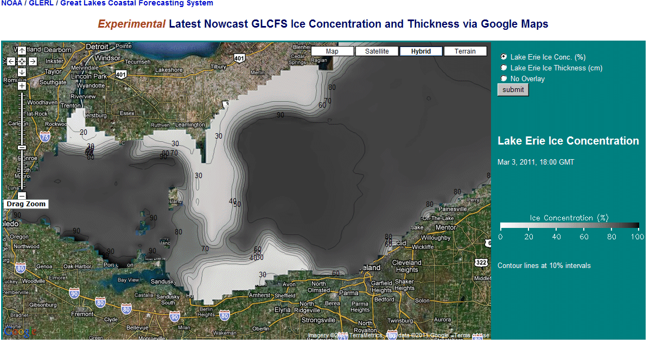
GLIM Forecast via Google Maps

Slide 13
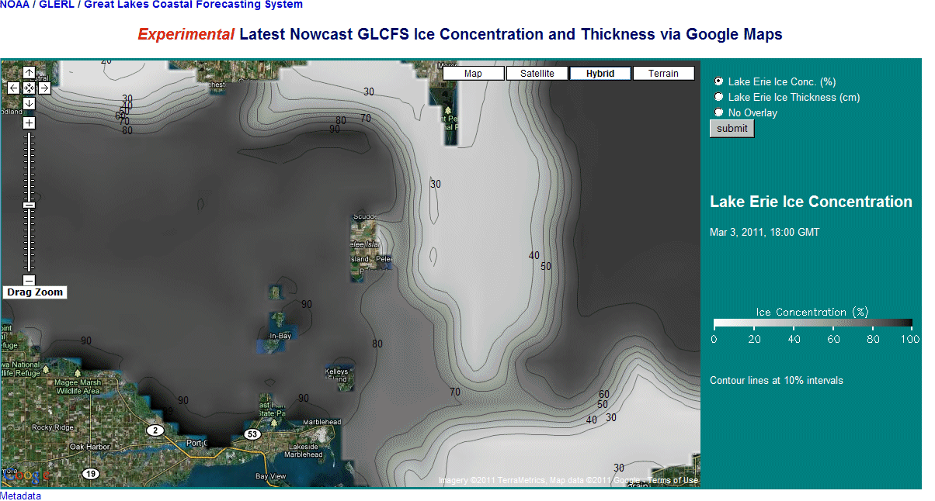
GLIM Forecast via Google Maps

Slide 14
Sources of Error in the Ice Concentration Forecast
Error in the daily NIC ice concentration analysis
NIC analysis data sources are lagged: ~00 and ~12 UTC RADARSAT passes & previous day ~18 UTC MODIS imagery and current day ~18 UTC MODIS imagery are combined and posted about 00 UTC the next day
Error in the NDFD parameters (wind, temperature, or dewpoint)
Error in the GLIM: nudging procedure, vertical mixing, no wave mixing

Slide 15
Mean Ice Concentration GLIM 1,3,5 Day FCST compared with NIC

Slide 16
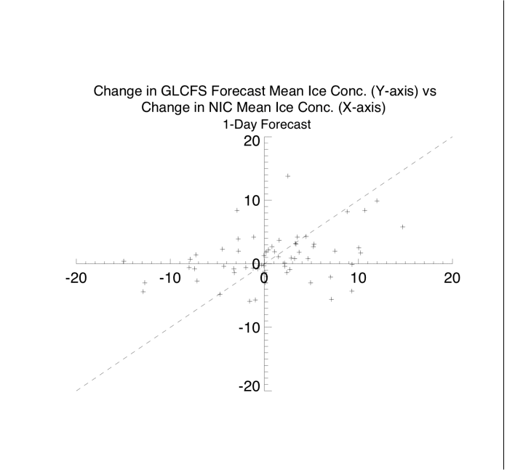
Day 1 Comparison Change in GLIM MEAN Ice Concentration to NIC MEAN Ice Concentration Dec - Mar

Slide 17
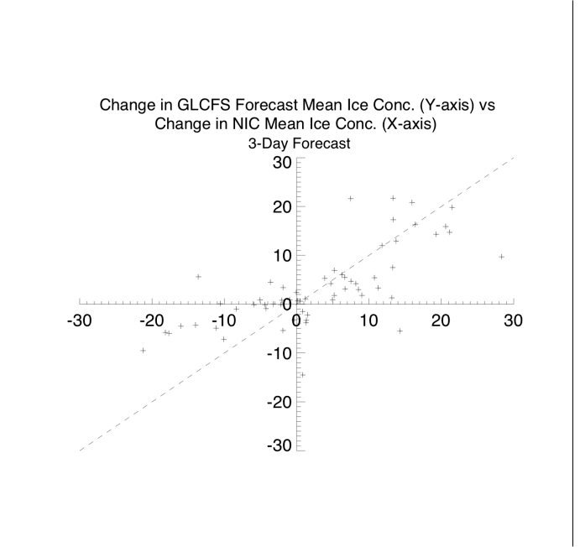
Day 3 Comparison Change in GLIM MEAN Ice Concentration to NIC MEAN Ice Concentration Dec - Mar

Slide 18
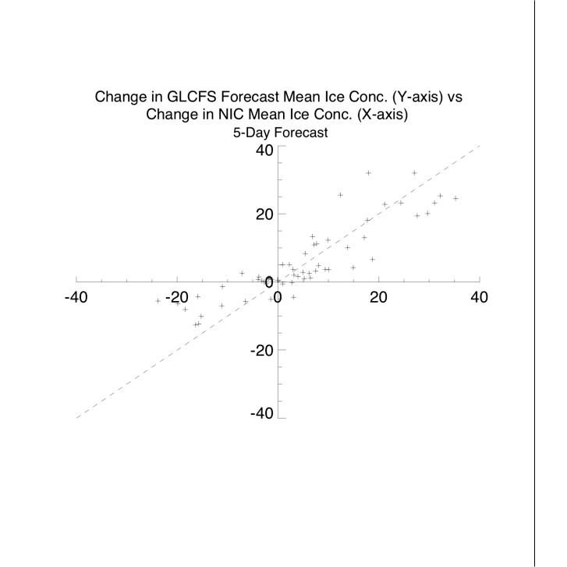
Day 5 Comparison Change in GLIM MEAN Ice Concentration to NIC MEAN Ice Concentration Dec -

Slide 19
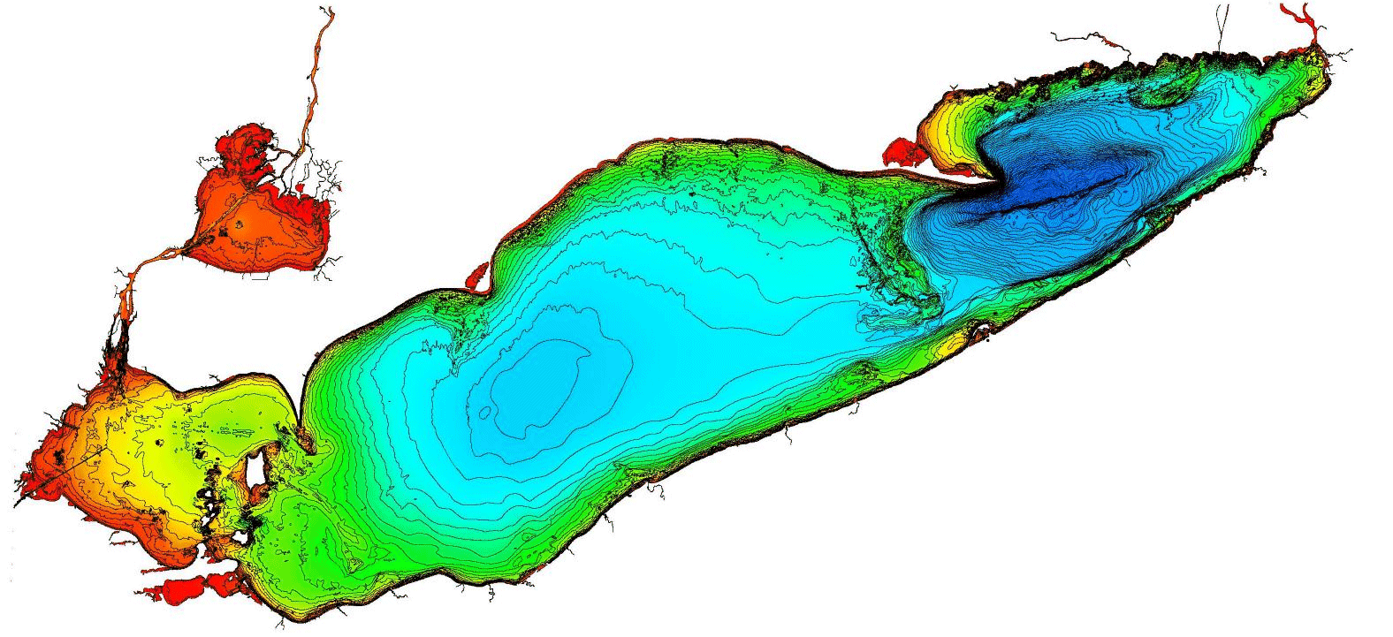
Bathymetry of Lake Erie (M)
64
22
10

Slide 20
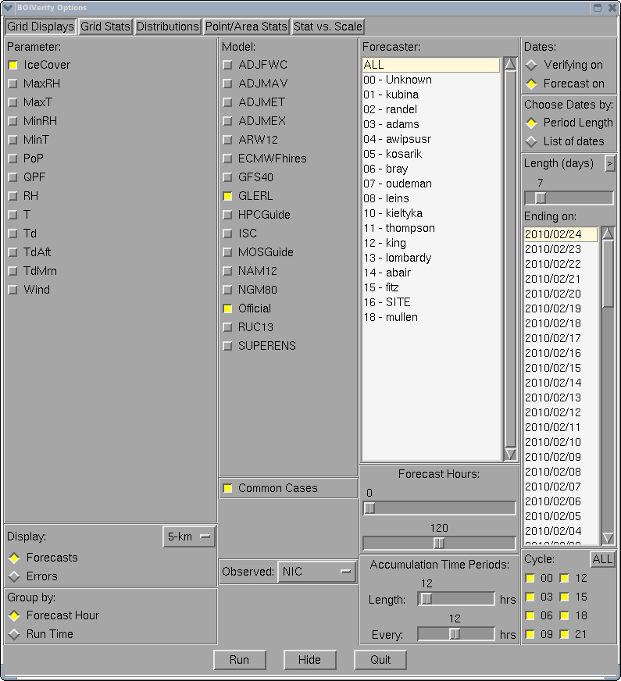
Comparison of the GLIM to the NIC Analysis
BOIVerify is a statistical analysis application that is run at many NWS offices to help verify locally produced gridded forecasts from the NDFD
BOIVerify was modified at NWS CLE to ingest the GLERL GLIM forecasts of ice concentration and ice cover analysis from the National Ice Center (NIC) to help evaluate the GLIM

Slide 21
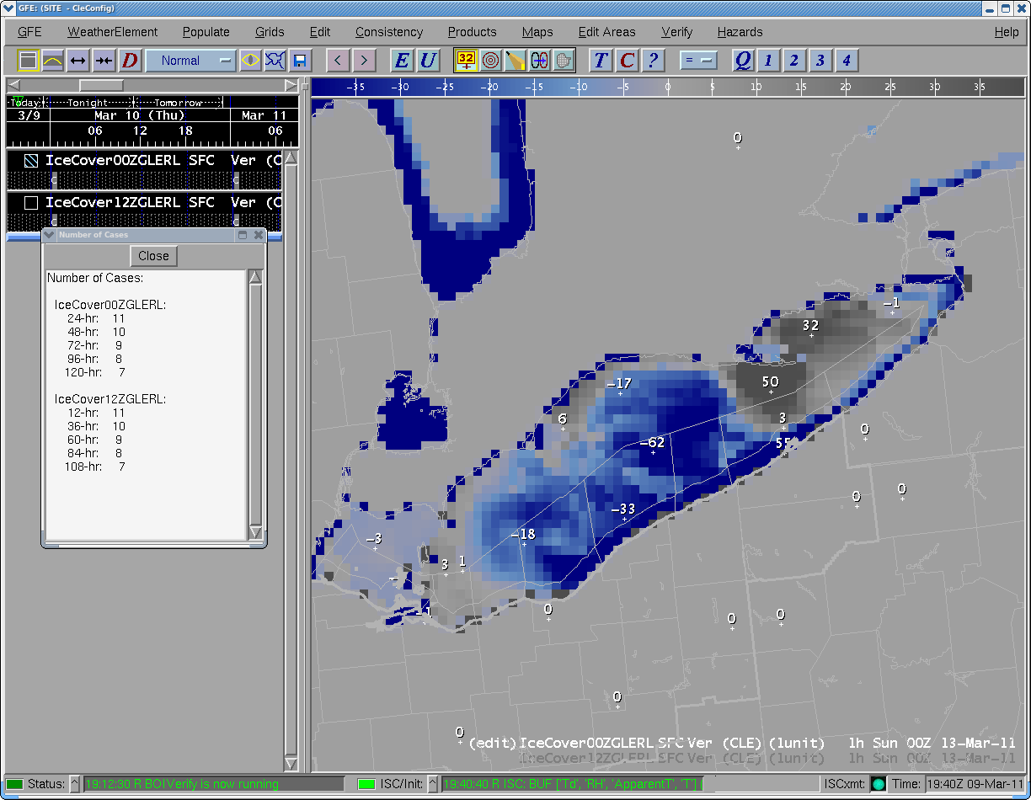
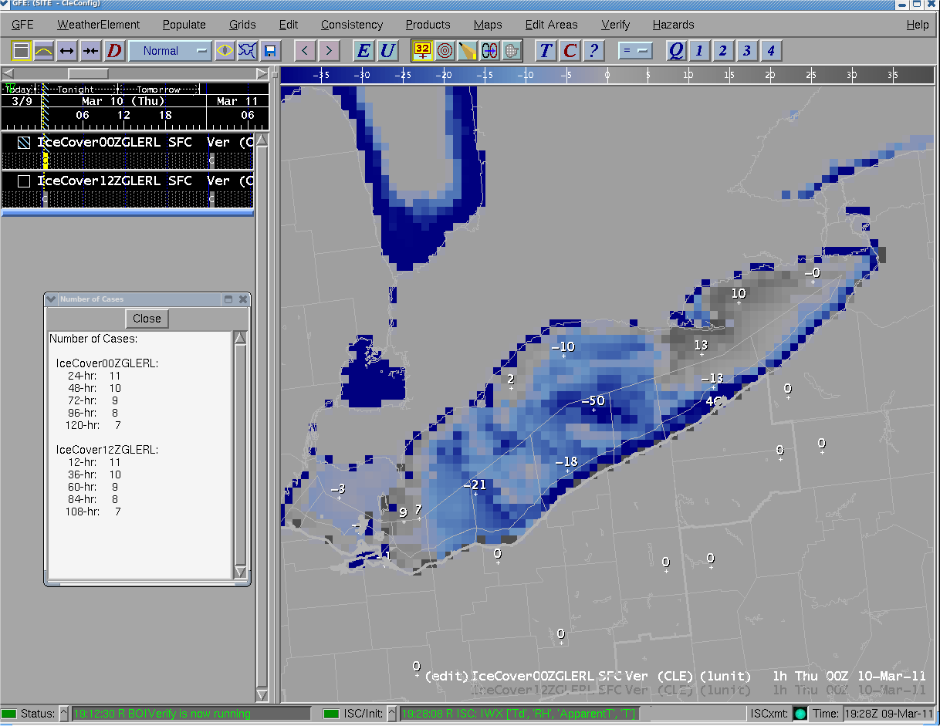
Ice Concentration Bias (%) 24 hour GLIM- NIC 6-21 Jan 2011
Too much ice
forecast
Too little ice
forecast

Slide 22
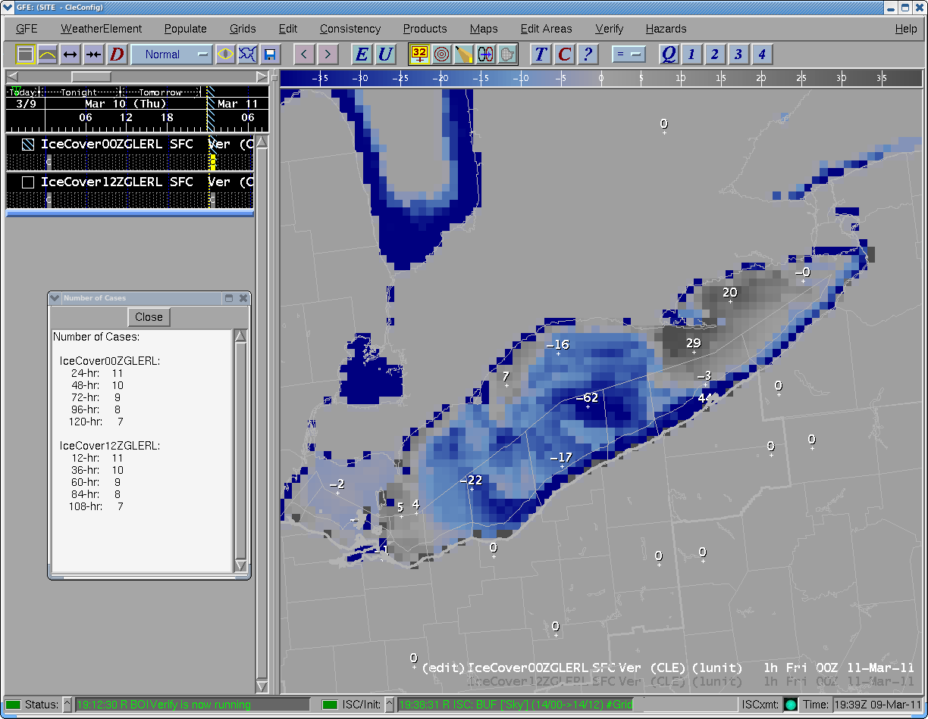
Ice Concentration Bias (%) 48 hour GLIM- NIC 6-21 Jan 2011
Too much ice
forecast
Too little ice
forecast

Slide 23
Ice Concentration Bias (%) 72 hour GLIM- NIC 6-21 Jan 2011
Too much ice
forecast
Too little ice
forecast

Slide 24
Ice Concentration Bias (%) 96 hour GLIM- NIC 6-21 Jan 2011
Too much ice
forecast
Too little ice
forecast

Slide 25
Ice Concentration Bias (%) 120 hour GLIM- NIC 6-21 Jan 2011
Too much ice
forecast
Too little ice
forecast

Slide 26
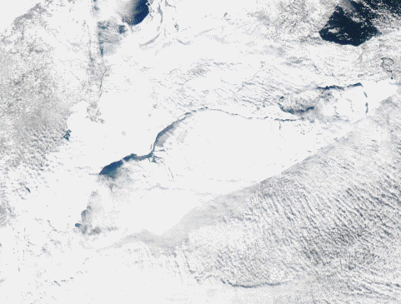
Lake Erie Ice Drift 30 Jan- 15 Feb 2011
Persistent easterly drift of ice cover over the central basin of Lake Erie

Slide 27
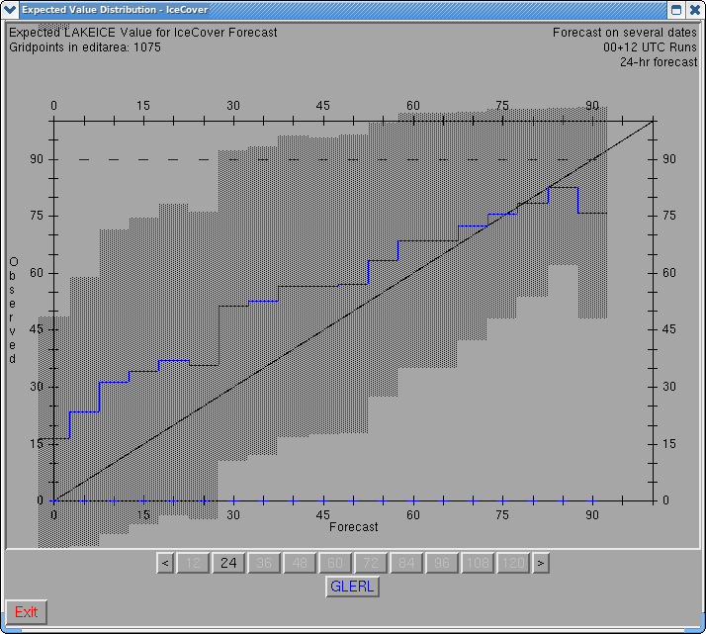
Expected Value of the GLIM vs NIC 24 hr Fcst 6-21 Jan 2011
Observed = NIC
Forecast = GLIM
Too little Ice
Fcst

Slide 28
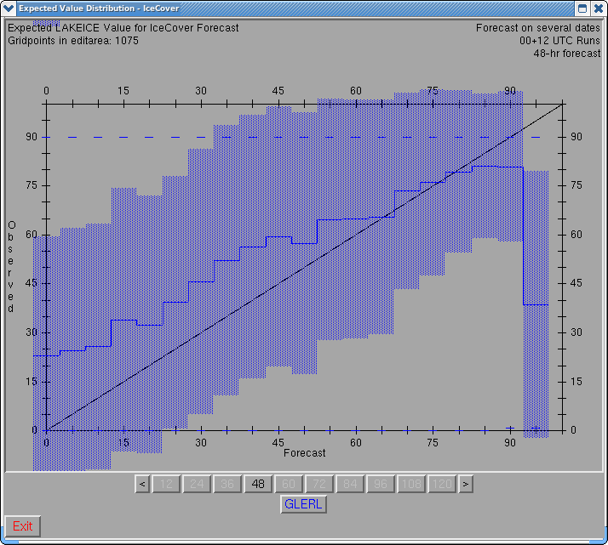
Expected Value of the GLIM vs NIC 48 hr Fcst 6-21 Jan 2011
Observed = NIC
Forecast = GLIM
Too little Ice
Fcst

Slide 29
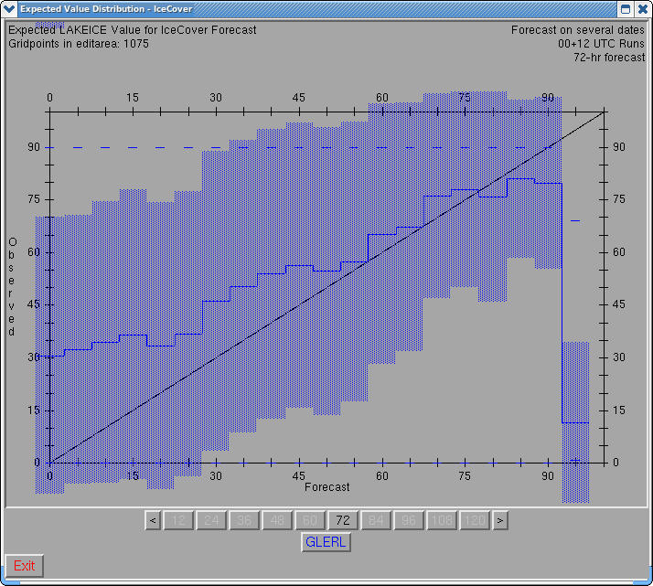
Expected Value of the GLIM vs NIC 72 hr Fcst 6-21 Jan 2011
Observed = NIC
Forecast = GLIM
Too little Ice
Fcst

Slide 30
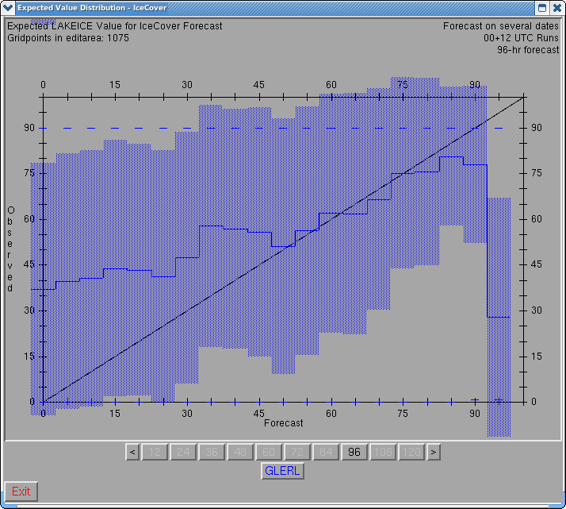
Expected Value of the GLIM vs NIC 96 hr Fcst 6-21 Jan 2011
Observed = NIC
Forecast = GLIM
Too little Ice
Fcst

Slide 31
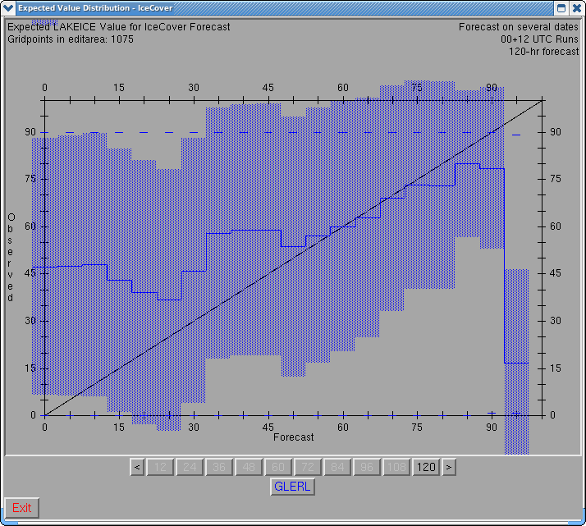
Expected Value of the GLIM vs NIC 120 hr Fcst 6-21 Jan 2011
Observed = NIC
Forecast = GLIM
Too little Ice
Fcst

Slide 32
Summary of the GLERL GLIM 2010-2011 ice season on Lake Erie
GLIM nowcasts for 2010-2011 were more realistic with daily nudging from the NIC ice concentration analysis
GLIM 1-5 Day forecasts were more realistic with being initialized with better nowcasts
During the rapid freeze up in January, the GLIM produced too little ice in the central basin and too much ice near Long Point
Trends in changes in observed spatial coverage were better simulated this season
Difficult to separate error in NDFD with error in GLIM

Slide 33
Future Plans for the GLIM
Upon evaluation the 2010-2011 ice season, the GLIM may be expanded to the other Great Lakes for the 2011-2012 ice season
Additional refinement of the GLIM is expected for the 2011-2012 ice season
Additional NDFD fields may be used by the GLIM – snowfall and QPF to make the model more realistic
Output from the GLIM may be added to the NDFD

Slide 34
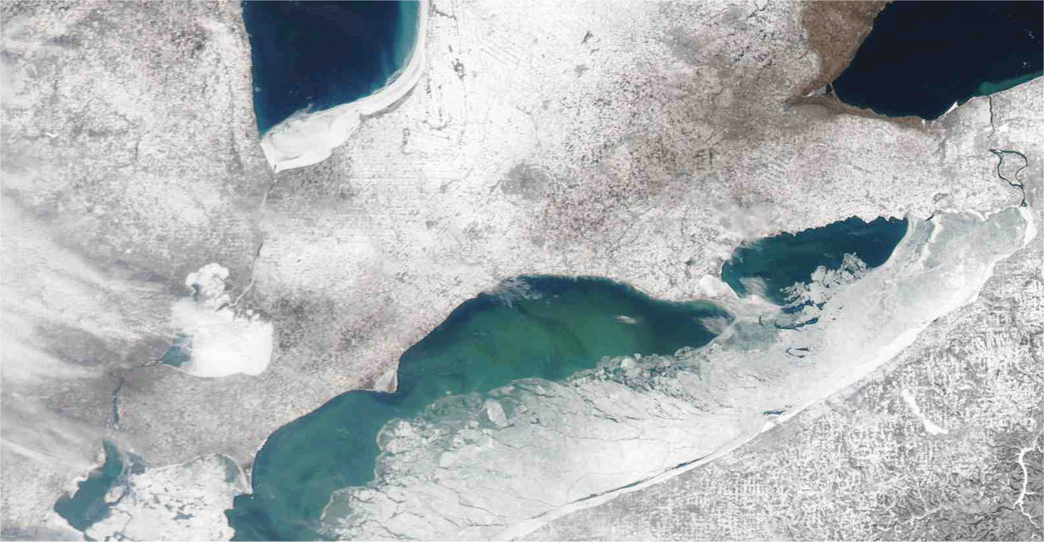
Questions ?
Robert.laplante@noaa.gov

