Slide 1
The Evolution of NWS Aviation Weather Services in Chicago
Mike Bardou
National Weather Service Chicago
The views expressed in this presentation are those of the author and not necessarily those of the National Weather Service

Slide 2
Goals
Improve collaboration among the NWS, FAA, Commercial Airlines, and Airport Operators
Disseminate more frequent weather information
Increase service to aviation interests
Improve service delivery infrastructure
Develop improved tools for the forecaster
These are the keys to managing the impact of weather on the Chicago airspace and reducing weather related flight delays.

Slide 3
First Steps
Meet with Air Traffic Management Officials to:
determine specific conditions which affect airport operations
determine if the proper information is available
discuss modes and frequency of information receipt

Slide 4
First Steps
Leverage other Aviation Improvement Efforts
demonstration project for the NYC area
trip to meet with NYC NWS
Aviation Weather Workshop
discuss specific service enhancements with the user community
raise awareness of the initiative

Slide 5
Initial Efforts
2-hr TAF updates on weekdays
Improved aviation AFD format
Increased collaboration between WFO and CWSU
Hourly updates to wind and POP/Wx grids
Listen in on FAA/Airline strategic planning telcons

Slide 6
www.weather.gov/zau
Developed as a one-stop source for Chicago Airspace Wx information
Development of wind and TS Tactical Decision Aids (TDA)

Slide 7
www.weather.gov/zau

Slide 8
www.weather.gov/zau

Slide 9
Resources
Addition of 3 forecasters
cross trained as WFO and CWSU forecasters
allow a dedicated Aviation Desk 24 hrs a day/5 days a week
Addition of Aviation Services Improvement Meteorologist
allows for more interaction with customers and expansion of new services

Slide 10
Evolution
Development of WFO/CWSU Aviation Team
integrate Science and Service aspects
build relationships and communication with customers
assess initial service enhancements
develop/implement new service improvements
analyze significant aviation weather events to better understand impacts and build forecaster knowledge base
Develop training for the user community

Slide 11
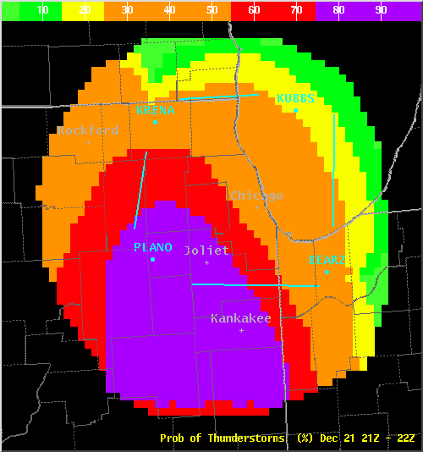
Evolution – TS TDA

Slide 12
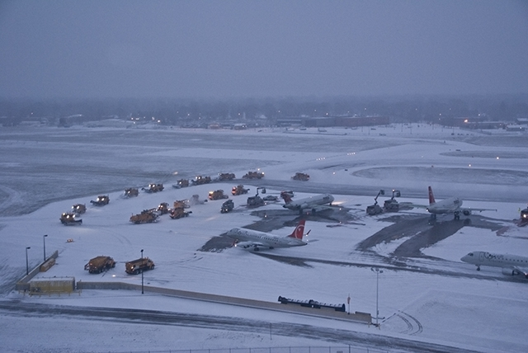
Evolution – O’Hare Winter Precipitation Outlook
Developed based on user feedback regarding winter operations and event reviews
Produced in GFE
Scott Shelerud

Slide 13
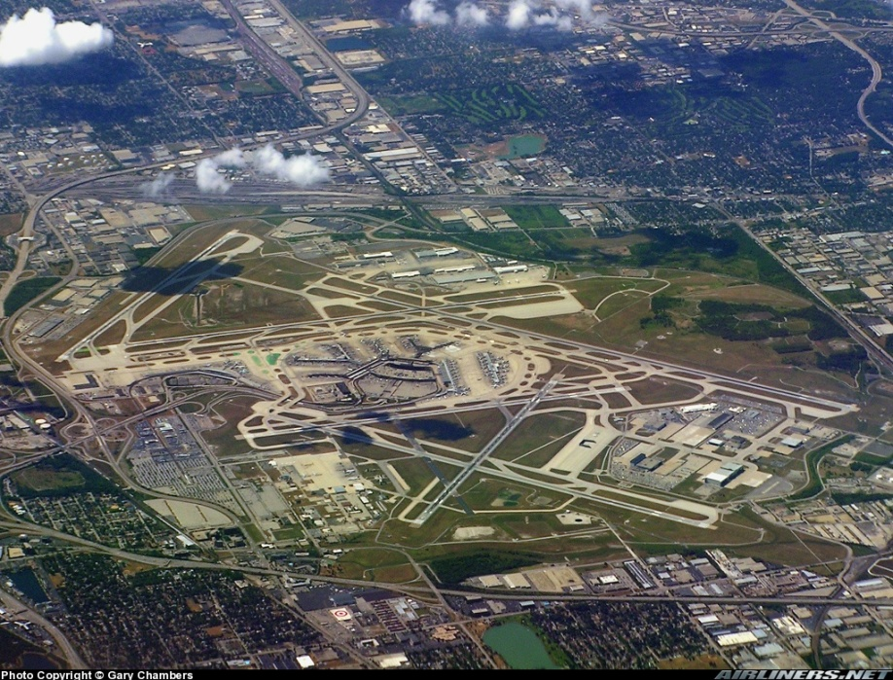
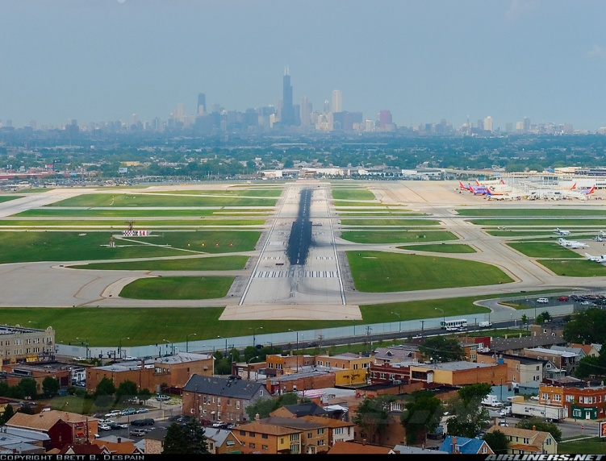
Evolution
Improved Airspace-specific Support
ARTCC
TRACON
ORD/MDW Towers
Enhanced ZAU Web page

Slide 14
Evolution - NextGen
Next Generation Air Traffic System
4-D Cube of data
Additional gridded weather forecast elements
Ceilings
Visibility
Guidance for areas beyond TAF sites

Slide 15
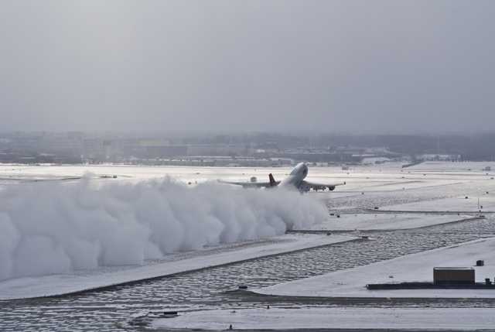
Questions??

