Slide 1
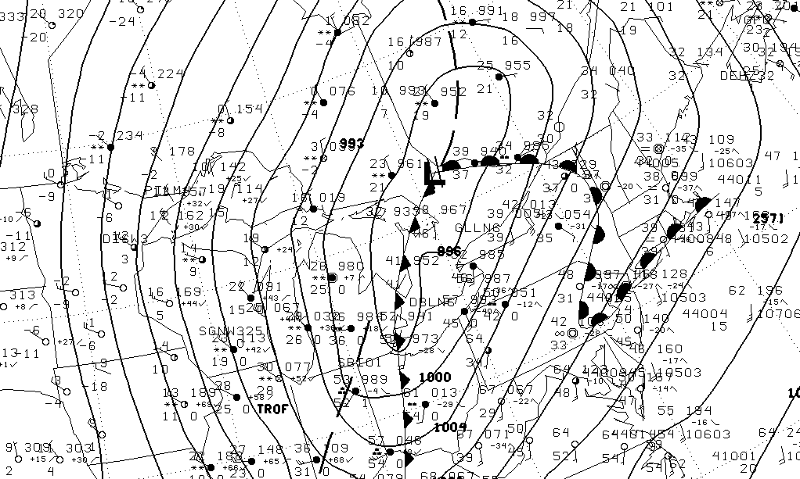
Surface Fronts, Troughs, and Baroclinic Zones in the Great Lakes Region
Neil Laird
Hobart & William Smith Colleges
Melissa Payer
University at Albany/SUNY
Richard Maliawco
University of Illinois
formerly of Lyndon State College
Eric Hoffman
Plymouth State University
This research was completed as part of the 2008 undergraduate summer research program at Hobart & William Smith (HWS) Colleges. Funding for this project was provided by the National Science Foundation and the HWS Provosts Office.

Slide 2
Introduction
Motivation
Frontal passages are a critical factor in influencing weather in the region:
- lake effect snow - air mass distribution
- severe thunderstorms - pollution transport
Objectives
Determine the spatial and temporal frequency of fronts and troughs across the Great Lakes region and examine their association with surface baroclinic zones.
Previous Studies
Morgan et al. (1975) | Created frequency maps for fronts over North America
Cousins (2006) | Wintertime (Nov-Mar) climatology of frontal passages in Great Lakes region Found cold fronts were most common, followed by warm, occluded and stationary
Sanders and Hoffman (2002), Hoffman (2008) | Investigated the degree of correspondence between baroclinic zones and operational frontal analyses Concluded many fronts are not associated baroclinic zones

Slide 3
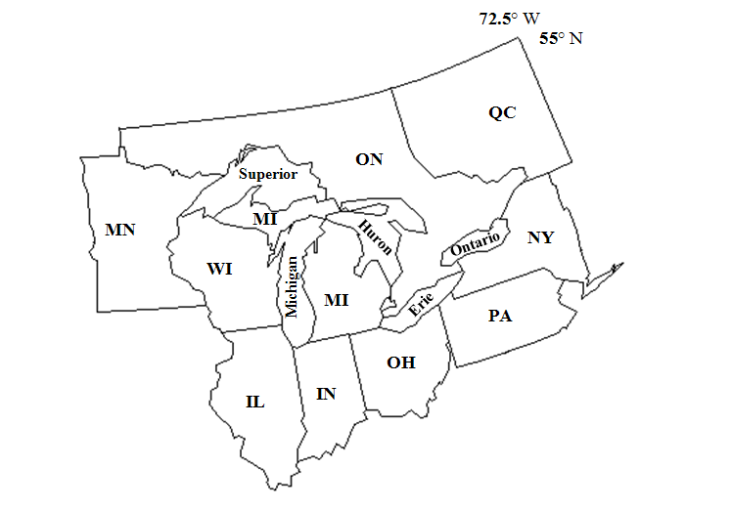
Frontal Frequency: Data and Methodology
Analysis Time Period
Jan 2000 – Dec 2005
0000, 0600, 1200, 1800 UTC
NCEP Surface Analysis
8,663 examined
1.2% missing
Identified 2,173 Fronts & 1,075 Troughs
Type
First/Last Appearance Date and Time
Lakes and States/Provinces Crossed
Analyst name
Methods
Accepted NCEP analysis as is
Front must cross over at least one lake
Identified each frontal segment – along each boundary there can be multiple frontal classifications (e.g. cold → stationary)

Slide 4
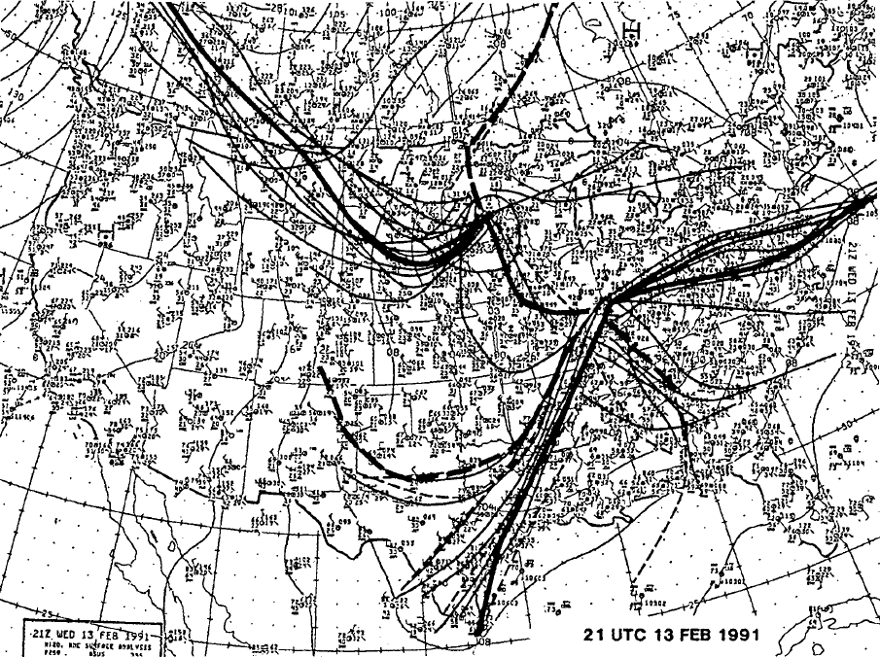
Composite of Surface Analyses (Uccellini et al. 1992)

Slide 5
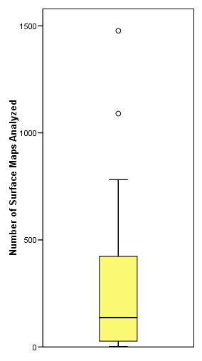
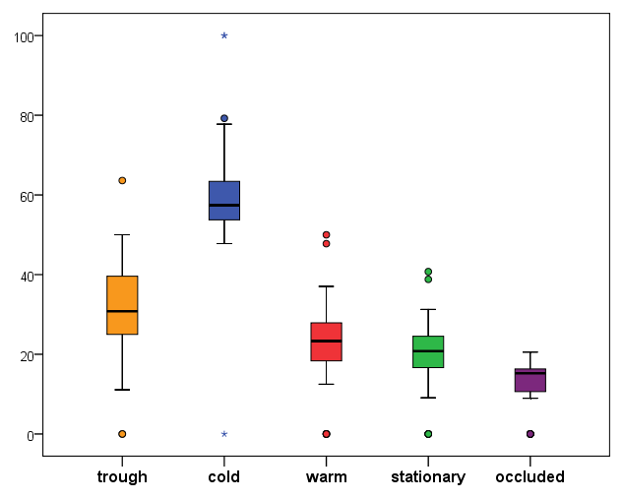
Analyst Consistency with Frontal Analyses
n=33
Small interquartile ranges suggest some consistency across analysts in analyzing fronts.
Larger variability across analysts in analyzing troughs
Distribution of the number of analyses each analyst completed
Distribution of the percentage of analyses for each analyst where front or trough was indicated

Slide 6
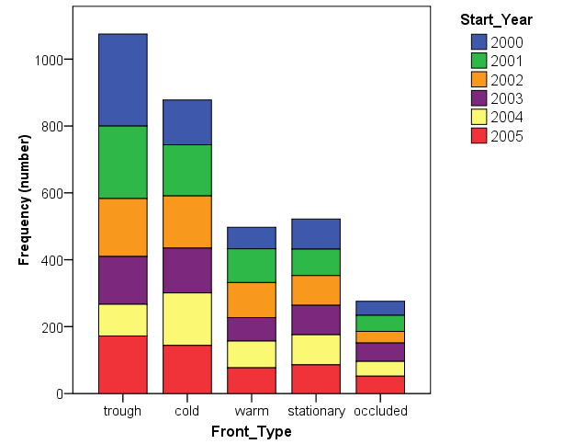
Frequency of Fronts & Troughs: 2000-2005
Represents the number of fronts and troughs followed for their entire evolution within Great Lakes region

Slide 7
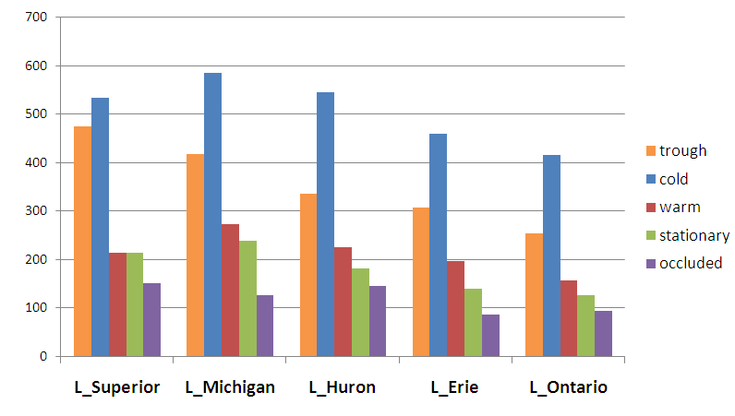
Frequency of Front & Trough Passages: 2000-2005
Represents the number of fronts and troughs which passed over each individual Great Lake.
As an example, a single cold front would be counted for Lakes Superior and Michigan if it had passed over both during its evolution.

Slide 8
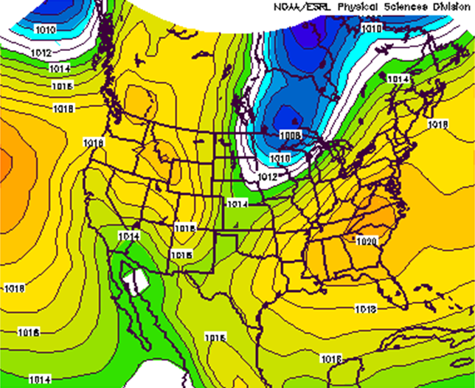
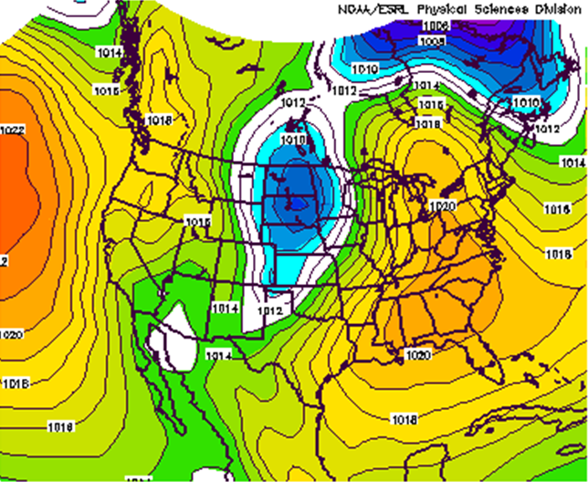
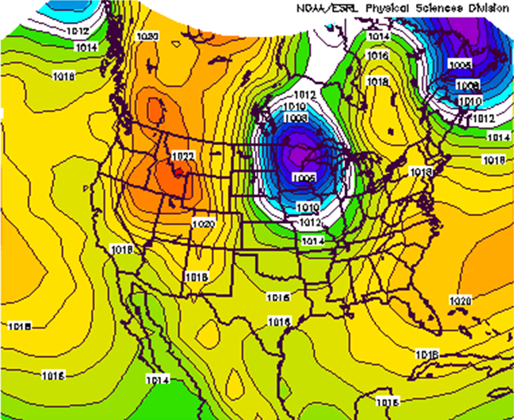
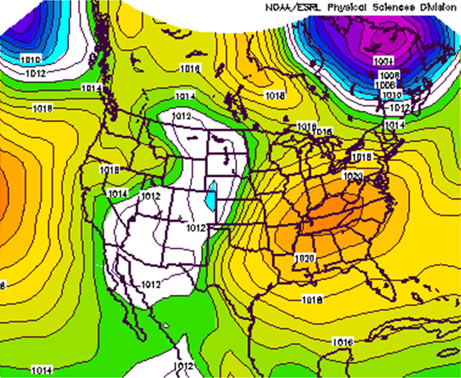
SLP Composites for Fronts that Crossed all Five Lakes
n=208
n=24
Cold Fronts
Warm Fronts
n=16
n=10
Occluded Fronts
Stationary Fronts

Slide 9
Summary: Front & Trough Frequency
Cold fronts are the most common in the Great Lakes region, followed by stationary, warm, and occluded fronts.
Troughs are more frequent than cold fronts.
The frequency of fronts and troughs decreases from west to east across the lakes.

Slide 10
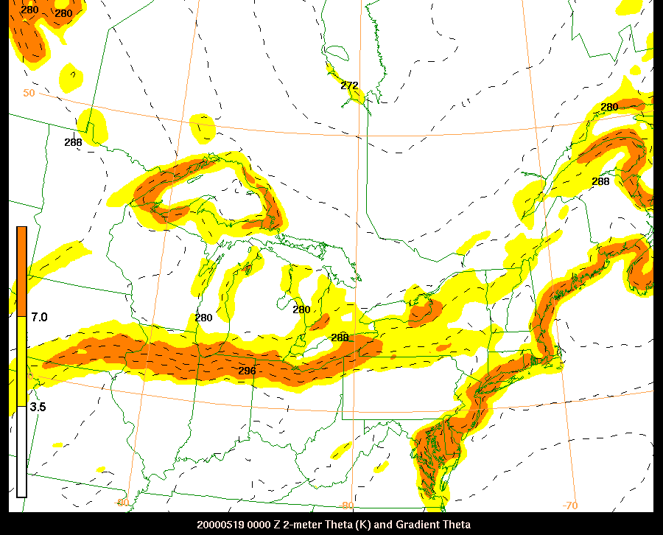
Baroclinic Zones: Data & Methodology
Analysis Time Period Jan 2000 – Dec 2005 0000, 0600, 1200, 1800 UTC | 2-m potential temperature North American Regional Reanalysis (NARR) | Baroclinic Zone Strength * Strong > 7°C (100 km)⁻¹ Moderate > 3.5°C (100 km)⁻¹
19 May 2001 0000 UTC
* Sanders and Hoffman (2002)

Slide 11
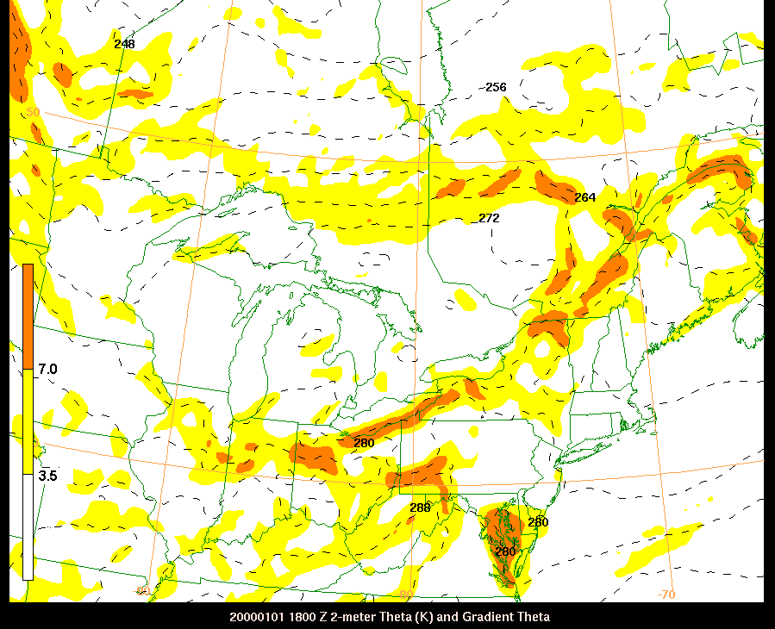
Baroclinic Zones: Data & Methodology (continued)
Baroclinic zone must be:
within 200 km of the front | along 50% of the front’s length | within 45° of the front’s orientation
1 Jan 2000 1800 UTC

Slide 12
Fronts & Troughs related to Baroclinic Zones: 2000-2005
weak/none
moderate
strong
14
Represents the percentage of analyses with fronts that were associated with a baroclinic zone
Note: NCEP uses 1.2°C(100km)⁻¹ as the minimum requirement for frontal zone

Slide 13
Idealized Examples of Trough Length Scale
Mesoscale Trough
Sub-synoptic Trough
Synoptic Trough

Slide 14
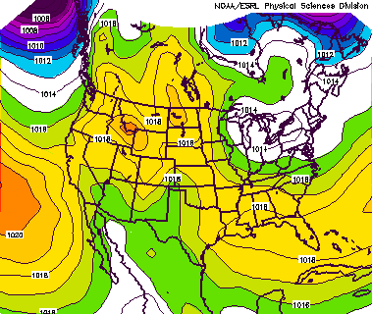
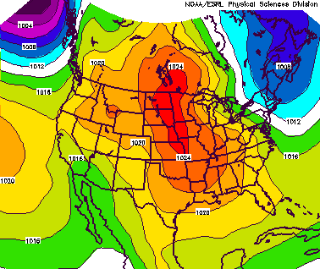
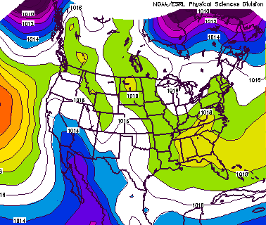
SLP Composites for Each Trough Length Scale
Synopic Troughs
Sub-synoptic Troughs
MesoscaleTroughs

Slide 15
Trough Length Scale Related to Baroclinic Zones: 2000-2005
weak/none
36
moderate
strong
synoptic
sub-synoptic
mesoscale

Slide 16
Summary: Fronts & Troughs with Baroclinic Zones
51% of all analyzed fronts in the Great Lakes region are associated with baroclinic zones.
Stationary and warm fronts are most often associated with baroclinic zones (~ 60% of the time).
Association is less for cold and occluded fronts (~50% and ~30% of the time, respectively).
Only 8.7% of all fronts are associated with strong baroclinic zones.
Association of baroclinic zones with troughs increases as trough length decreases (from synoptic to mesoscale).

Slide 17
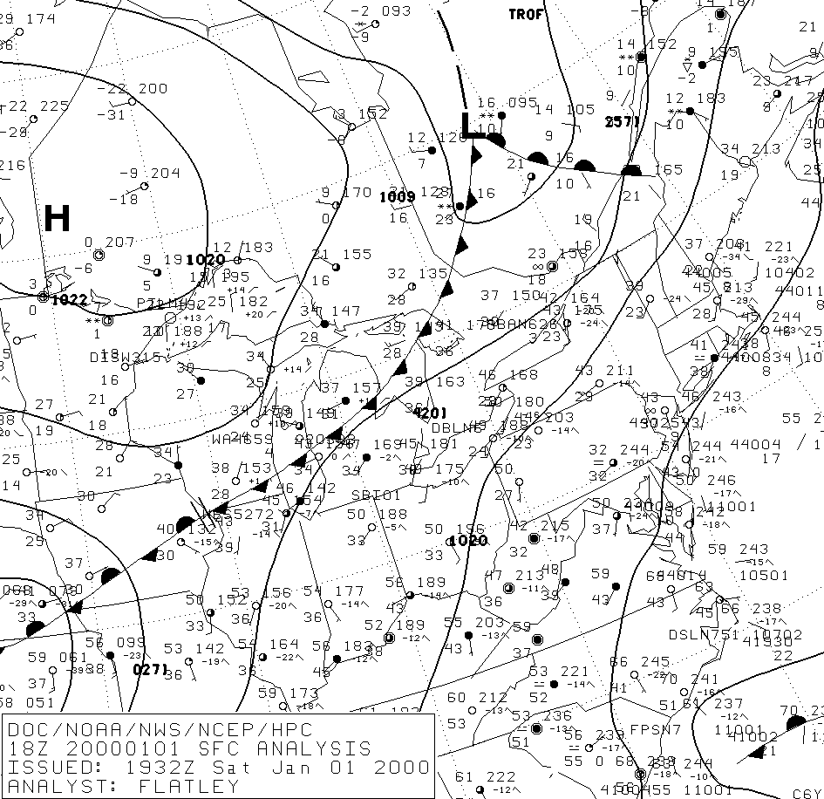
Surface Analysis 01 Jan 2000 18 UTC

